Slide 1


Slide 2
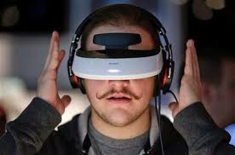

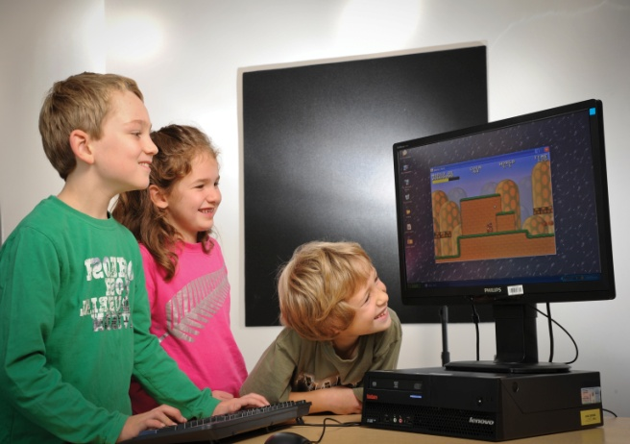


Professor and Head, School of Computing
فناوری های نوین در حوزه آموزش
الکترونیکی
عبدالحسین صراف زاده

Slide 3
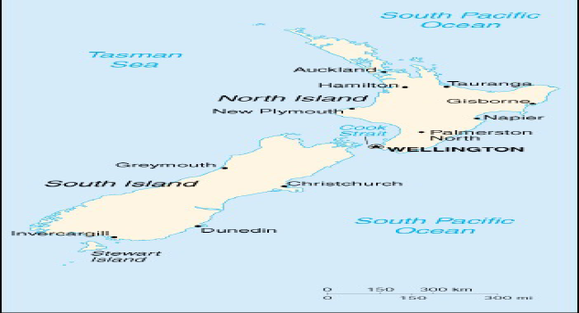




Slide 4


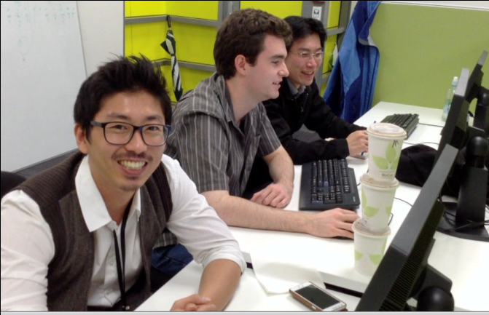
One of the largest Computing Departments in NZ
Student Numbers-
Variety of Programs from Certificate to Doctorate
IBM on campus
Centres for research excellence
Priorities
High Impact Research
Industry Linkages
Commercialization of Research
Internationalization of Education
Student numbers
2014 1356 – 900 FTE (298 International)
Staff
2014 54

Slide 5











Research Centres and industry Links
…

Slide 6
Environmental Change Detection
Network security and Cyber Security
Data mining
Computational intelligence
Research
Foci
Computer vision and Emotion detection
Health and IT
Health informatics
Social networking and health
Games in health
Robots in eldercare
Machine translation

Slide 7
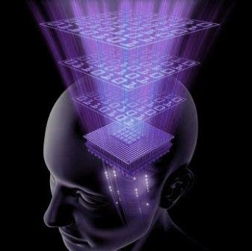
Cyber-security/IT security
Internet of Things (IoT)
Smart sensors
Cloud computing- private cloud
Business intelligence
Services computing and data centres
Data mining and big data/Educational DM
Smart cities and planet
mobile, location awareness, etc.
Business process modelling
Mobile computing
MOOCS

Slide 8
Developments in intelligent systems
Emotion sensitive systems
Gesture based games
Gesture based interfaces
Intelligent and affective systems
Natural Language Processing
Natural language interfaces and
Machine translation
Wearable intelligence

Slide 9
Impact on Education

Slide 10
Intelligent and affective tutoring systems

Slide 11
How effective is eLearning? What are the issues/challenges?

Slide 12
Intelligent Tutoring Systems

Slide 13

Student
Modeller
Domain
Knowledge Base
Pedagogical
Module
Communication Module
Major Components of an Intelligent Tutoring System

Slide 14
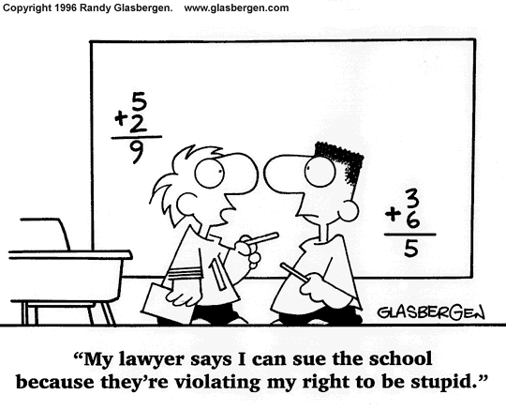
An Example
Multiplication
6 * 3
6*3=9
6*3=3
6*3=18
6*3=63
6*3=2

Slide 15
Intelligent Tutoring Systems
Select
A Concept
Present
A Problem
Analyse
Solution & Behaviour
Give
Feedback
Update The Student Model
OR
Present
The Same
Problem
Again
Present Relevant Multimedia
Instruction
Present
A Similar
Problem
Give
More Detailed
Feedback
Present
A New
Problem
Start
A New Concept
The Tutoring Process

Slide 16
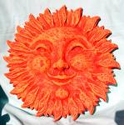
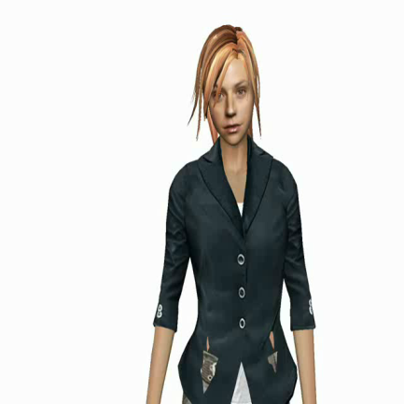
ITSs
More effective than classroom teaching
Not as good as one to one tutoring
Missing
Solution

Slide 17
There is a strong relationship between emotions and learning, but this interaction has not been articulated in existing theories.
Impact of emotions on learning is not well studied
Affective tutoring systems

Slide 18
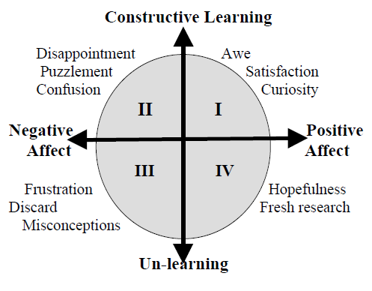

Slide 19
A computerized model that recognizes learners affective state and responds to it

Slide 20
Easy with Eve The Virtual Tutor Detects and adapts to learners’ affective state

Slide 21
Research Questions
Is it possible to build affective tutors?
What does it take? Gesture recognition,
Facial expression recognition,
Life like agents
Will an affective tutor perform better than an ITS?
Will it be able to perform as good as good human tutors?

Slide 22
Affective Systems for Learning

Slide 23
NGITS (Sarrafzadeh et al., 2001)
Prime Climb Educational Games (Conati et al., 2002)
MOODS (de Vicente 2003)
ITSpoke (Litman & Riley, 2006)
AutoTutor
Affective Learning Companion (Picard et al., 2006)
Essex-Shanghai initiative (2007)
Affective tutors facial expressions, gestures, heart rate and
skin resistance (IntelliMouse)
Diagnostic assessment and predictive assessment from student
Interactions- intend to use facial expressions and biometric sensors
Diagnosing motivation using motivation planning rules and affective
dialogue rules
Analysis of speech and natural language processing, Adaptation is
Going to be done in future
Uses natural language processing, passed the turing test, $1.2 M
funding to use facial expression recognition
Uses pressure mouse, skin conductance, posture analysis seat and
Intend to use facial expression recognition
Test the use of emotion aware tutor for distance learning-boredom & confusion

Slide 24
Gesture Analysis
FacialExpression Analysis
Physiological Analysis
Vocal Inflection Analysis
Student Model
Responses to Questions
Student Answers
Nonverbal Behaviour
Domain Knowledge
Tutoring Module
Architecture of Affective Tutoring Systems
Notes:
The architecture of a complete Affective Tutoring System is shown in the Figure, which shows the scope of the current research (the bold red box) and how it will be extended in future to include other channels for detecting nonverbal behaviour of the learner.
There will be four main components in an Affective Tutoring System: a student model, a set of tutoring strategies, domain knowledge, and a tutoring module
that will interface with the student.
The student model of an ATS will be divided into two main parts: one will analyse the student’s answers to questions, and the other will analyse the student’s
non-verbal behaviour. Non-verbal behaviour will be identified by analysing images of the student’s upper body and face to detect gestures or facial movements.
The tutoring module will select the most appropriate tutoring strategies on the basis of the state of the student model; material from the domain knowledge
component will then be presented on the basis of these tutoring strategies.
In the remaining time the Facial expression analysis component, the gesture recognition module and the life like agent and how it expresses emotion will be presented.

Slide 25
Emotion sensitive systems
Detection of emotion
Facial expression recognition
Gesture recognition
Physiology based emotion recognition
Expression of emotion

Slide 26
Facial Expression Recognition

Slide 27
Facial Expression Recognizer
Notes:
The Figure on this slide shows a screenshot of a state-of-the-art automated facial expression analysis system that was developed in-house by the research team in 2003. There are three main components to the system: face detection using an Artificial Neural Network, facial feature extraction and a fuzzy facial expression classifier. The right hand side bars show the certainty of the system in its detection. In this case a surprise expression with a certainty of 0.7 has been detected.
The system is capable of accurately identifying seven affective states: surprise, happiness, sadness, puzzlement, disgust, and anger, plus a neutral state.
A new improved system has recently been developed and tested which is more suitable for use in ATS and operates in realtime. Test results show a high degree of accuracy and real-time performance as presented in the following slides.

Slide 28
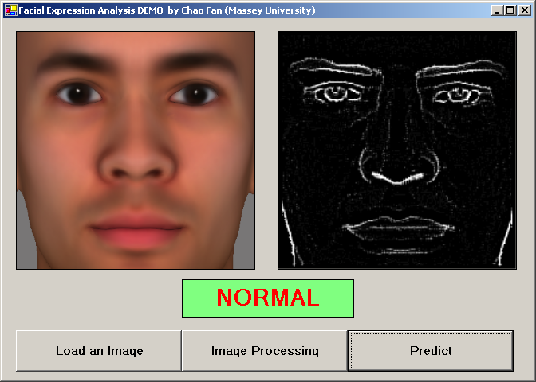
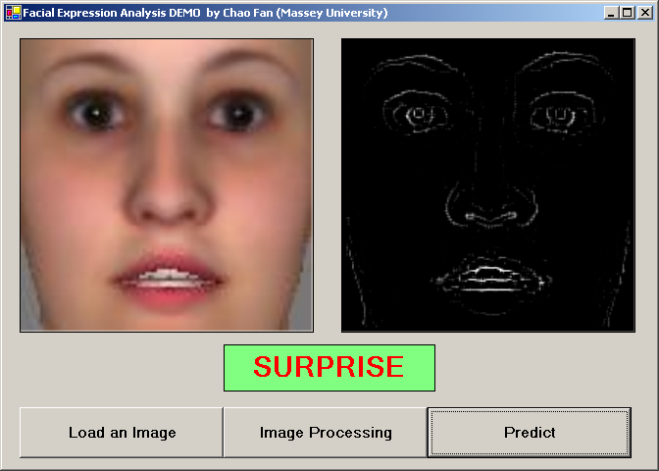
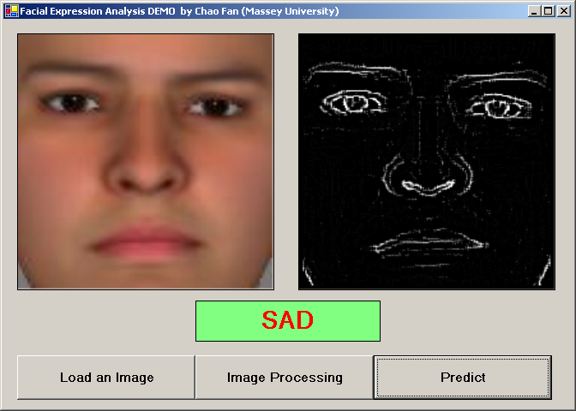
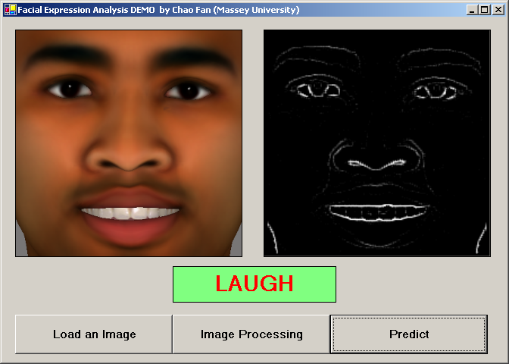
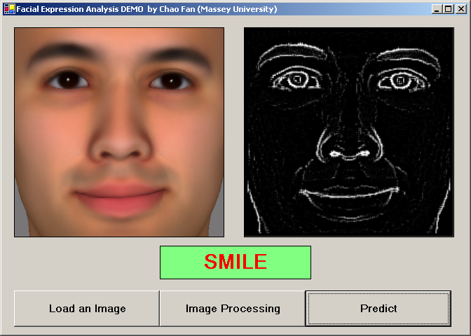
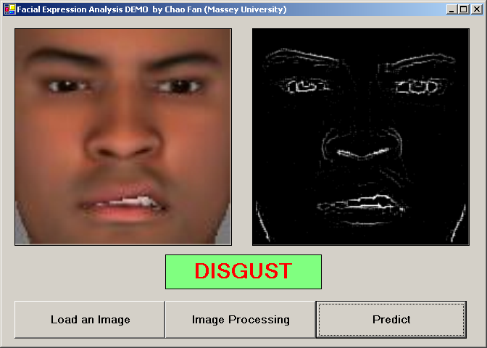
Facial Expression Analysis Results

Slide 29
The early result for facial expression recognition system
Expression | Recognition
Normal | 92%
Disgust | 93%
Fear | 90%
Smile | 93%
Laugh | 96%
Surprised | 94%
Notes:
The new approach based on support vector machines (SVM) has produced promising results. An SVM is a supervised learning algorithm based on statistical regression. The SVM algorithm operates by mapping the training set into a high-dimensional feature space, and separating positive and negative samples.
We represented the facial expression database that we used by connection features. Each raw image is 200 pixels in width and 200 pixels in height. By connection extraction, we reduced the image size to 50 pixels by 50 pixels, which is 2500 connection features. This makes the training process significantly faster than the pixel-wise analysis of the image which we used in the earlier version.
The SVM was trained using the summarized facial images using our connection features algorithm. The training was obviously considerably shorter using this
approach. Memory requirements were also considerably lower. To train SVM, a 5-fold crossvalidation was applied. Different Kernel methods are used in SVM to classify non-linear functions. We tested different kernel models, namely a linear model, a polynomial model and an RBF Kernel with the SVM, and have presented the results in Table 1. The test image database contains 1000 image for each facial expression, 6000 images in total. Results obtained using an RBF kernel were the most promising.
Video sequences are recorded and analyzed at a rate of 12 frames per second which is real-time. Our SVM analyzer is triggered each 0.0833 seconds. These results indicate that the system is capable of operating in real-time and with a high rate of accuracy.

Slide 30
Gestures

Slide 31
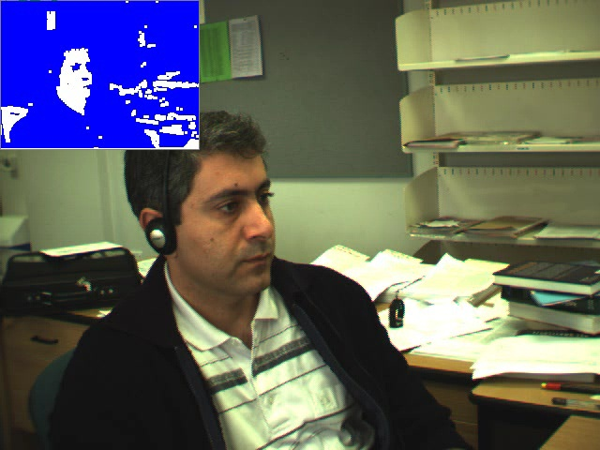

Slide 32
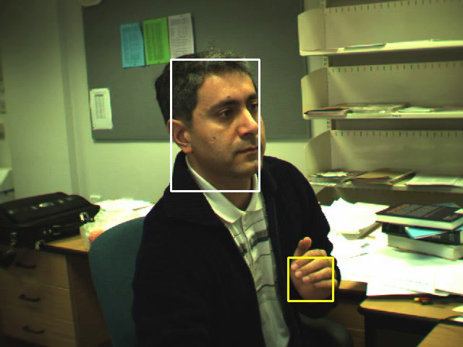
Multi-Tracker

Slide 33
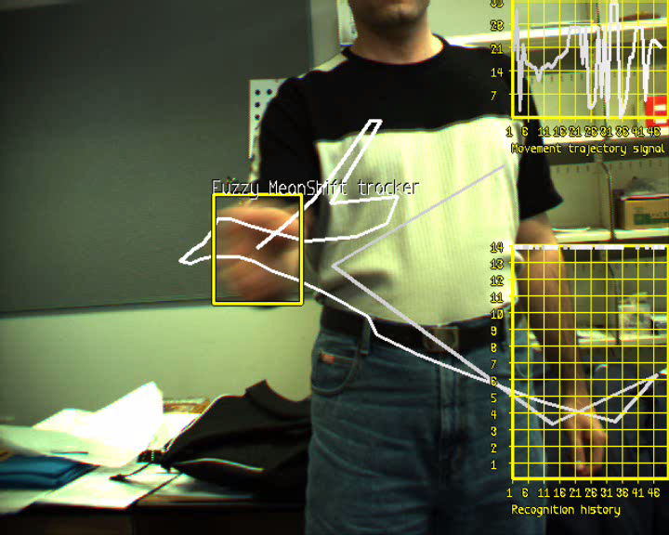
Gesture recogniser tracking the hand
Demos
Notes:
An affective tutoring system should be able to analyse the body movements of the learner just as a human tutor would. A child counting fingers when given an addition or subtraction is in a totally different developmental stage than one who doesn’t. Detecting counting on fingers and various other head and hand movements is a slightly different case, as these are gestures, and not facial expressions. However, similar techniques employed by automated facial expression analysis can also be applied to automated gesture analysis. We have developed a system that detects various hand and body movements which is being extended to include a student counting on his/her fingers.

Slide 34
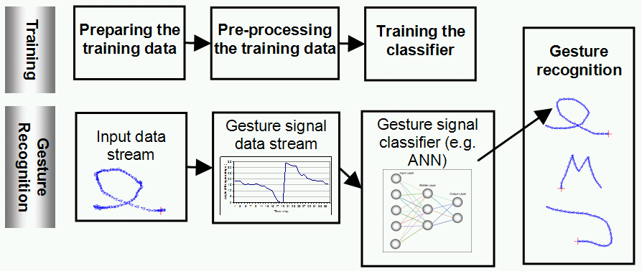
The gesture recognition technique - Overview
Notes:
We have developed a novel approach to 2D gesture trajectory recognition for use in our affective tutor. This approach taken consists of two main steps: i) gesture modeling, and ii) gesture detection.
The gesture modeling technique which we have developed is robust against slight rotation, requires a small number of samples, is invariant to the start position of the gesture and it is device independent. For gesture recognition, we used one classifier for detecting each gesture signal. We implemented the gesture recognition system using both multilayered feed-forward ANNs and support vector machines. We evaluated the neural network approach in comparison with a SVM with radial basis kernel function.
The results showed high accuracy of 98.27% for ANN and 96.34% for SVM in gesture signal recognition. The results also show that the overall
performance of the ANN classifier is slightly better than the SVM classifier. We have therefore adopted the ANN approach.

Slide 35
Evaluation of gesture recognition system
Gesture No. | Correctly Detected | Correct Positive Detection
1 | 80 | 100%
2 | 110 | 98.21%
3 | 101 | 98.05%
4 | 96 | 93.2%
5 | 175 | 99.43%
6 | 176 | 96.7%
7 | 93 | 100%
8 | 82 | 97.62%
9 | 96 | 100%
10 | 89 | 98.89%
11 | 103 | 98.09%
12 | 105 | 100%
13 | 116 | 98.30%
Avg |  | 98.27%
Notes:
This table presents the results of testing the gesture recognition system which is currently capable of movement trajectory information. Therefore, it can be
used with a variety of front-end input systems and techniques including vision-based hand and eye tracking, digital tablet, mouse, and digital gloves, recognizing 13 gesture signals. The accuracy of the detection is satisfactory as shown here.

Slide 36
The results in comparison to a SVM classifier

Slide 37
Physiology based recognition

Slide 38
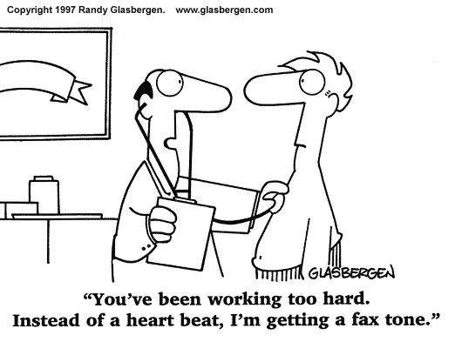
IntelliMouse
شما حتما زیاد کار می‌کنید. بجای صدای قلب صدای فکس میشنوم!!!

Slide 39
Expression of Emotion

Slide 40
A study of human tutors
Method
Several human tutors were videoed as they tutored a total of 60 students one-on-one
The students were all 8 or 9 years old
About 20 minutes each
Over 3000 videos
Students were hand-picked for the level of the tutoring exercise
Notes:
The observational study of human tutors involved videoing several tutors. There were three tutors altogether, and nine student participants- 8 or 9 years old. Each participant was tutored for about 20 minutes.

Slide 41
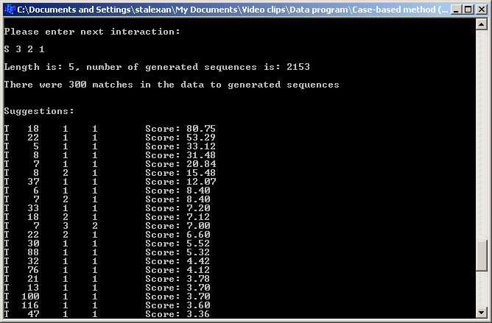
Case based reasoning program suggesting tutoring behaviour
Notes:
Here is an example screen from the case based program suggesting what behaviour Eve should display next.
What happens in the case-based program:
A history of interactions is input in the same format as the coding scheme
From this, a set of relevant interaction sequences is generated
Each of these (weighted) sequences is searched for in the data from the videos
Whenever a match is found, what the human tutor did next is recorded
Thus a set of weighted tutoring suggestions is output
For an explanation of the output please refer to our relevant publication in the proceedings of User Modelling 2005.

Slide 42
Other applications

Slide 43


Gesture based interfaces
Gesture based games

Slide 44
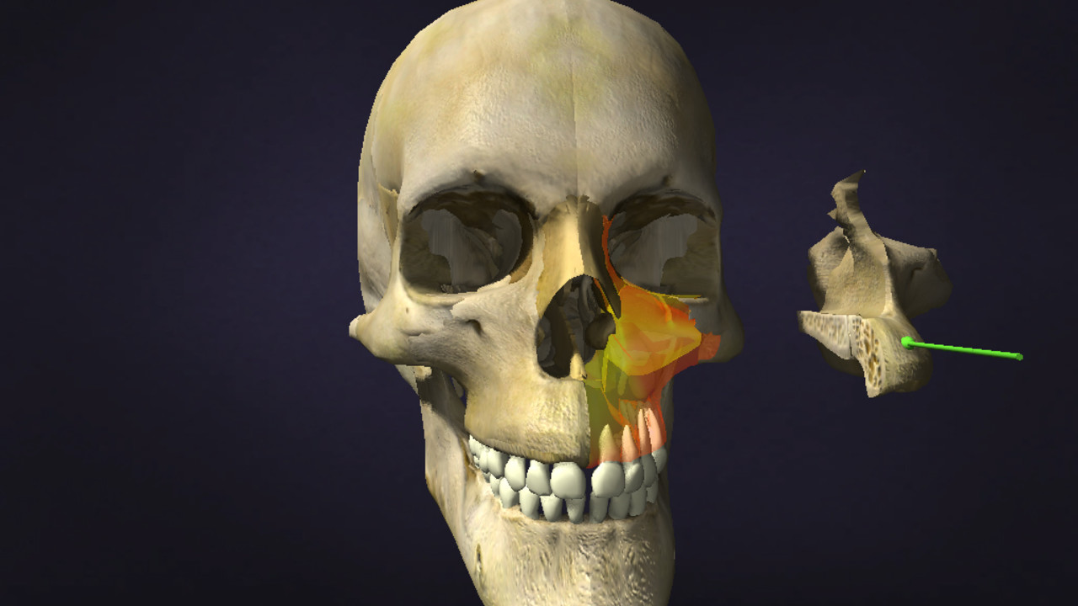
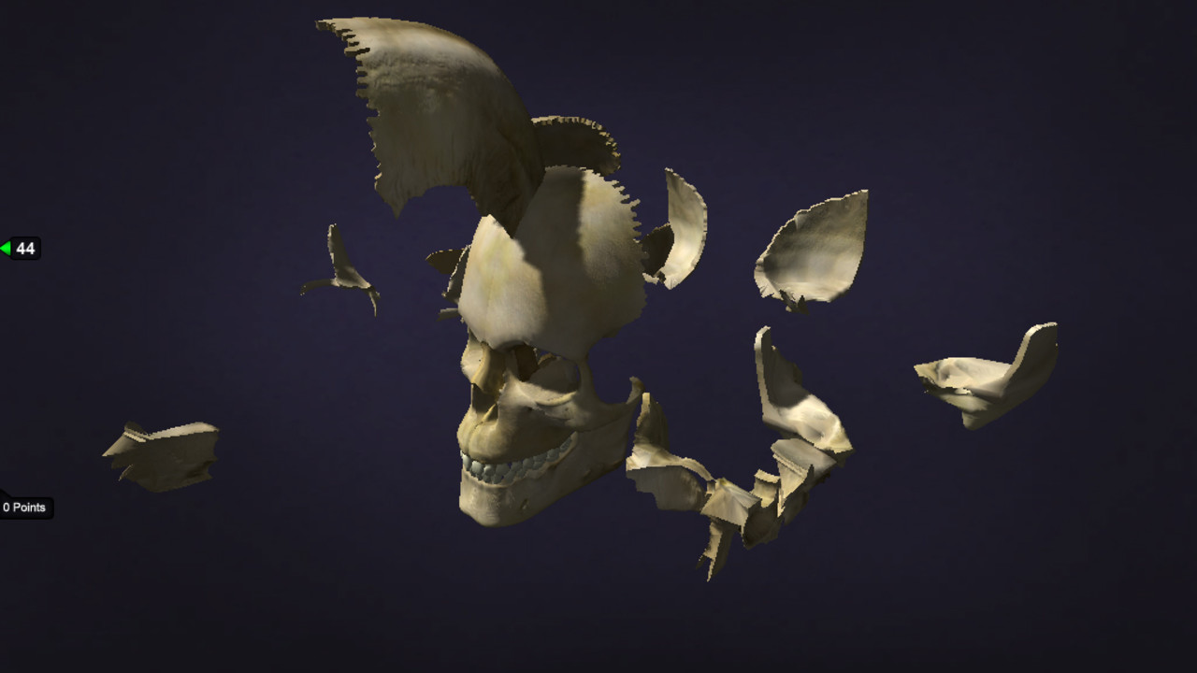
Demo

Slide 45
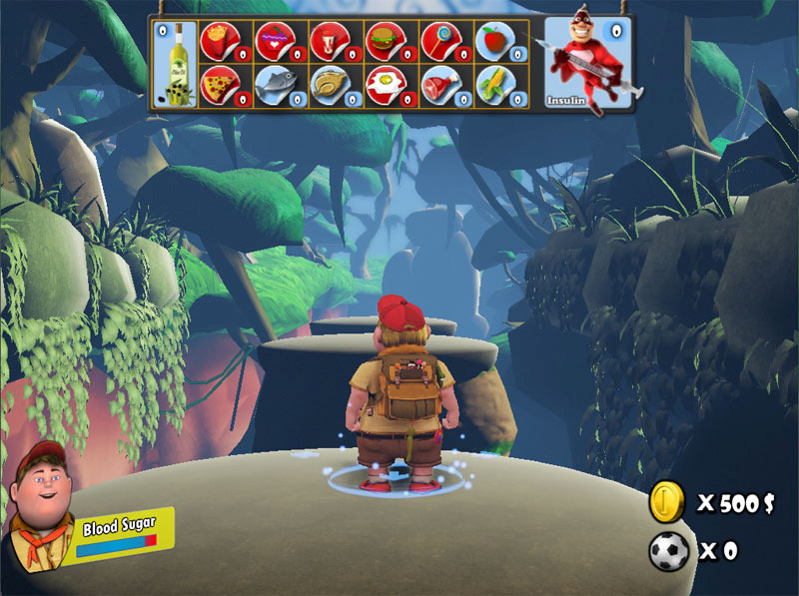
3D Game

Slide 46
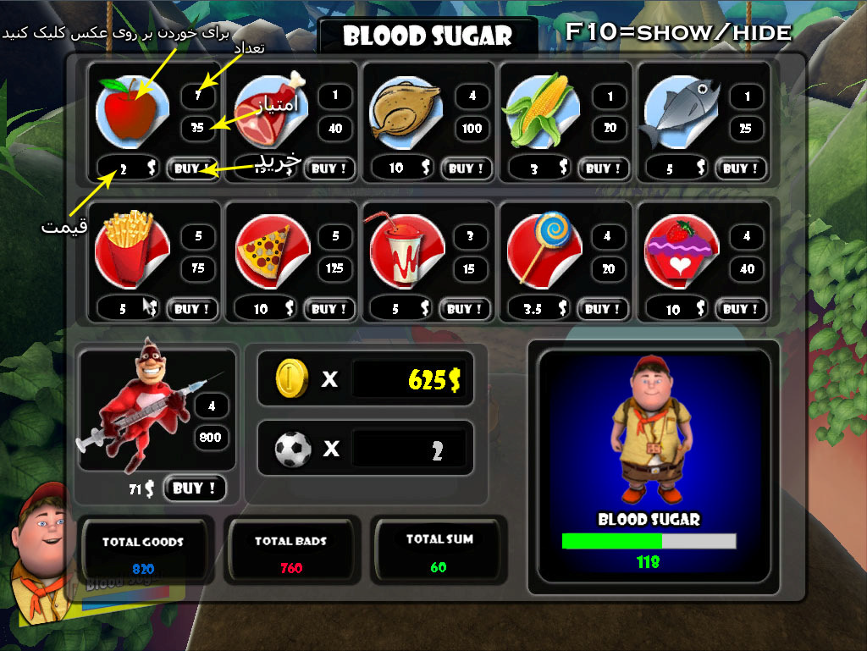
Blood sugar maintenance window

Slide 47
Question Answering Systems
Dr Eve
Dr Watson

Slide 48
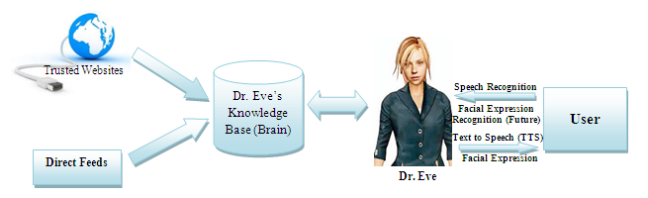

Dr. Eve- Starship Hospital Others

Slide 49
Dr Watson
IBM
Watson Research Center

Slide 50
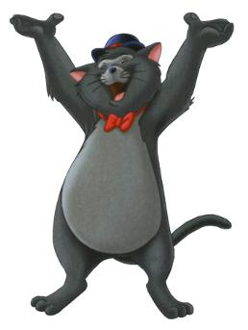
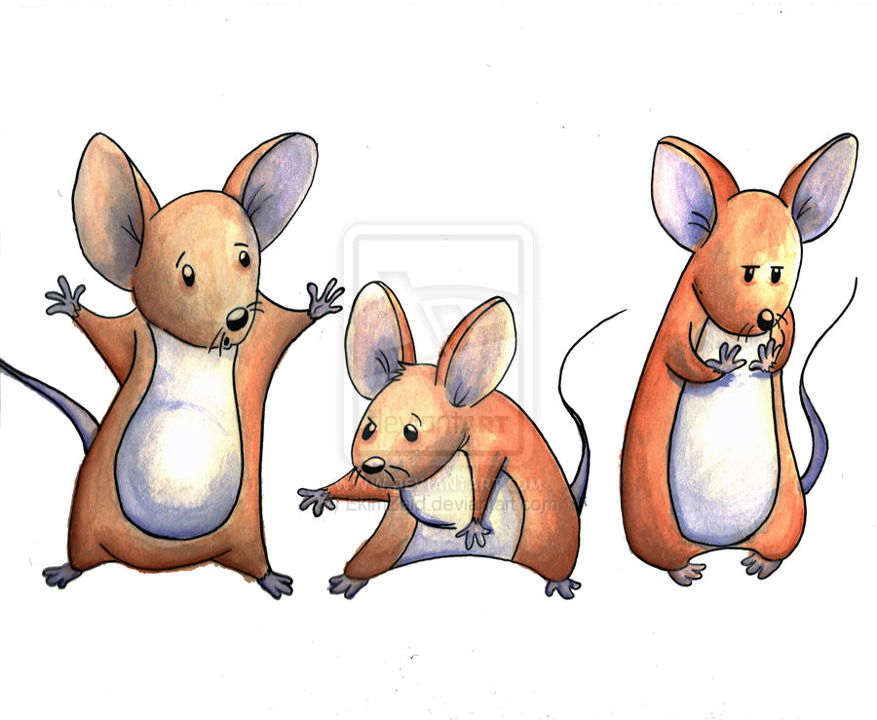

Slide 51

NLP,
Natural language interfaces and
Machine translation

Slide 52
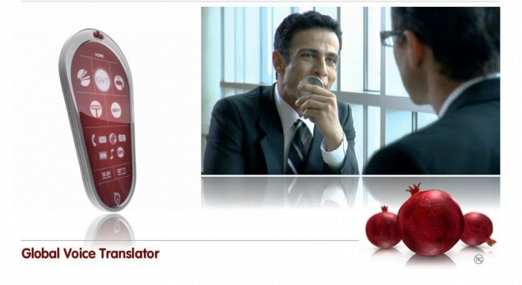
Phone Global Voice Translator
Phone Global Voice Translator
Persian Language
Notes:
To give you a better understanding of what I am talking about here a short clip: pomegranate
When I saw this video it was 11 o clock at night but I called my supervisor and said what we wanted to do has already been done and for persian too. But The video turn out to be just the dreams of some people in Canada but something that we had started to do , I will now explain the work I have done to date and what planned for the next two years of my PhD study .

Slide 53
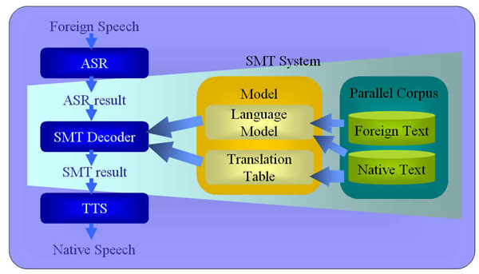
Speech-to-Speech translation systems
Speech-to-text
Machine translation
Text-to speech
Speech-to-Speech translation system
5/24/2014
Phone Global Voice Translator
Notes:
The user of the system will speak into a microphone provided with the handheld device which translates the spoken words into English and vice versa in real-time.
The system will consist of an off-the-shelf handheld device, speech-to-text and text-to-Speech engines, and a statistical machine translation component as well as a server and a database
These components will be implemented using a combination of Microsoft products (e.g. text to speech and speech to text engines, Windows, MS Access, etc.) and a statistical machine translation system which will be developed in-house. The statistical machine translation system will be developed using Moses which is a public domain statistical development tool the team is familiar with.Speech-to-speech translation, which is still in the experimental stage, is a complex process requiring speech-recognition technology that converts speech to text, machine translation of the text, and then text-to-speech conversion.

Slide 54
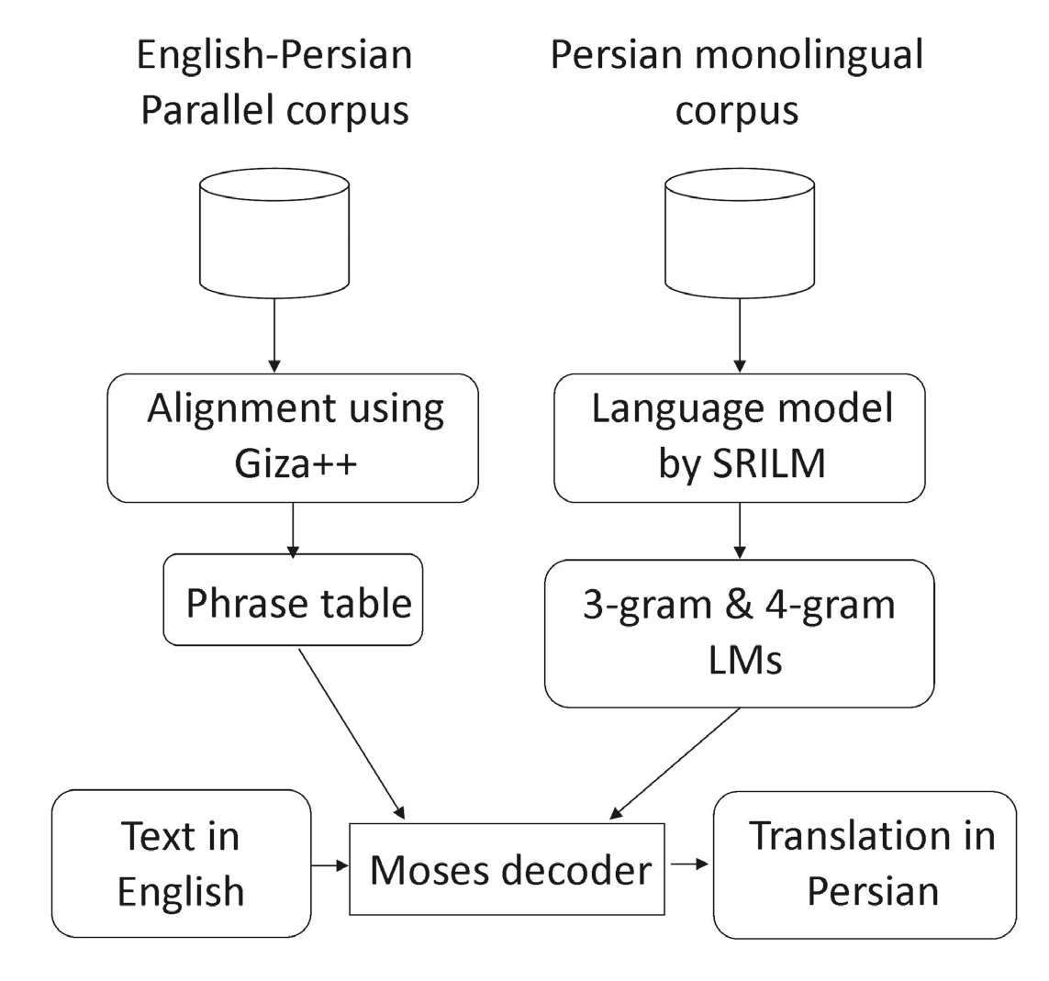
Schematic overview of an SMT system
A typical SMT system is divided into two core modules
Language model.
Translation model
To build a good baseline system it is important to build a sentence aligned parallel corpus which is spell-checked and grammatically correct for both the source and target language
Schematic overview of an SMT system
Statistical Machine Translation
Notes:
A typical SMT system is divided into two core modules the translation model and the language model.
To build a good baseline system it is important to build a sentence aligned parallel corpus which is spell-checked and grammatically correct for both the source and target language.
The accuracy of statistical machine translation (SMT) relies heavily on the existence of large amounts of data which is commonly referred to as a parallel corpus.

Slide 55
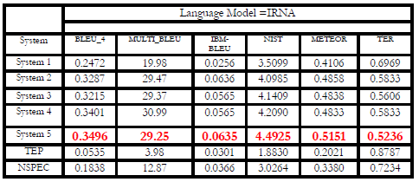


Experiment and Result (3)
Automatic Evaluation Metrics of PeEn-SMT System
Automatic Evaluation Metric of Google Translator Output

Slide 56
Planned
Develop the tools and make them available for other applications
e.g. Dynamic performance system
Autism assistive tool
Use speech as another channel
Study the socio-cultural issues
Develop the Intelli-mouse further
Give the agent the ability to understand other languages!

Slide 57
Other applications
Business
Targeted advertising, intelligent sales assistance (US Patent)
E-commerce
Online shops tracking the interests of the shoppers (Being worked on as a joint collaboration between Massey University and Unitec Dept of Computing and Marketing)
Health
assistive tools for the disabled, the same for the elderly care
Security
Movement tracking and things left behind, Suspicious behaviour

Slide 58
Overview of the assistive tool

Slide 59

Equipment
(Lighting, camera, stage,
sound, effects, etc.)
Commands
Inside Out Production Studios
Rosebank Business Park
ace
Interface Unit
Audience mood
Cameras
Actor(s)
Facial Expression Recognition System
Gesture Recognition System
Audience
Dynamic performance system

Slide 60
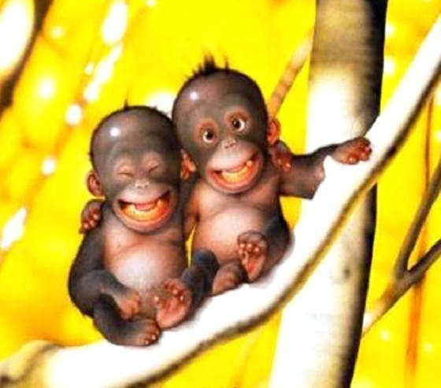


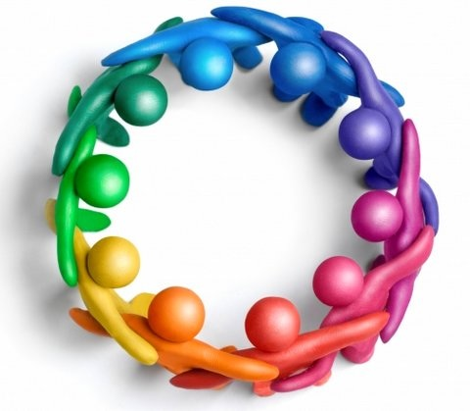
با تشکر
Thank you!

