Slide 1

WHAT DOES IT TAKE TO BE A LANGUAGE TEACHER?
Jack C Richards
www.professorjackrichards.com

Slide 2
The Core Dimensions Of Teacher Development
Developing appropriate linguistic competence
Acquiring relevant content knowledge
Developing a repertoire of teaching skills
Acquiring contextual knowledge
Developing identity as a language teacher
Developing learner-focussed teaching
Acquiring specialized cognitive skills
Learning how to theorize from practice
Joining a community of practice
Becoming a language teaching professional

Slide 3
The Language Proficiency Factor
How does language proficiency affect teacher performance?

Slide 4

1. Developing Appropriate Linguistic Competence
Give explanations and instructions in the target language
Provide examples of words and grammatical structures
Give accurate explanations (e.g. of vocabulary and language points)
Use appropriate classroom language

Slide 5
1. Developing Appropriate Linguistic Competence
Monitor one’s own speech and writing for accuracy
Give correct feedback on learner language
Provide input at an appropriate level of difficulty
Provide language enrichment experiences for learners (i+1)
Access target-language resources (e.g. newspapers, magazines, internet)

Slide 6
1. Developing Appropriate Linguistic Competence
Comprehend texts accurately
Provide good language models
Maintain use of the target language in the classroom
Maintain fluent use of the target language

Slide 7
The Language of the Native Speaker
How does the native speaker need to modify his or her language?

Slide 8
Obama’s Inauguration Speech
Original version
My fellow citizens: I stand here today humbled by the task before us, grateful for the trust you have bestowed, mindful of the sacrifices borne by our ancestors. I thank President Bush for his service to our nation, as well as the generosity and cooperation he has shown throughout this transition.

Slide 9
Obama’s Inauguration Speech
Globish version
My friends and citizens: I stand here today full of respect for the work before us. I want to thank you for the trust you have given, and I remember the sacrifices made by our ancestors. I thank President Bush for his service to our nation, as well as for the spirit of giving and cooperation he has shown during this change-over.

Slide 10
Discourse skills
To monitor one’s language use in order to provide suitable learning input
To avoid unnecessary colloquialisms and idiomatic usage
To provide a model of spoken English appropriate for students learning English as an international language
To provide language input at an appropriate level for learners

Slide 11
2.The Role of Content Knowledge
What constitutes the essential knowledge-base of language teaching?
How do teachers make use of content knowledge?

Slide 12
Van Lier on content knowledge
“Instead of the usual linguistic sub-topics such as phonetics, syntax, discourse analysis and so on, I propose that we identify language-related themes from the teachers’ own sphere of activity...

Slide 13
Van Lier on content knowledge
...This exploration will necessitate a certain amount of linguistic study in the traditional sense, but it is very important that such study is now motivated by a real-life question that requires an answer.
...We do not teach linguistics because it is there, but because it helps us to solve language problems in real-life tasks.”

Slide 14
2. Acquiring Relevant Content Knowledge
Disciplinary knowledge - core knowledge that relates to the knowledge base of the profession
Linguistics, Sociolinguistics, SLA, History of Language Teaching, Critical Applied Linguistics

Slide 15
2. Acquiring Relevant Content Knowledge
Pedagogical content knowledge - knowledge that supports teaching
Methodology, curriculum design, classroom management, testing and assessment, teaching the 4 skills

Slide 16
Applications of Pedagogic Content Knowledge
Understand learners’ needs
Diagnose learners’ learning problems
Plan suitable instructional goals for lessons
Select and design learning tasks
Evaluate students’ learning

Slide 17
Applications of Pedagogic Content Knowledge
Design and adapt tests
Evaluate and choose published materials
Adapt commercial materials
Make use of authentic materials
Make appropriate use of technology
Evaluate their own lessons

Slide 18
Example of the Use of Pedagogical content Knowledge
Two groups of teachers receive a sample of literary texts
One group has a training in literature and the other does not
They are asked to review their potential for language teaching…

Slide 19
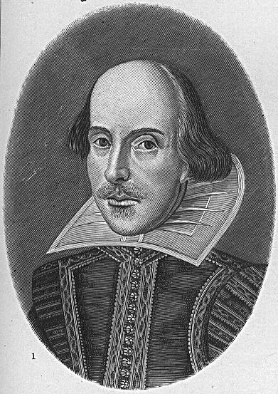
Using Literary Texts In Teaching
Literature majors
Saw ways of dealing with any difficulties the texts posed
Saw a wide variety of teaching possibilities with the texts
Addressed literary aspects of the texts
A variety of strategies were used to help students explore the meanings of the texts
Non-literature majors
Worried about how to deal with the difficulties the texts posed
Planned to use the texts mainly for reading comprehension
Did not address literary aspects of the texts
Mainly used questions to check comprehensions of the texts

Slide 20
3. Developing a Repertoire of teaching Skills
What are the essential skills and competencies teachers need to be able to navigate their way through lessons?
How do inexperienced and experienced teachers differ in their use of teaching skills?

Slide 21

3. Developing a Repertoire of teaching Skills
Opening the lesson
Introducing and explaining tasks
Setting up learning arrangements (group work, pair work, whole-class learning)
Checking student’s understanding
Notes:
All up at once
Pics – pic of students reading books

Slide 22
3. Developing a Repertoire of teaching Skills
Guiding student practice
Monitoring student’s language use
Making transitions from one task to another
Ending the lesson
Notes:
All up at once
Pics – same photo as previous page

Slide 23
3. Developing a Repertoire of teaching Skills
Barr and Dreeben
Practical knowledge about teaching is acquired mainly through experience. During each successive year of instruction, teachers learn about different groups of children, about the content of instructional materials, and about teaching methods and classroom arrangements that facilitate class management and children’s learning. We expect that a difference between one and two years of experience is of greater significance than that between successive pairs of years, because the first year marks the break between no prior experience with full-class responsibility and some experience in carrying out an instructional program.

Slide 24
3. Developing a Repertoire of teaching Skills
[D] Stages in development of expertise in teaching
[MT] Stage 1 (novice): Teacher labels and learns each element of the classroom task. Set of context-free rules of performance acquired. Performance is rational, inflexible and needs purposeful concentration. Stage 2 (advanced beginner): Similarities across contexts are recognized and episodic knowledge acquired. Strategic knowledge gained; knows when to ignore or ‘break’ rules. Prior classroom experiences begin to guide behavior. Stage 3 (competent): Teacher able to make conscious choices about actions, to set priorities and plan. Teachers know, from experiences, what is important and not important. Teacher now knows how to deal with errors. Stage 4 (proficient): Intuition and knowledge begin to guide performance. Recognition of similarities across contexts acquired. Teacher picks up information from classroom and can predict events with precision. Stage 5 (expert): Has an intuitive grasp of situations, and non-analytic sense of appropriate behavior. Teaching apparently effortless and fluid. Automatic, standardized routines for management and instruction now operate. Teachers are likely to have difficulty in describing their thinking.

Slide 25

Expert Teachers
Have a wide repertoire of routines and strategies that they can call upon
They are willing to depart from established procedures and use their own solutions
They learn to automatize routines associated with managing the class; this skill leaves them free to focus on content

Slide 26
Expert Teachers
They improvise more than novices & make greater use of interactive-decision making as a source of their improvisational performance
They have more carefully developed schemata to support their practical classroom decisions
Notes:
All at once
Pic – same photo as previous page

Slide 27
Expert Teachers
They pay more attention to language issues than novices (who worry more about classroom management)
They are able to anticipate problems and have procedures available to deal with them
They carry out needed phases more efficiently, spending less time on them
Notes:
All at once
Pic – same photo as previous page

Slide 28
Expert Teachers
They relate things that happen to the bigger picture, seeing them not in the context of a particular lesson
They distinguish between significant and unimportant issues that arise
Notes:
All at once
Pic – same photo as previous page

Slide 29
4. Acquiring Contextual knowledge
A key factor in understanding any teaching situation is the social and physical context – the rules, facilities, values, expectations, and personal backgrounds, which act as resources, constraints, and direct influences on teaching and learning. (Posner)

Slide 30
Conceptions Of Teaching
Notions of good teaching are culturally determined
Notions of good teaching are situated concepts

Slide 31
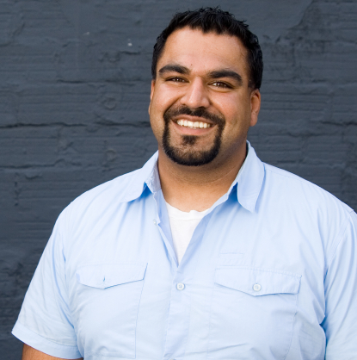
Conceptions of Teaching
“When I present a reading text to the class, the students expect me to go through it word by word and explain every point of vocabulary or grammar. They would be uncomfortable if I left it for them to work it out on their own or if I asked them just to try to understand the main ideas.”
Egyptian EFL teacher

Slide 32
Conceptions of Teaching
“If a student doesn’t succeed, it is my fault for not presenting the materials clearly enough. If a student doesn’t understand something I must find a way to present it more clearly.” Taiwanese EFL teacher

Slide 33

Conceptions of Teaching
“If I do group work or open-ended communicative activities, the students and other colleagues will feel that I’m not really teaching them. They will feel that I didn’t have anything really planned for the lesson and that I’m just filling in time.” Chinese EFL teacher

Slide 34
Conceptions of Teaching
“The trouble with Chinese teachers is that they’ve never done any real teacher-training courses so they don’t know how to teach. All they do is follow the book. They never give us any opportunity to talk. How in the world do they expect us to learn?”
Australian student in China

Slide 35
Conceptions of Teaching
“Australian teachers are very friendly but they can’t teach very well. I never know where they’re going – there’s no system and I just get lost. Also, they’re often very badly trained and don’t have a thorough grasp of their subject.”
Chinese student in Australia

Slide 36
Acquiring Contextual Knowledge
Teaching is a situated activity governed by the norms of practice of a school.
Teaching involves learning how to teach in a specific context.

Slide 37
The role of context
Campus-based versus school-based learning
On-line learning

Slide 38
5. Developing one’s sense of identity as a language teacher
The differing social and cultural roles teachers enact through their interactions with students and others.
These roles are not static but emerge through the social processes of the classroom.
Shaped by many factors, including personal biography, gender, culture, working conditions, age, and the school and classroom culture.

Slide 39
5. Developing one’s sense of identity as a language teacher
A model: Providing examples of how language is used and giving feedback on students’ language use.
A planner: Selecting and organizing learning materials for lessons.
A resource: Providing information about English.
A performer: Creating lessons that reflect careful planning and execution.
A manager: Controlling and managing learner behaviour to maximize learning opportunities and to minimize disruptions.
A motivator: Providing experiences that motivate and engage learners.
An inquirer: Learning more about the nature of second language learning through teaching different kinds of learners and reflecting on observations they make.
A mentor: Guiding learners towards successful learning strategies and approaches.
A learner: Learning more about teaching through the experience of teaching.
A theorizer: Developing a deeper understanding of language teaching by developing explanations and theories to account for things the teacher observes in the classroom.

Slide 40
5. Developing one’s sense of identity as a language teacher
Students comments on their teacher’s English in Croatia
It’s the pronunciation. It’s the British accent that’s some kind of prestige … Some of our teachers here have awful pronunciation. The idea that those professors have a doctoral degree in English … and they talk like that ... I know they didn’t have TV back then ... We will be school language teachers one day, so if you are going to teach others, then you have to know how to speak English, and pronunciation is part of that.
Native-speaker teachers on their native-speaker based pronunciation: of some of the Croatian professors to sound quaint and stilted:
Some of the professors here speak a sort of very snobbish English, like X. I mean, terribly posh ... and a lot of other people I met. So, obviously, they'd internalized some sort of model of their stays in England, which carries a slightly old-fashioned sense of prestige.

Slide 41
5. Developing one’s sense of identity as a language teacher
I would describe students’ perception of me, as both an individual and a professor, as proceeding through three general phases ... The first phase lasts for the first two or three classes, wherein I am perceived as an object of curiosity, in the sense that I am a real foreigner from the legendary Wild West of the US, and that there is much that is unknown and mysterious about me … Following about the second or third class, students get a sense that I am not all that much unlike them … By the fourth class … students seem resolved, above all else, to determine what it is exactly that I expect of them in class and what elements are to be the most important in determining their grades. Finally … students make a final judgement surrounding my ethos and the overall impression that I have left upon them.

Slide 42
6. Developing Learner Focussed Teaching
What is the difference between teacher-focussed and learner-focussed teaching?
What factors facilitate a move from teacher-focussed to learner-focussed teaching?

Slide 43
6. Developing Learner Focussed Teaching
As a beginning teacher, I was given the lower levels of English, and they tended to be large, about 30 students. I enjoyed the dynamics of a large class and prepared my classes thinking of how I could get across the grammar I was teaching. I looked at the textbook and planned how to get through each activity of the unit I was planning. I felt if I could go through every textbook and workbook activity, students would learn. Of course, this type of thinking was somewhat top down because I assumed that giving out the information of these activities would be the way for my students to learn the language. In essence, I controlled these activities, beginning with the first activity and continuing on with each one. These activities seemed to be rushed. In one of these classes, I was teaching questions in the present simple tense, such as What do you do? Where do you live? etc. I ran through the activities, and at the end of the class, two of my students asked me if they could use the grammar related to their lives. It was a wake-up call for me, and I learned two things. I realized my way of thinking was not tapping into my students’ lives, and I also thought that completing all the book activities was the way for learning.

Slide 44
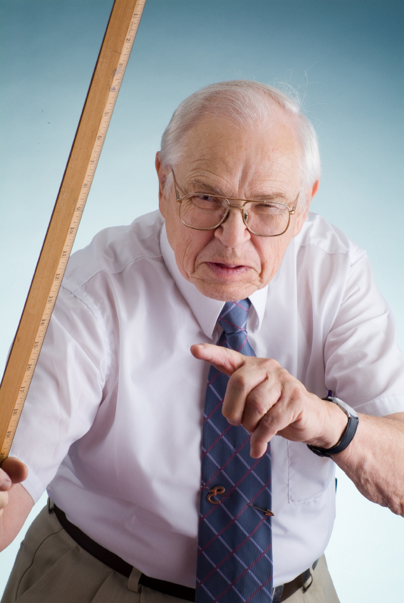
6. Developing Learner-focussed Teaching
The amount of talking the teacher does during the lesson
The extent to which input from learners directs the shape and direction of the lesson

Slide 45
6. Developing Learner-focussed Teaching
The extent to which the teacher’s primary preoccupation during the lesson is with such things as classroom management, control, and order
The extent to which the lesson reflects the teacher’s lesson plan

Slide 46

6. Developing Learner-focussed Teaching
The degree of engagement learners have with the lesson
The quantity of student participation and interaction that occurs
The learning outcomes the lesson produced

Slide 47
6. Developing Learner-focussed Teaching
The ability to present subject-matter from a learner’s perspective
How well they address learners’ needs
How they are able to reshape the lesson based on learner feedback
How they respond to learners’ difficulties
Notes:
All at once, same picture as previous page

Slide 48
6. Developing Learner-focussed Teaching
Maria:
“It’s important to me that I achieve the goals I set for the lesson and don’t skip things I planned to cover. I need to feel I did a good job on covering the different stages of the lesson – the presentation phase, the practice stage, and the free production stage for example.”

Slide 49

6. Developing Learner-focussed Teaching
Phillip:
“To me the most important thing is that the students enjoyed themselves and had useful practice. And that the lesson was at the right level for them – not too easy or too difficult so that they felt it was really worth while coming to class today.”
Notes:
Picture – a man teacher please

Slide 50
6. Developing Learner-focussed Teaching
Maria:
“I believe the best lesson is a well planned lesson. I find it much easier to teach when I have a detailed plan to follow. I find that I am more likely to use the time efficiently in the classroom if I know exactly what I will do and what I expect students to do during the lesson.”

Slide 51
6. Developing Learner-focussed Teaching
Phillip:
“I believe every child in my class has got the capacity to learn, even if he or she is not aware of it. Every learner is a winner. I try to encourage each student to discover what he or she is good at and to help them be successful at it.”
Notes:
All at once
Picture – a man teacher please – same photo as other

Slide 52
6. Developing Learner-focussed Teaching
They are familiar with typical student behaviours
They use their knowledge of learners to make predictions about what might happen in the classroom
They build their lessons around students’ difficulties
They maintain active student involvement
Notes:
All at once, same picture as previous page

Slide 53
7. Acquiring Specialized Cognitive Skills
What cognitive skills do teachers make use of when they plan and teach lessons?
How do teachers develop pedagogic reasoning skills?

Slide 54
Borg on teacher cognition
“A key factor driving the increase in research in teacher cognition has been the recognition that teachers are active, thinking decision-makers who play a central role in shaping classroom events. Coupled with insights from the field of psychology which have shown how knowledge and beliefs exert a strong influence on teacher action, this recognition has suggested that understanding teacher cognition is central to the process of understanding teaching.”

Slide 55
7. Acquiring Specialized Cognitive Skills
A teacher has just called in sick. You are going to teach her 50-minute spoken English class, lower intermediate level, in 5 minutes. Your only teaching aid is a glass of water. What will your lesson look like?

Slide 56

7. Acquiring Specialized Cognitive Skills
1) I would start by showing the glass and ask students to form groups and brainstorm for five minutes to come up with the names of as many different kinds of containers as possible. They would then group them according to their functions.

Slide 57
Acquiring Specialized Cognitive Skills
For example things that contain food, things that are used to carry things, things that are used to store things in and so on.
I would model how they should do this and suggest the kind of language they could use. (10 minutes).

Slide 58
Acquiring Specialized Cognitive Skills
2) Students would present their findings to the class to see who had come up with the longest list. (10 minutes).
Notes:
All at once

Slide 59
Acquiring Specialized Cognitive Skills
3) For a change of pace and to practice functional language I would do some dialog work, practicing asking to borrow a container from a neighbour. First I would model the kind of exchange I want them to practice. Then students would plan their dialog following this outline :

Slide 60
Acquiring Specialized Cognitive Skills
a) Apologize for bothering your neighbour.
b) Explain what you want and why you need it.
c) Your neighbour offers to lend you what you want.
d) Thank your neighbour and promise to return it on the weekend.

Slide 61
Acquiring Specialized Cognitive Skills
Students would then perform their dialogues.

Slide 62
Pedagogical Reasoning Skills
To analyse potential lesson and identify ways in which it could be used
To identify specific linguistic goals
To anticipate any problems that might occur and ways of resolving them
To make appropriate decisions about time, sequencing, and grouping arrangements

Slide 63
8. Learning How To Theorize From Practice
Application of theory versus theorizing of practice
The source of the teacher’s understanding of teaching
The source of teachers’ practical actions

Slide 64

8. Learning How To Theorize From Practice
Arriving at generalizations and explanations
Developing personal principles and teaching philosophy

Slide 65
Arriving At Generalizations & Explanations
Children are much better language learners than adults - they are not worried about making mistakes and are much more prepared to take risks
When we begin learning a language it’s better to follow the natural way, using imitation. But when you are more advanced then you need to know more about the grammar
Error correction works best when you ask students to monitor their own language, rather than having them depend on the teacher all the time

Slide 66
Arriving At Explanations & Generalizations
The essential thing in language learning is knowing how to say what you want to say but not why you have to say it in a particular way
Learners learn more when they work in groups because they can learn from each other and they get more opportunities to talk than when the teacher is conducting the class
Notes:
Heading & first bullet then 2nd bullet on mouse click

Slide 67
Arriving At Explanations & Generalizations
“I think it’s important to be positive as a personality. I think the teacher has to be a positive person. I think you have to show a tremendous amount of patience. And I think if you have a good attitude you can project this to the students and hopefully establish a relaxed atmosphere in your classroom so that the students won’t dread to come to class but have a good class... ...I feel that it’s important to have a lesson plan of some sort.

Slide 68
Arriving At Explanations & Generalizations
Because you need to know what you want to teach and how you are going to go from the beginning to the end. And also taking into consideration the students, what their ability is, what their background is and so on. I have been in situations where I did not understand what was being taught or what was being said, and how frustrating it is and so when I approach it I say: how can I make it the easiest way for them to understand what they need to learn?”
Maria

Slide 69
Developing Personal Principles
Follow the learners’ interest to maintain students involvement
Always teach to the whole class - not just to the best students
Seek ways to encourage independent student learning
Make learning fun
Build take-away value in every lesson
Address learners’ mental processing capacities
Facilitate learner responsibility or autonomy
Every child is a winner

Slide 70
9. Joining A Community Of Practice
It involves a group of people who have common interests and who relate and interact to achieve shared goals
It focuses on exploring and resolving issues related to the workplace practices that members of the community take part in
Notes:
1. Heading 2. All at once

Slide 71
9. Joining A Community Of Practice
Collaboration with fellow teachers
Collaboration with university colleagues
Collaboration with others in the school
Notes:
All at once

Slide 72
10. Becoming A Language Teaching Professional
Institutionally prescribed professionalism
Independent professionalism
Notes:
1. Heading 2. Photo & text

Slide 73
Rethinking of teaching methods
Co-construction of knowledge rather than transfer of knowledge
Dialogic teaching
Collaborative approaches
Self-directed learning
Teacher-networks

Slide 74
Wallace’s three models of teaching
“In the craft model all of the expertise of teaching resides in the training, and it is the trainee’s job to imitate the trainer. With the applied science model all teaching problems can be solved by experts in content knowledge and not by the ‘practitioners’ themselves. The third model envisions as the final outcome of the training period that the novice teacher become an autonomous reflective practitioner capable of constant self-reflection leading to a continuous process of professional self-development.”

Slide 75
Dialogic learning
“First, it requires the participation of the teacher and the teacher-learners. There can be no learning if either one is missing. Because of the complexity of what the teacher and teacher-learners bring to the classroom, and the further complexity of their interaction in class, it is impossible to predict exactly what teacher learners will or will not learn. Finally, dialogue involves constant negotiation.”

Slide 76
Collaborative learning
“Collaborative learning creates a social context that helps students negotiate entry into the academic discourse community and acquire disciplinary knowledge. But, at the same time, their joint efforts will produce new knowledge, and eventually lead to a critique of accepted knowledge, conditions, and theories, as well as of the institutions that produce knowledge.”

Slide 77
The Core Dimensions
Developing appropriate linguistic competence
Acquiring relevant content knowledge
Developing a repertoire of teaching skills
Acquiring contextual knowledge
Developing identity as a language teacher
Developing learner-focussed teaching
Acquiring specialized cognitive skills
Learning how to theorize from practice
Joining a community of practice
Becoming a language teaching professional
Notes:
All at once

Slide 78
Thank You
Jack C Richards
www.professorjackrichards.com
Notes:
All at once
Picture of Jack

