Slide 1

Current Trends in Language Teaching
Dr. Jack Richards

Slide 2

Professional Development
Language teaching provides a career for hundreds of thousands of teachers worldwide
Language teaching is subject to constant changes:
            profession responds to new movements and trends in language teaching
            expanding demand for quality language programmes and language teachers
Maintain interest, creativity and enthusiasm

Slide 3

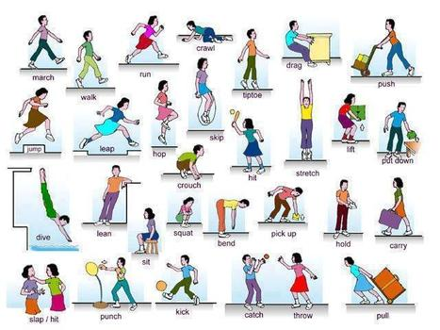
The Nature of Professionalism
          - not something anyone who can speak English can do
          - is a profession, a career in a field of educational specialization
          - requires a specialized knowledge base, obtained through academic study and practical experience
English Language Teaching

Slide 4



The Nature of Professionalism
TESOL (Teachers of English to Speakers of Other Languages)
IATEFL (International Association of Teachers of English as a Foreign Language)
JALT (Japan Association for Language Teaching)

Slide 5

The Nature of Professionalism
Teacher education
Field that deals with the preparation and professional development of teachers, and teacher development and teacher training

Slide 6
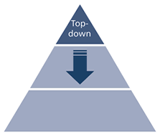
Types of Teacher Education
Earlier approaches: based on a process of acquiring a body of knowledge and skills from an external source, i.e. from experts
Expert-driven
Modelling good practices

Slide 7



Relevant Questions
▪ Is language teaching a branch of applied linguistics or a branch of education
▪ How much linguistics do teachers need to know, and whose linguistic theories are more relevant
▪ What are the essential subjects in a pre-service or in- service curriculum for language teachers?
▪ Do teachers need to know how to carry out research? If so, what kind of research?

Slide 8

Teacher Training
▪ Understanding the basic concepts and principles as a prerequisite for applying them to teaching
▪ Developing a repertoire of classroom techniques, routines, skills and strategies
▪ Providing opportunities to try out different strategies in the classroom
▪ Developing ability to teach using a textbook and classroom technology
▪ Monitoring oneself and getting feedback from others on one’s practice

Slide 9
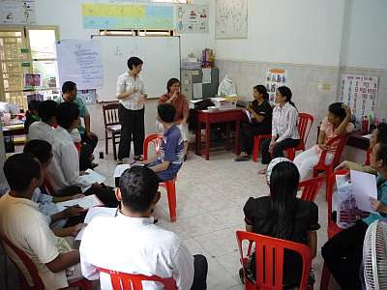
Teacher Training
Development of basic concepts, theories and principles
Training involves
Repertoire of teaching skills

Slide 10

Teacher Training
TKT consists of 3 core modules:
▪ Language and background to language learning and teaching
▪ lesson planning and the use of resources for language teaching
▪ Managing the teaching and learning process

Slide 11
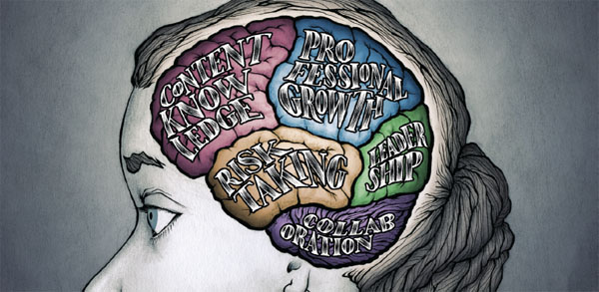


Teacher Development
Serves a long-term goal and seeks to facilitate growth of the teacher’s general understanding of teaching, of the teaching context and of his or her performance as a teacher
Teacher Development
Examination of different dimensions of one’s own practice as a basis for reflective review

Slide 12
Teacher Development
Freeman (1982:21-22):
Training deals with building specific teaching skills: how to sequence a lesson or how to teach a dialogue, for instance. Development, on the other hand, focuses on the individual teacher – on the process of reflection, examination, and change which can lead to doing a better job and to personal growth and professional growth. These two concepts assume different views of teaching and the teacher. Training assumes that teaching is a finite skill, one which can be acquired and mastered. The teacher then learns to teach in the same way s/he learned to tie shoes or to ride a bicycle. Development assumes that teaching is a constantly evolving process of growth and change. It is an expansion of skills and understanding, one in which the teacher is responsible for the process in much the same way students are for learning a language.

Slide 13

Teacher Development
How useful do you think theory is for teachers? How can they make use of theory?

Slide 14

Teacher Development
sociocultural view of learning, constructing new knowledge and theory through participating in specific social contexts and engaging in particular types of teaching activities and processes
to
Traditional perspectives (cognitive issue, something the learner did on his or her own)

Slide 15

Teacher Development
Interests evolve from a ‘teacher-trainer’ to a ‘teacher-development’ perspective

Slide 16


Professional Development
▪ encompasses both teacher training and teacher development
▪ refers to both formal as well as informal activities that seek to promote dimensions of teacher learning

Slide 17


Professional Development
Mutual sharing of knowledge and experience
Approaches to ongoing Professional Development

Slide 18

Professional Development
Teachers are generally motivated to continue their professional development
Approaches to ongoing Professional Development

Slide 19

Professional Development
Teachers need regular opportunities to upgrade
Approaches to ongoing Professional Development

Slide 20
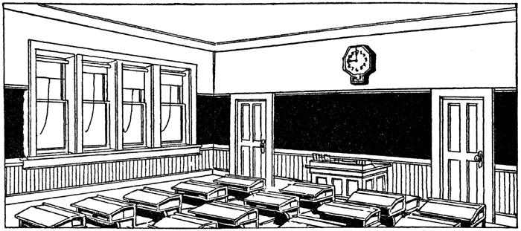
Professional Development
Classrooms are places where teachers can also learn, not just students
Approaches to ongoing Professional Development

Slide 21
Professional Development
Teachers can play an active role in their own professional development
Approaches to ongoing Professional Development

Slide 22

Professional Development
It is the responsibility of schools and administrators to provide opportunities for continued professional education
Approaches to ongoing Professional Development

Slide 23

Professional Development
Professional development benefits both institutions as well as the teachers who work in them
Approaches to ongoing Professional Development

Slide 24
Institutional and personal professionalism
Professionalism
Individual – independent professionalism, which refers to teachers’ own views of teaching and the processes by which teachers engage in reflection on their own values, beliefs and prctices
Institutional – reflects a managerial approach to professionalism, one that represents the views of ministries of education, teaching organisations, regulatory bodies, school principals

Slide 25



Institutional professionalism
▪ there are likely to be procedures for achieving accountability and process to maintain quality teaching
▪ familiarization with standards
▪ such standards involve acquiring the qualifications the profession recognizes as evidence of professional competence, as well as demonstrating a commitment to attaining high standards in one’s work, whether as classroom teachers, supervisors, administrators or teacher trainers

Slide 26


Institutional perspective
Goals of Staff Development
▪ Institutional development
- improves the performance of the school as a whole, to make it more successful, attract more students and achieve better learning outcomes
▪ Career development
- facilitates the professional advancement of teachers to more senior positions (senior teacher, coordinator)by providing them with necessary knowledge and skills
▪ Enhanced level of student learning
- an important goal is to raise the achievement level of students in the institution

Slide 27
Institutional perspective
Joyce (1991) identifies five dimensions of institutional improvement that professional development can contribute to:
1. Collegiality – creating a culture through developing cohesive professional relationships between staff (and the wider community)
2. Research – familiarizing staff with research findings on school improvement, teaching effectiveness and so on, which can support ‘in-house- development
3. Site-specific information – enabling and encouraging staff to collect and analyse data on students, schools ad effects of change, both as a formal evaluation and informally

Slide 28
Institutional perspective
4. Curriculum initiatives – collaborating with others to introduce change in their subject areas, as well as across the school curriculum
5. Instructional initiatives – enabling staff to expand their repertoires of teaching methods, such as learning to teach according to CLIL or Text-based teaching

Slide 29


The individual perspective
Reflection questions:
What kind of teacher am I?
What am I trying to achieve for myself and for my learners?
What are my strengths and limitations as a language teacher?
How do my students and colleagues view me?
How and why do I teach the way I do?
How have I developed as a teacher since I started teaching?
What are the gaps in my knowledge?

Slide 30

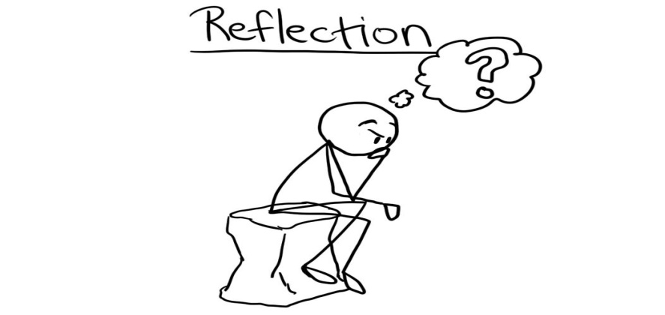
The individual perspective
Reflection questions:
8. What role do I play in my school, and is my role fulfilling?
9. What is my philosophy of teaching, and how does it influence my teaching?
10. What is my relationship with my colleagues, and how productive is it?
11. How can I mentor less-experienced teachers?

Slide 31


The individual perspective
1. Subject-matter knowledge
2. Pedagogical expertise
3. Understanding of one’s teaching philosophy
4. Theorisation of practice
5. Understanding of learners

Slide 32
The individual perspective
6. Understanding of curriculum and materials
7. Research skills
8. Career advancement

Slide 33
1. Workshops
An intensive, short-term learning activity that is designed to provide an opportunity to acquire specific knowledge and skills

Slide 34
Benefits of workshops
They can provide input from experts
They offer practical classroom applications
They can raise teachers’ motivations
They develop collegiality
They can support innovations
They are short-term and flexible in organization

Slide 35
Procedures for planning workshops
Choose an appropriate topic
Limit the number of participants
Identify a suitable leader
Plan an appropriate sequence of activities
Look for opportunities for follow up
Include evaluation

Slide 36
2. Self-monitoring
A systematic approach to the observation, evaluation and management of one’s own behavior in order to achieve a better understanding and control over the behavior

Slide 37
Self-monitoring procedures
Lesson reports
The extent to which the lesson was successful
Departures from the lesson plan
Difficulties experienced
Successful moments

Slide 38
Self-monitoring procedures
Written narrative
A descriptive summary of the lesson
Written shortly after the lesson
Both descriptive and reflective

Slide 39
Self-monitoring procedures
3. Checklist and questionnaires
Either broad or narrow in focus
Best developed collaboratively
Quick and easy to use
Need careful preparation

Slide 40
Self-monitoring procedures
4. Audio-recording a lesson
Recorder placed in central position
Often requires portable mike
Will not capture input from whole class
Later reviewed to explore aspects of the lesson

Slide 41
Self-monitoring procedures
5. Video-recording of a lesson
Students, colleague or other member can assist
Need to plan what to record

Slide 42
Benefits of self-monitoring
Self-affirmation and assurance
Identification of problems
Identify areas for improvement

Slide 43
3. Teacher support groups
Two or more teachers collaborating to achieve either their individual or shared goals or both on the assumption that working with a group is more effective than working alone

Slide 44
Purposes of teacher support groups
Reviewing and reflecting on teaching
Materials development
Trying out new teaching strategies
Peer observation
Observe videotapes
Write or read articles
Develop research projects

Slide 45
Purposes of teacher support groups
Improve teaching
Encourage collaboration

Slide 46
Types of support groups
Topic-based groups
School-based group
Job-alike groups
Reading groups
Writing groups
Research groups

Slide 47
Types of support groups
Virtual groups
Teacher networks

Slide 48
Forming a support group
Group membership
Group size
Group organization
Determining goals
Group time
Group meeting place

Slide 49
4. Teaching Journal
An ongoing written account of observations, reflections, etc about teaching, usually in the form of a notebook or in electronic mode, which serves as a source of reflection, discussion, or evaluation.

Slide 50
Purpose of a journal
To keep a record of classroom events
To develop new insights about teaching through writing about it
To provide a source of discussion by others with whom you share it

Slide 51
Procedures for journal writing
Decide on your audience
Decide on your focus
Make entries on a regular basis
Review what you have written regularly

Slide 52
Commenting on a journal
Affective and personalizing comments
Procedural comments
Direct responses to questions
Understanding responses
Exploratory suggestions
Synthesis comments and questions
Unsolicited comments and questions

Slide 53
5. Peer observation
Watching and monitoring a language lesson or part of a lesson in order to gain an understanding of some aspect of teaching, learning, or classroom interaction

Slide 54
Purpose and benefits of observation
Learn from watching experienced teachers
Compare strategies used by other teachers
Observer can provide an objective view of the lesson
Builds collegiality

Slide 55
Procedures for peer observation
Written narrative
Field notes
Checklists

Slide 56
Focus for observation
Use of teaching procedures
Time management
Students’ performance on tasks
Time on task
Teacher’s action zone
Use of the textbook
Pair and group work

Slide 57
6. Teaching portfolios
A collection of documents and other items that provide information about different aspects of a teacher’s work

Slide 58
Purpose of portfolio
A demonstration of how a teacher approaches his or her work
A source of review and reflection
Can promote collaboration with other teachers

Slide 59
Types of portfolio
Working portfolio - contains documents that show how a teacher has progressed towards meeting a particular goal
Showcase portfolio - designed to show the teacher at his/her best

Slide 60
Contents of a portfolio
Evidence of qualifications and knowledge
Evidence of skills and competency as a teacher
Your approach to classroom management and organization
Your commitment to professional development

Slide 61
7. Analyzing critical incidents
An unplanned and unanticipated event that occurs during teaching and that triggers insights about some aspect of teaching and learning

Slide 62
Purpose of reflecting on critical incidents
Can create a greater level of self-awareness
Can prompt an evaluation of established routines and procedures
Can encourage critical questions
Can help theorize practice
Can provide a resource for teachers

Slide 63
Preparing critical incident reports
Self-observation
Description of what happened
Analysis of the incident
Self-evaluation

Slide 64
8. Case analysis
Collecting information over time about a teaching situation and using the information to help better understand an issue and to derive principles from it

Slide 65
Purpose of case analysis
Develop insights and principles
Document problem-solving strategies
Develop a resource that can be shared

Slide 66
Procedures for case analysis
Finding sources for case analysis
Finding a topic

Slide 67
Writing case studies
Describe the context
Describe the problem
Describe the response or solution

Slide 68
9. Peer coaching
A procedure where two teachers collaborate to help one or both teachers improve some aspect of their teaching

Slide 69
Examples of peer coaching
Informal conversations between two teachers focusing on addressing problems
Collaboration on materials preparation
Observation of each other’s lessons
A teacher and a coach observing a video-taped lesson

Slide 70
Purposes of peer coaching
To develop solutions to problems
To induct a new teacher
To facilitate learning from an expert teacher

Slide 71
Types of peer coaching
Technical coaching
Collegial coaching
Challenge coaching

Slide 72
Procedures for peer coaching
Peer watching
Peer feedback
Peer coaching

Slide 73
10. Team teaching
A process in which two or more teachers share the responsibility for teaching a class

Slide 74
Purposes of team teaching
Collegiality
Different roles
Combined expertise
Teacher-development opportunities
Learner benefits

Slide 75
Procedures in team teaching
Decide on the goals
Decide on roles for each teacher
Prepare carefully
Address teachers’ concerns
Monitor progress
Evaluate what was learned

Slide 76
11. Action research
Teacher-conducted research that seeks to clarify and resolve practical teaching issues and problems

Slide 77
Characteristics of action research
Goal is to improve teaching and learning
Conducted during normal teaching process
Small scale and problem-oriented
Carried out by a single teacher or by a group of teachers

Slide 78
Purposes of action research
To improve practice
To develop better understanding of teaching
To empower teachers as change agents

Slide 79
Procedures in action research
Choose a topic
Select a research procedure
Collect information
Develop an action plan
Implement the plan and observe effects
Initiate a second action cycle if necessary

Slide 80
Ways of collecting data
Notes
Diaries/journals
Recordings
Transcripts
Interviews and discussions
Questionnaires and surveys
Documents

Slide 81
Implementing action research
Purpose
Topic and focus
Mode of data collection
Timing
Resources
Product
Follow-up and reporting

