Slide 1

Marcus Williams
Associate Professor – Creative Industries
Dean of Research and Enterprise
UNITEC
Finding Innovation In Education With New Technologies and Stronger Partnerships
Unitec NZ; a case study

Slide 2
1. New Zealand – context and history
2. New Zealand - economy, challenges, R&D
3. Some world trends in education
4. Unitec
5. Unitec Transformation
6. Unitec Innovation in Education

Slide 3
New Zealand – context and history

Slide 4
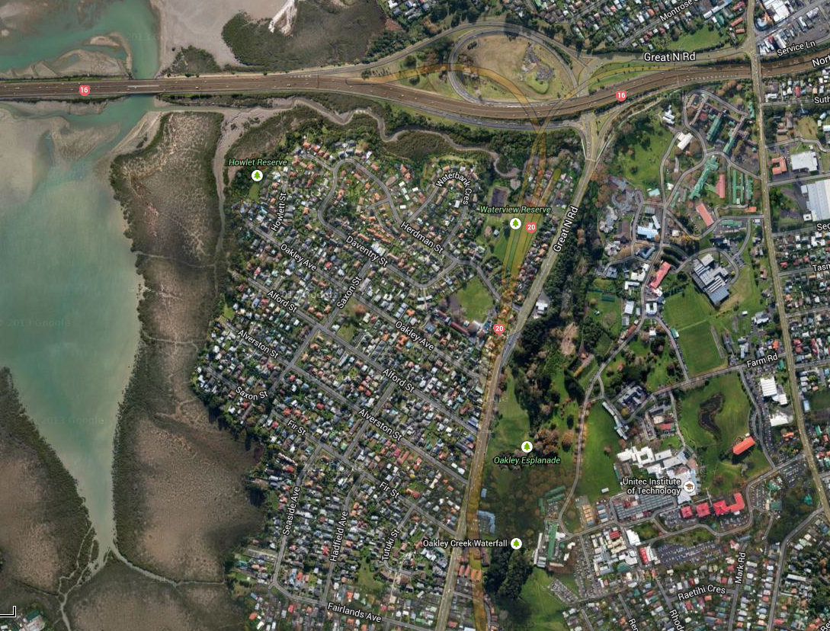

Slide 5
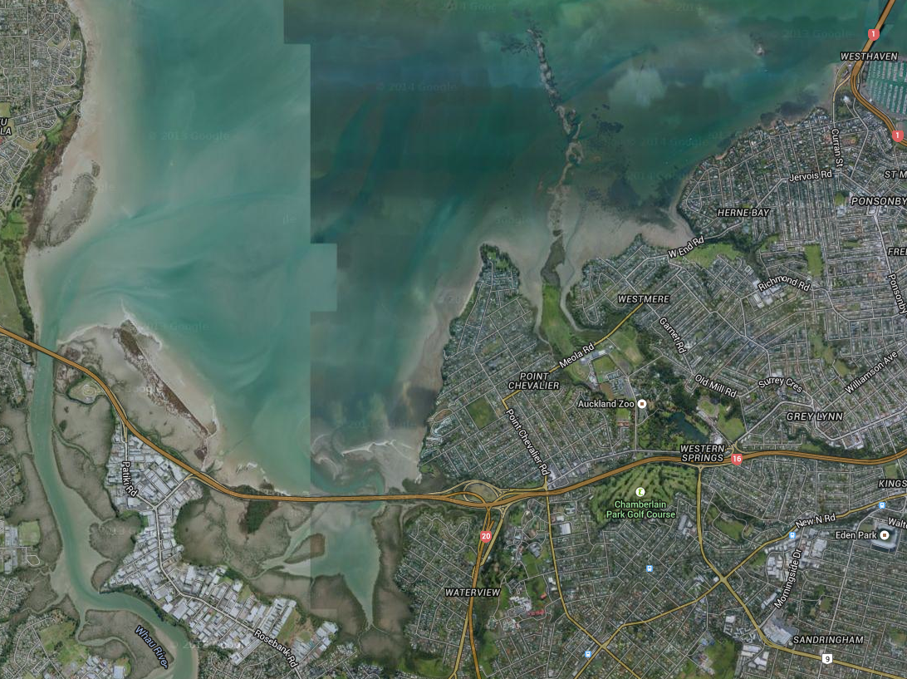

Slide 6
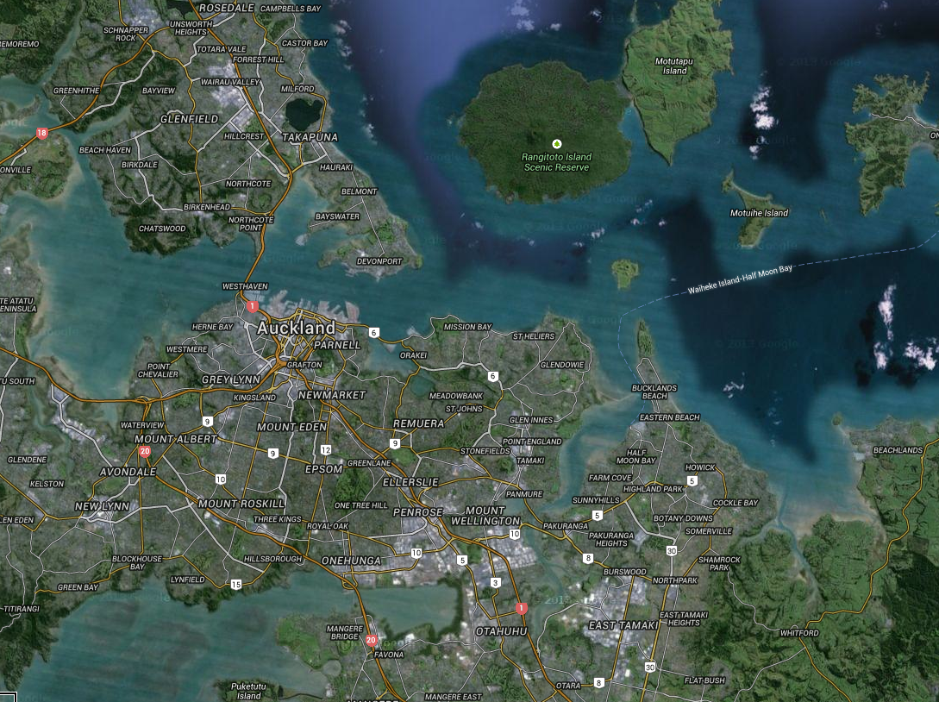

Slide 7
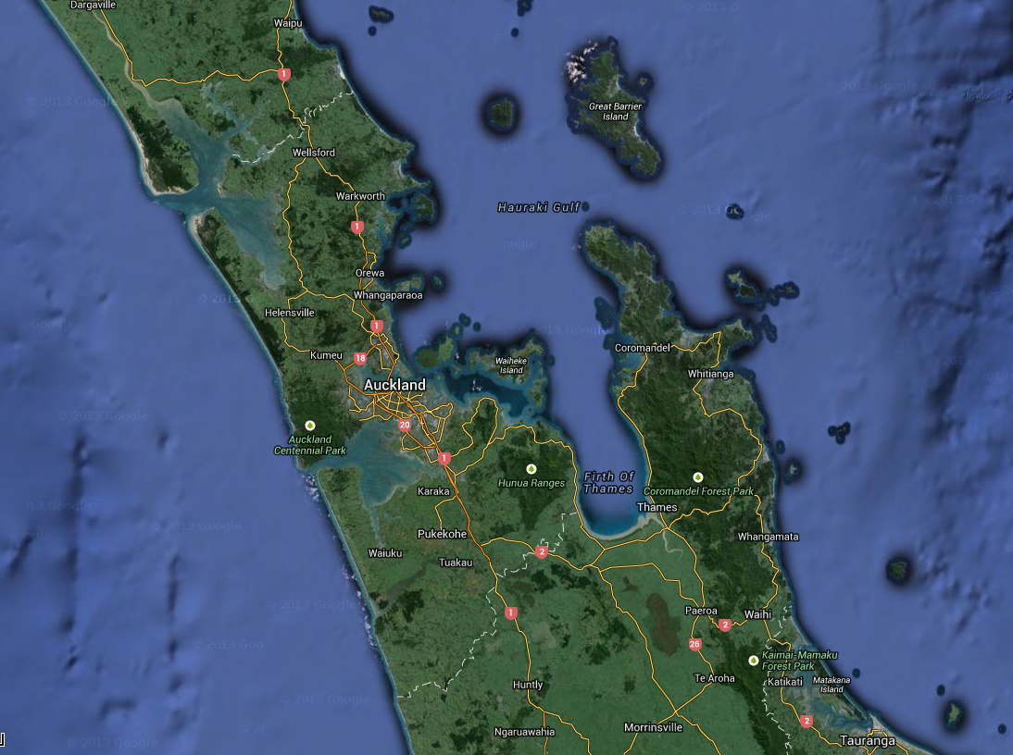

Slide 8
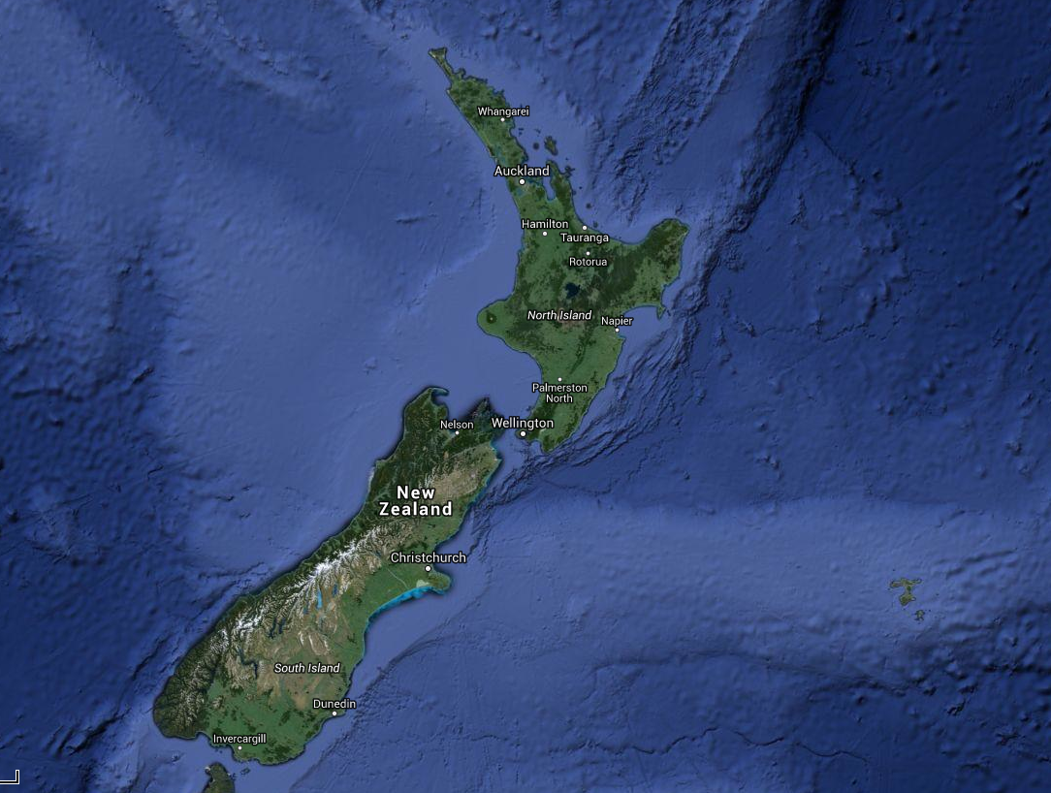

Slide 9
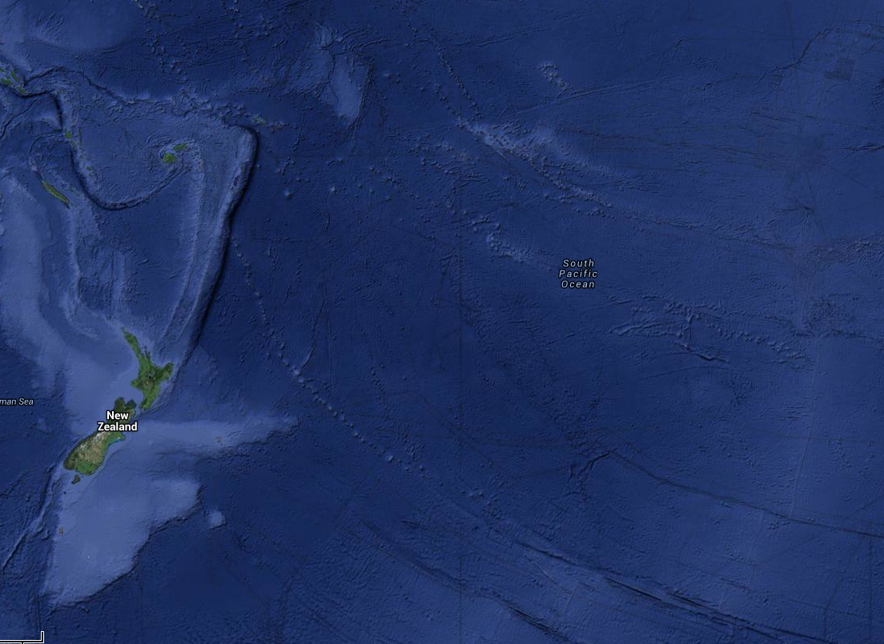

Slide 10
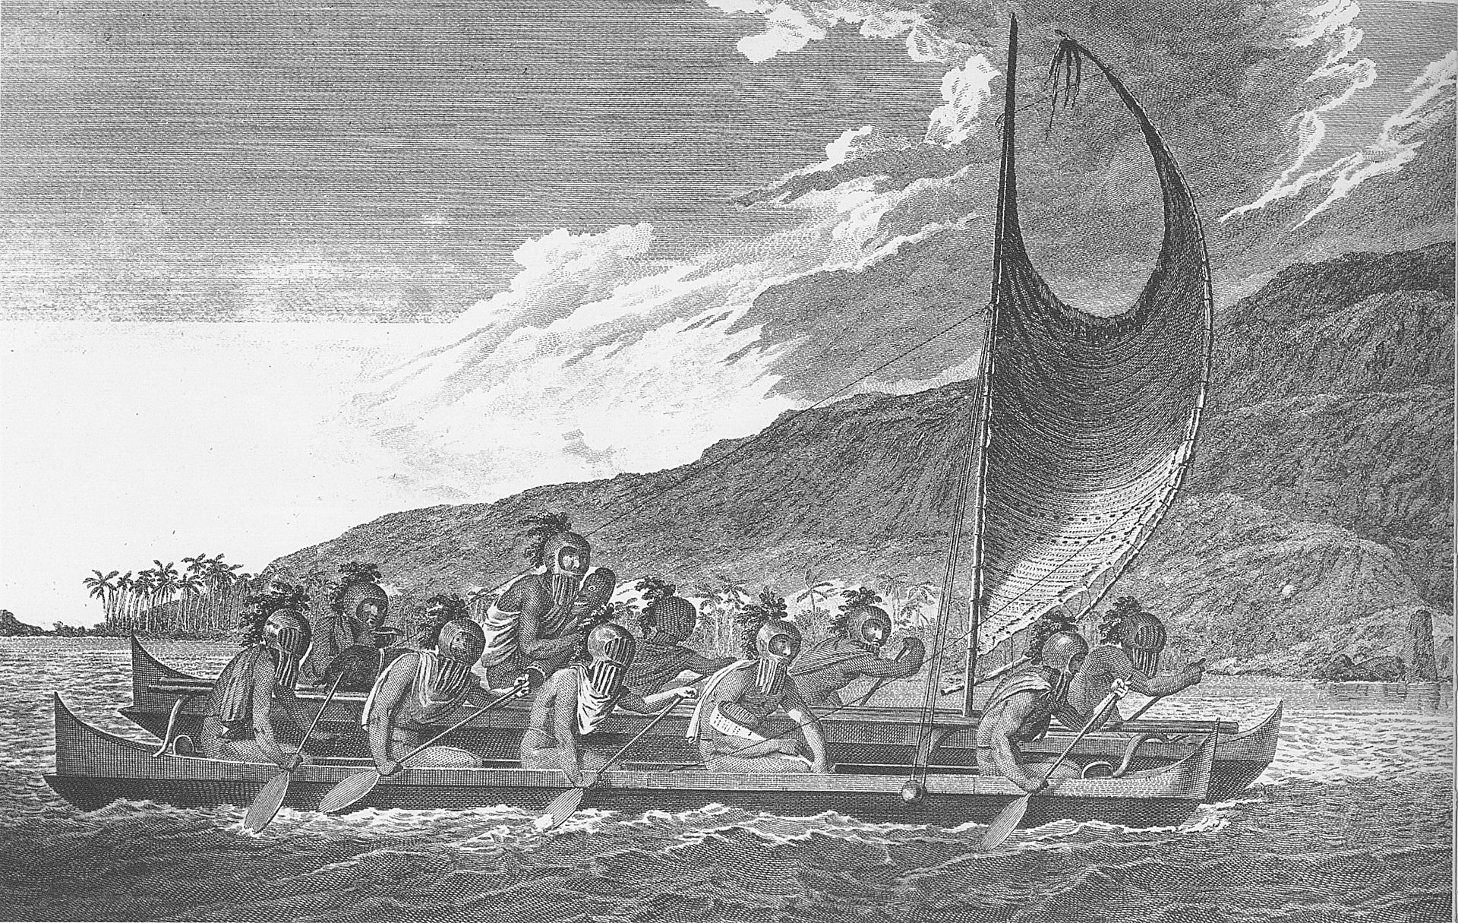

Slide 11
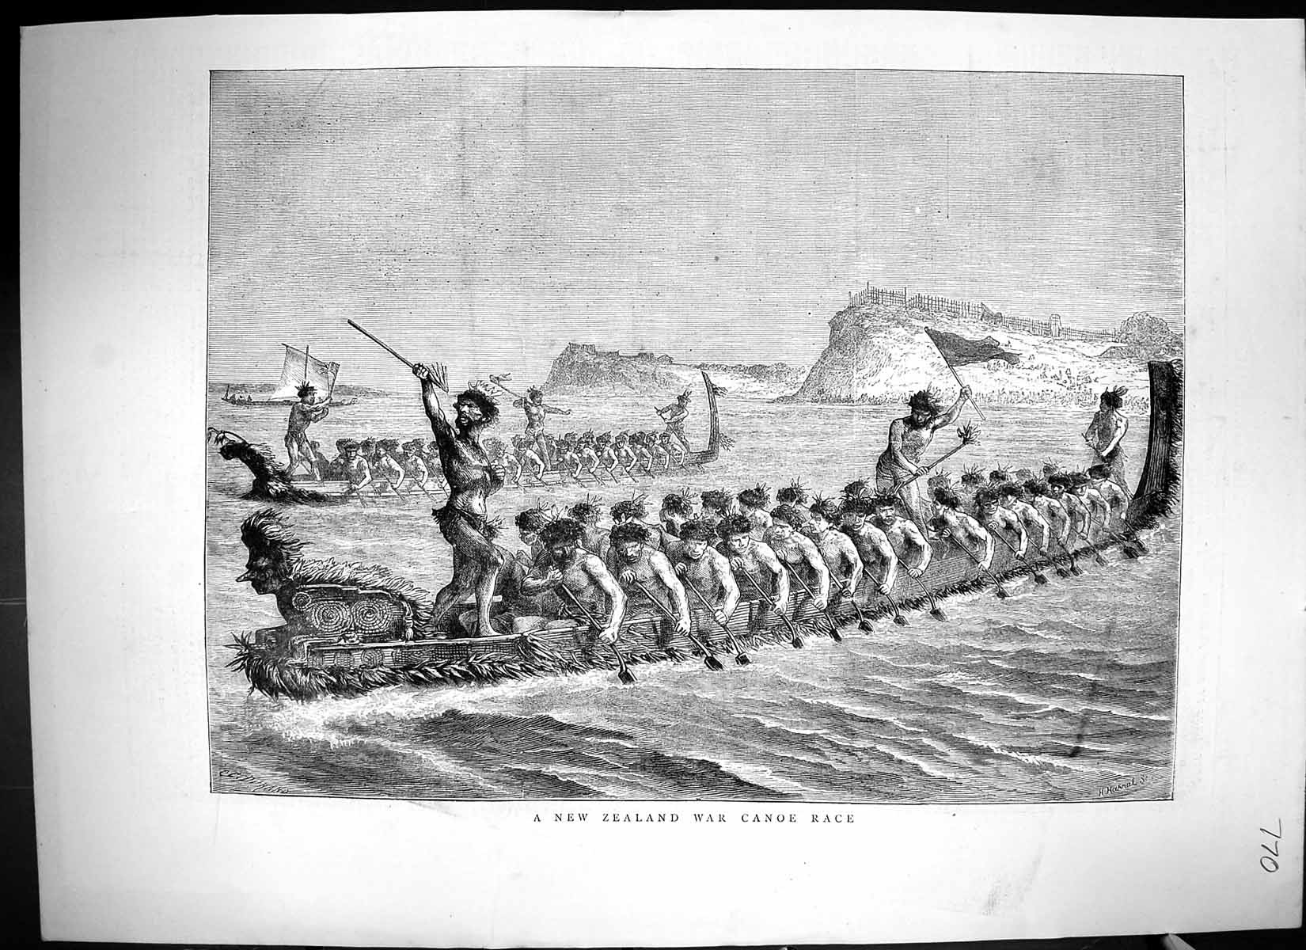

Slide 12
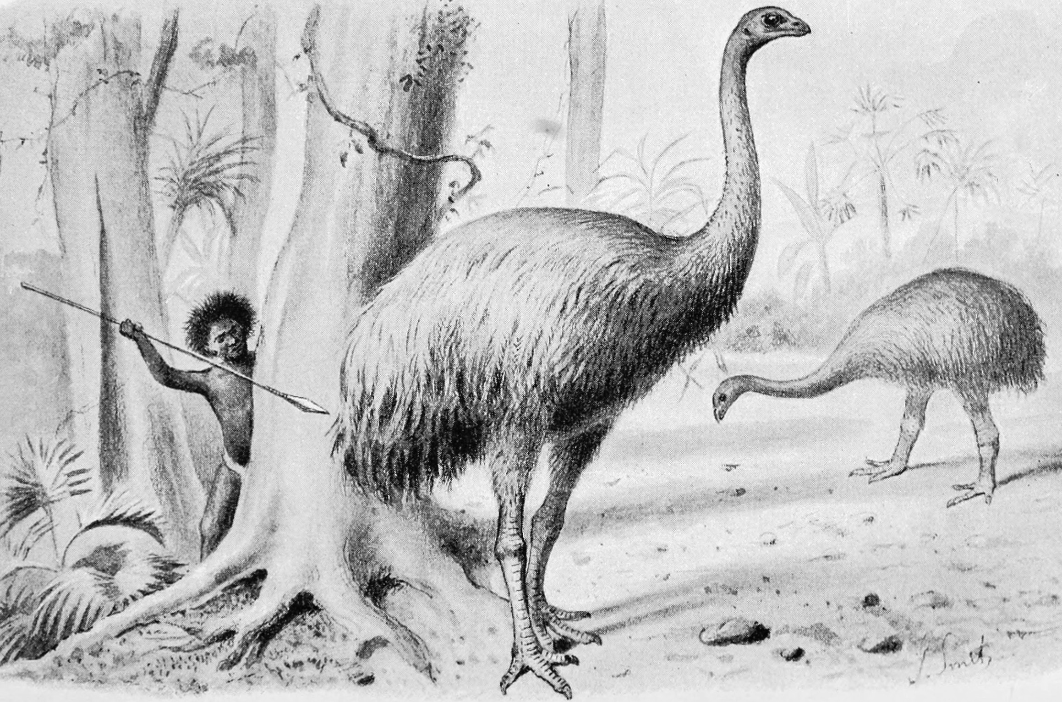

Slide 13
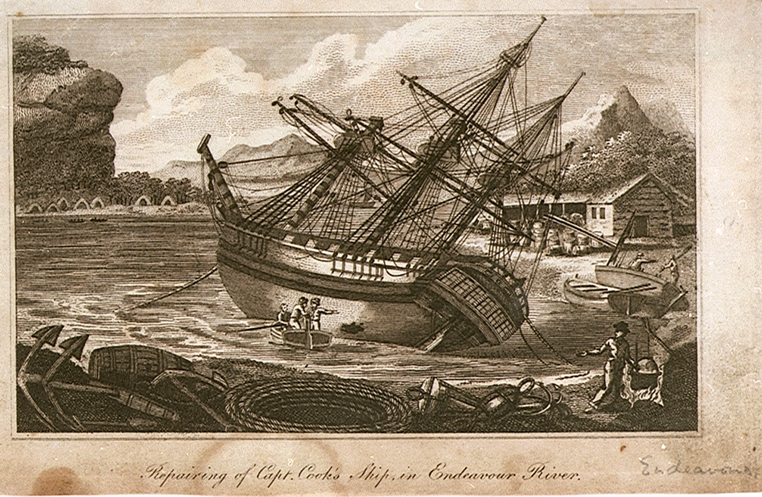

Slide 14
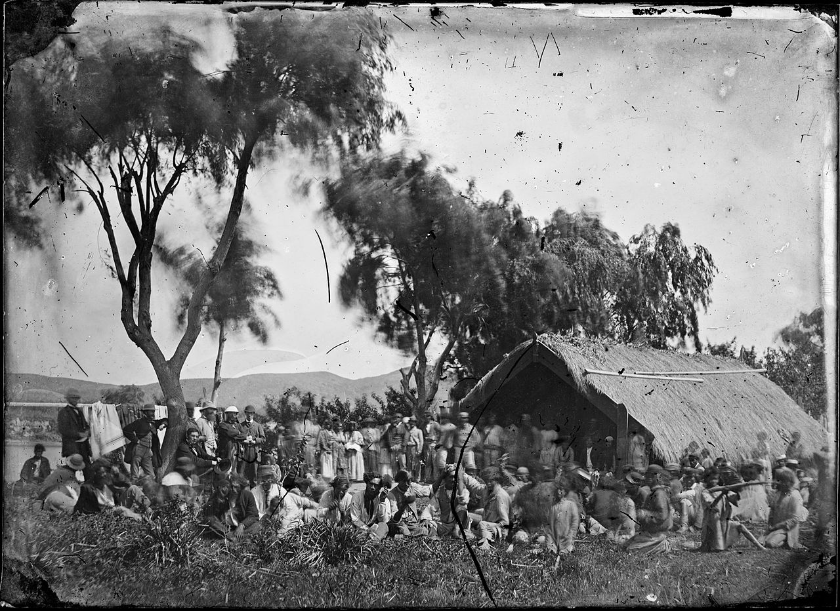

Slide 15


Slide 16
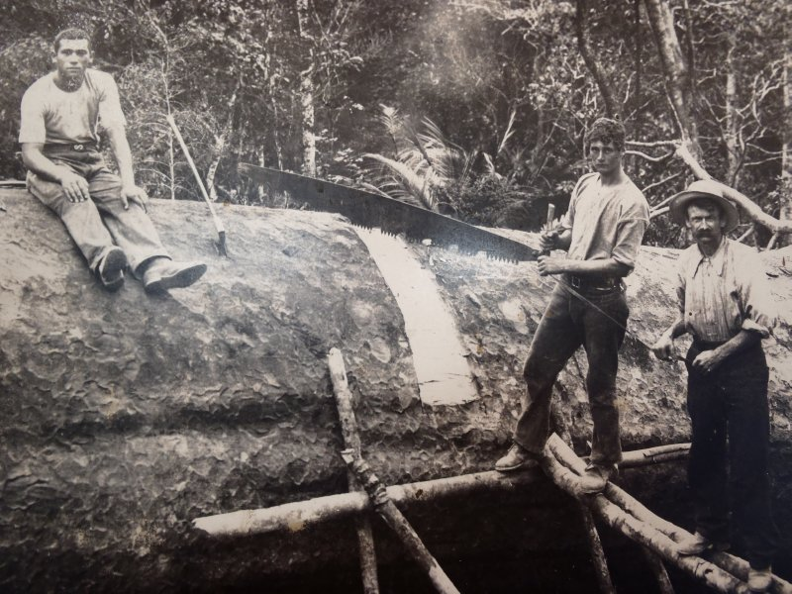

Slide 17


Slide 18
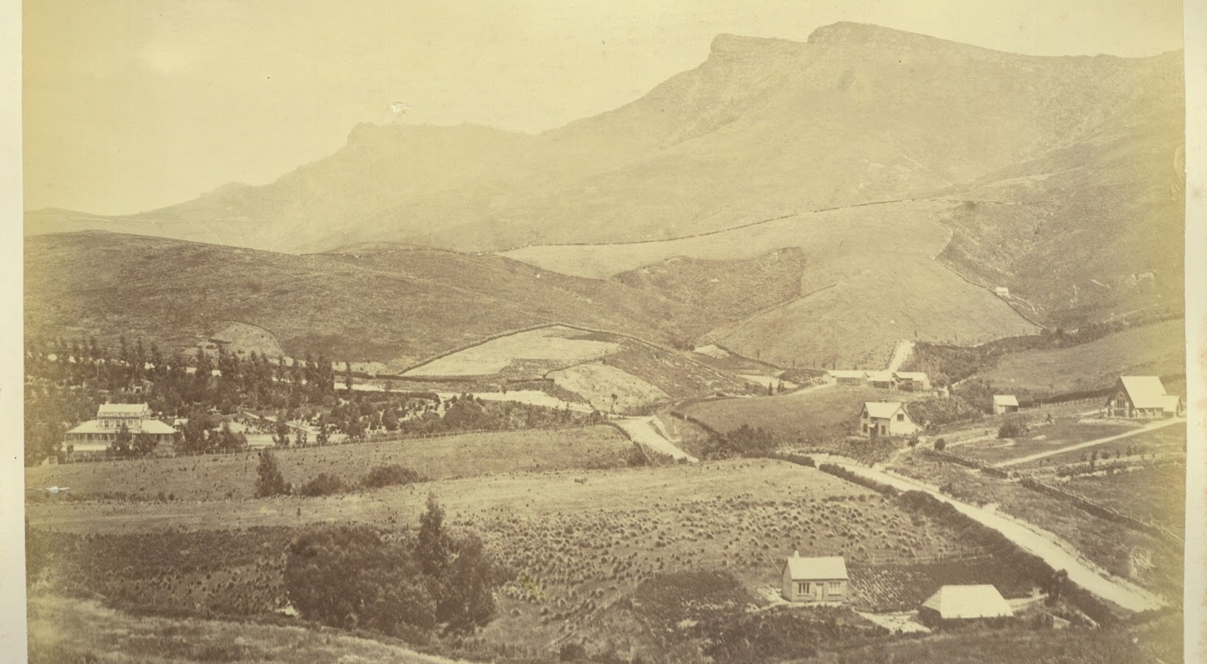

Slide 19


Slide 20
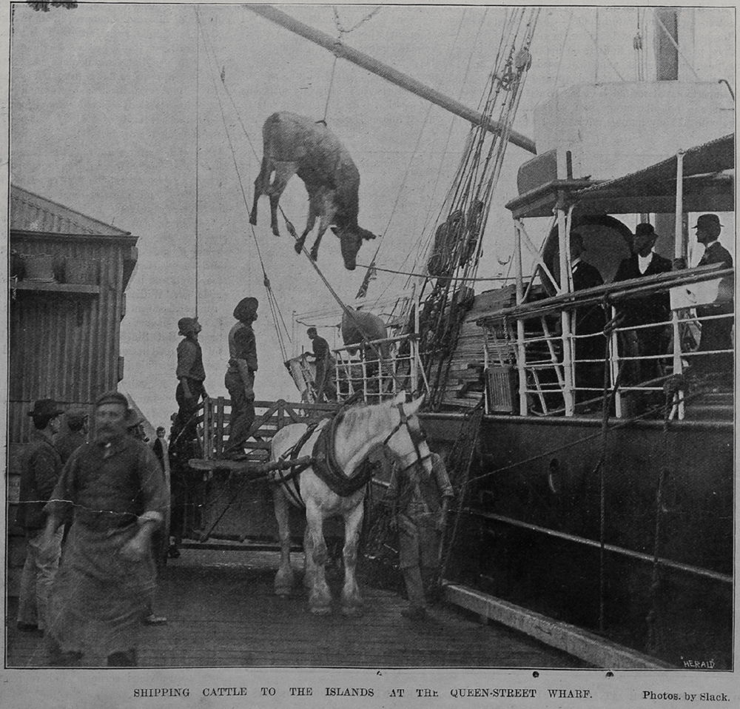

Slide 21
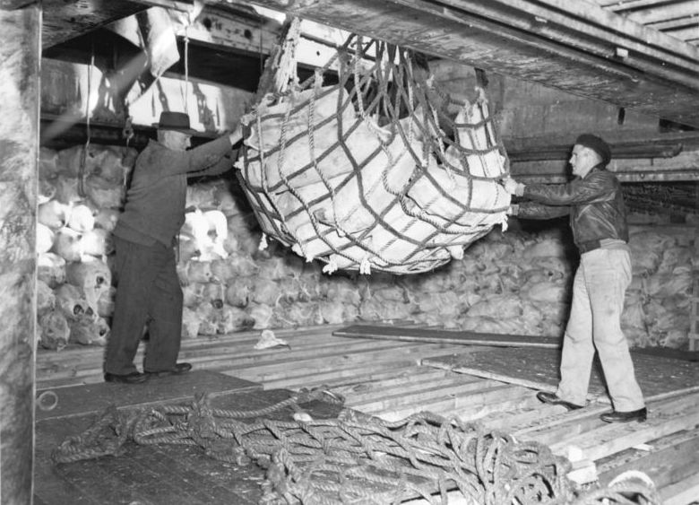

Slide 22

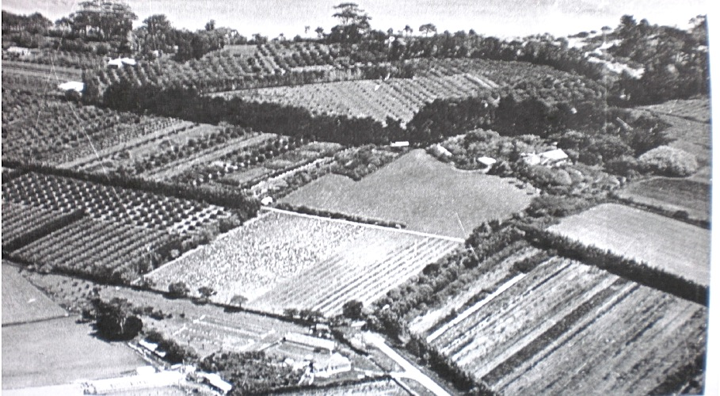

Slide 23


Slide 24
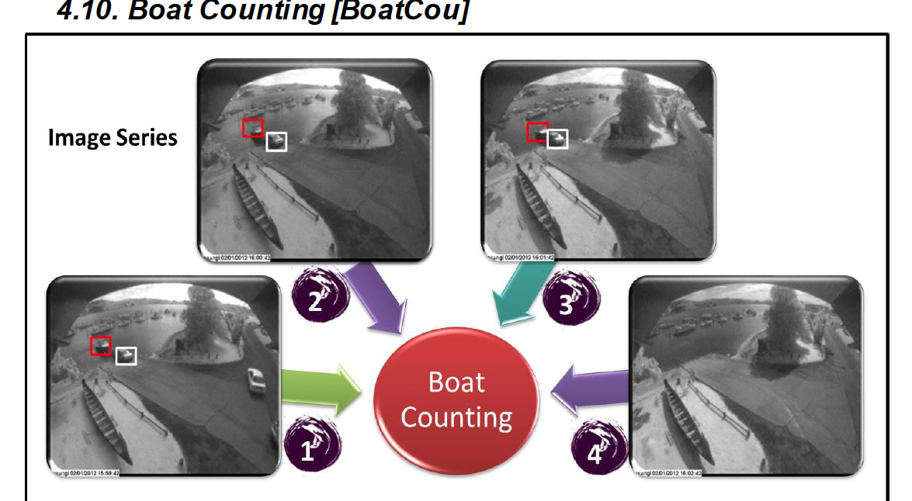

Slide 25
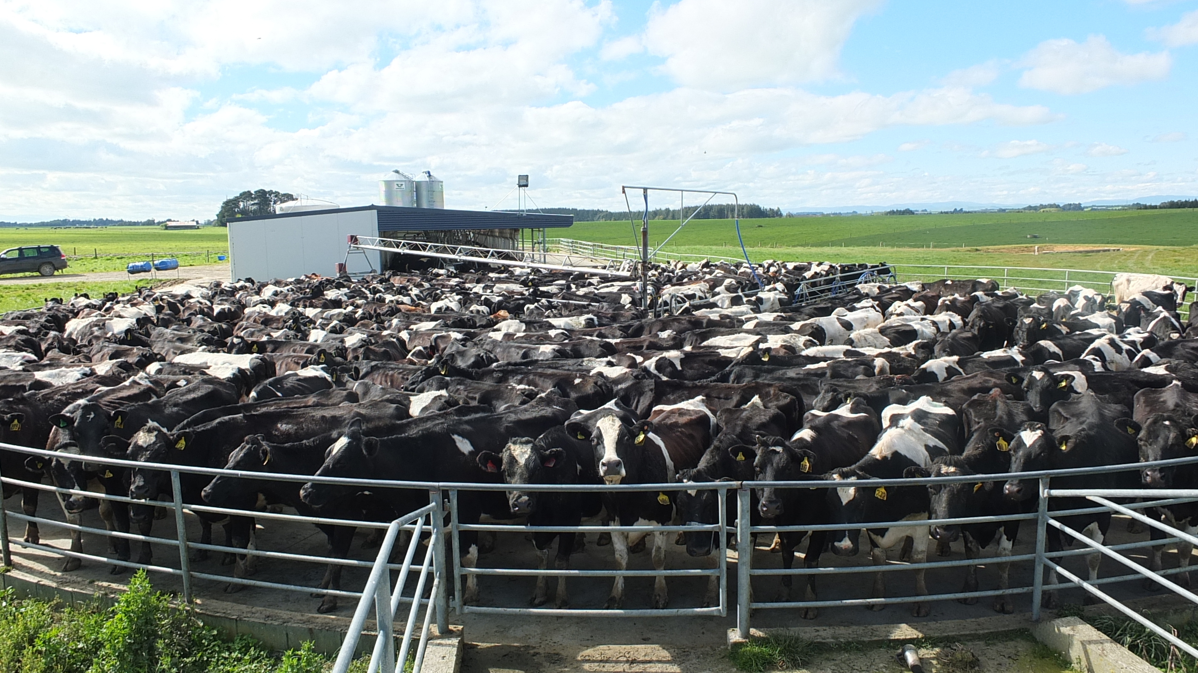

Slide 26
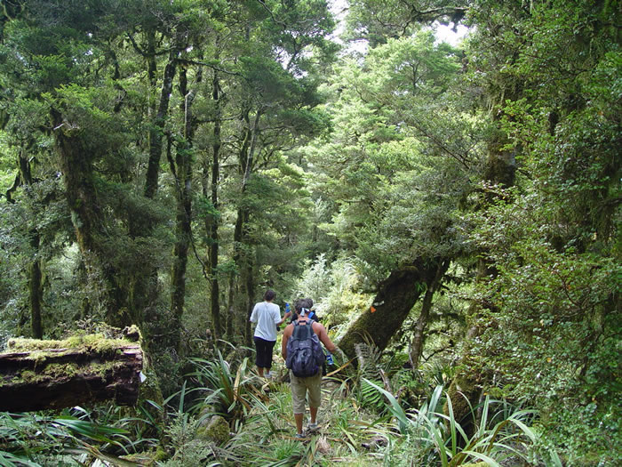


Slide 27
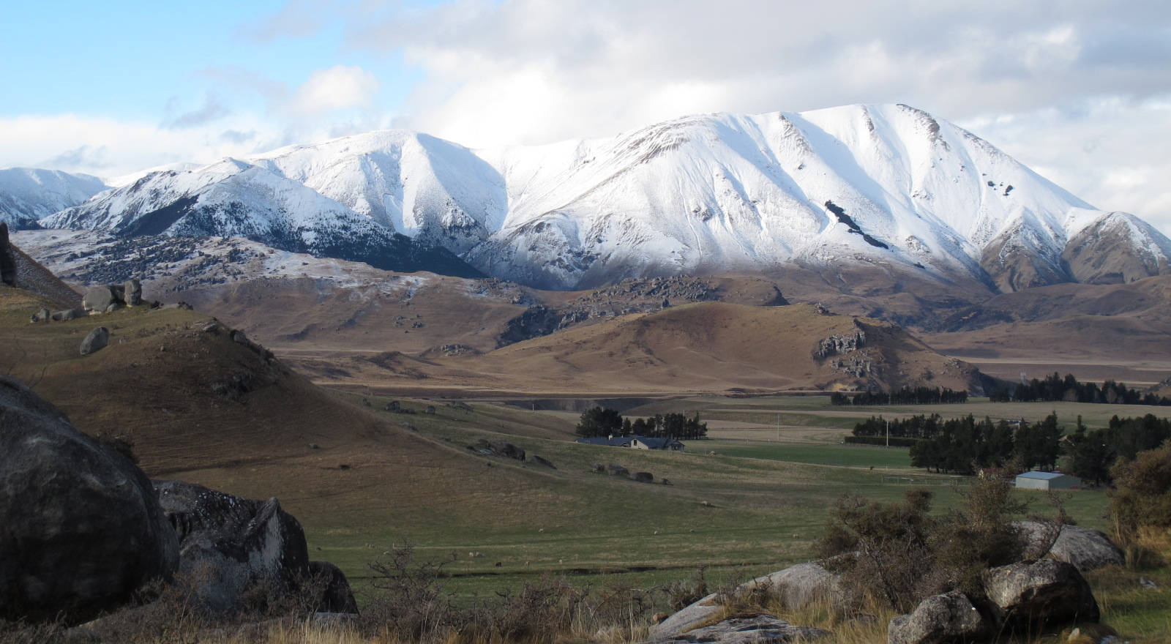

Slide 28
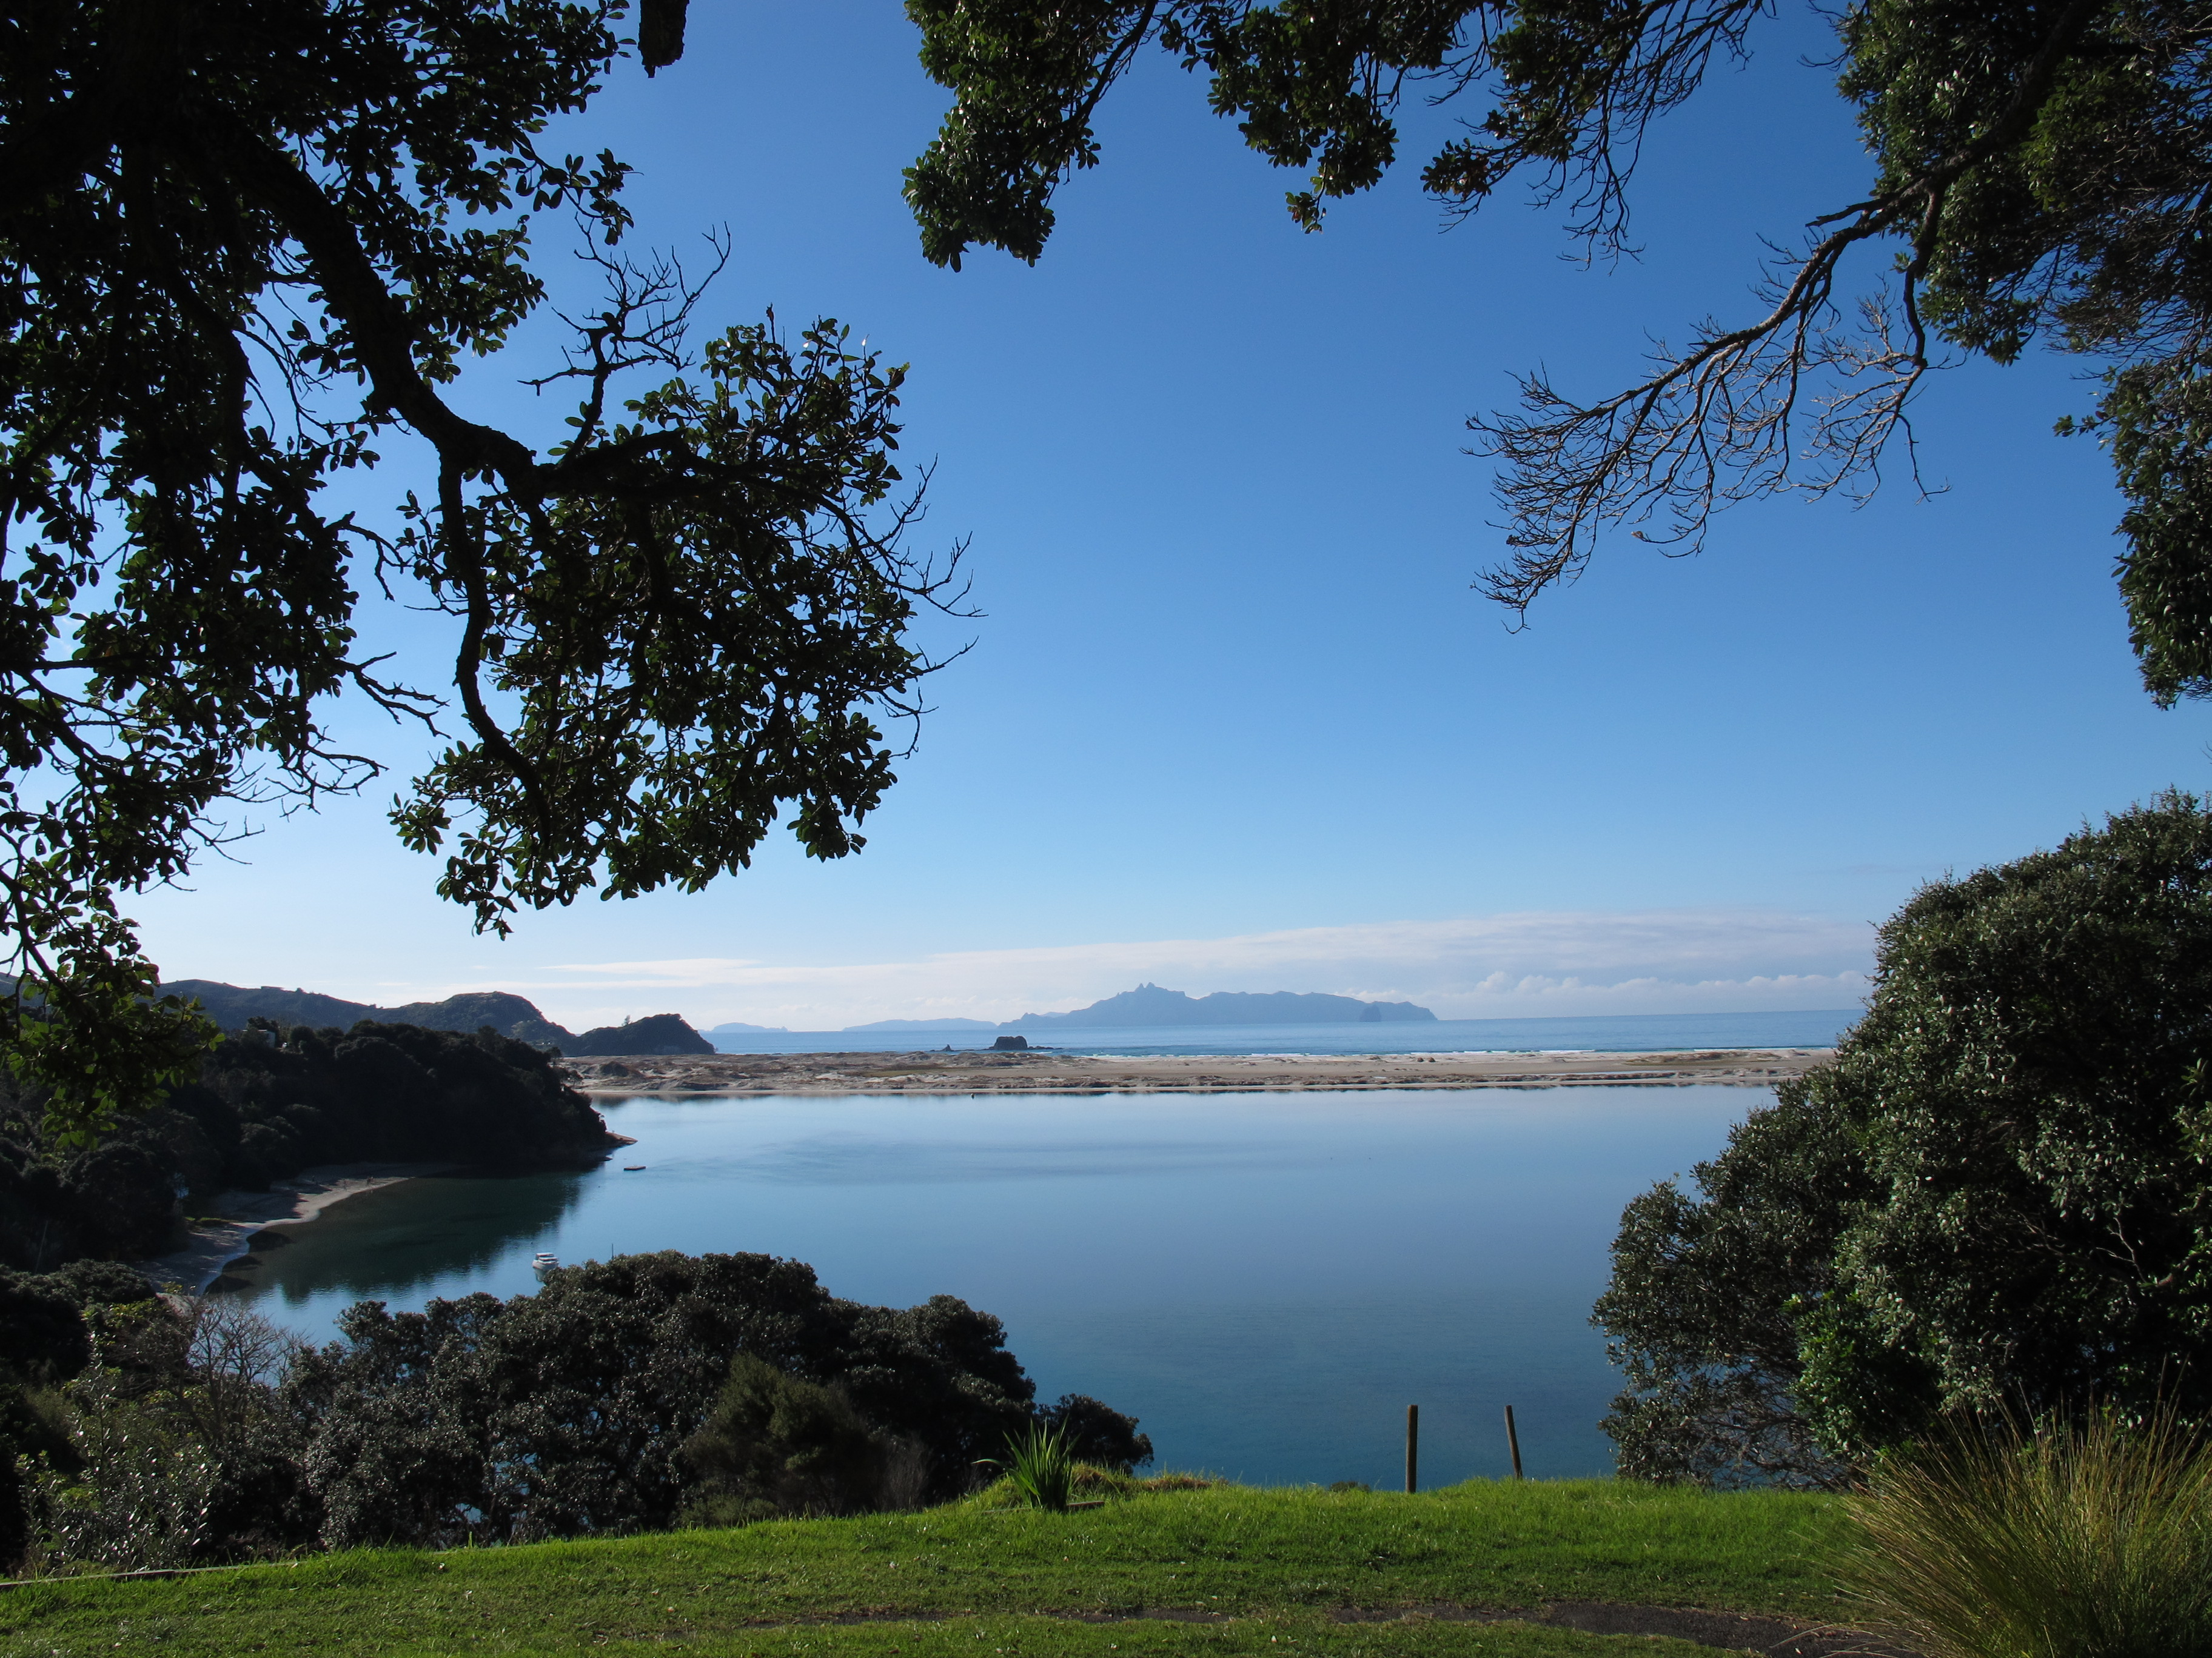

Slide 29


Slide 30
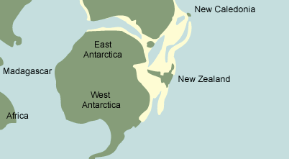

Slide 31
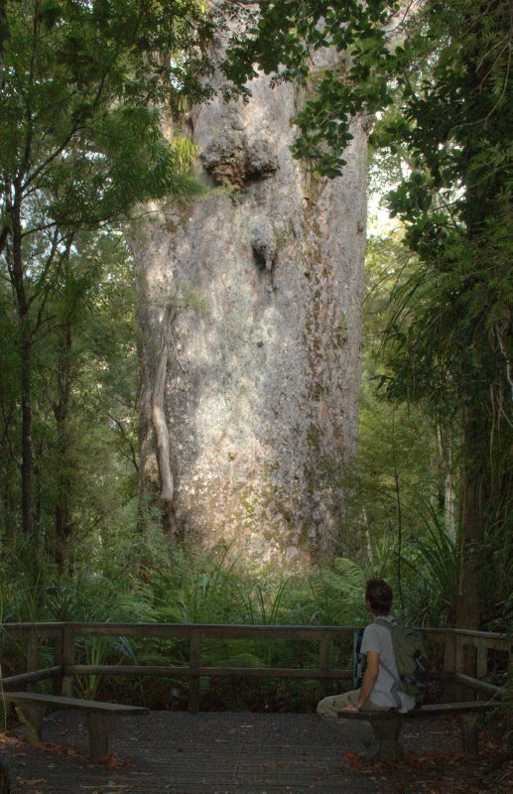
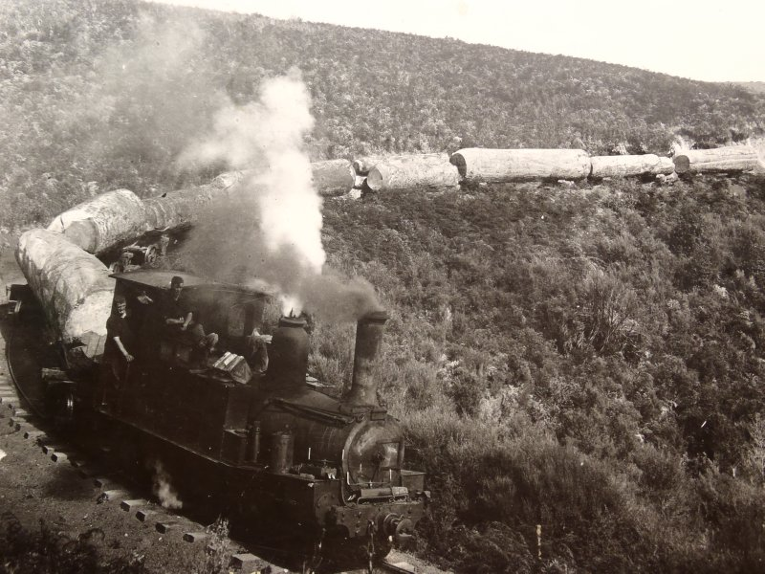

Slide 32
New Zealand - economy, challenges, R&D

Slide 33

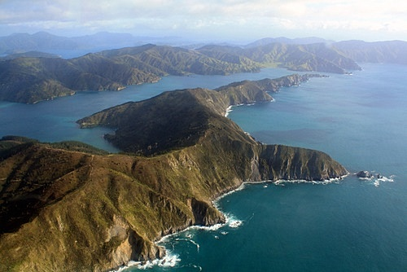
4.471 million people
268 square kilometers land area
15000 kilometers of coastline
GDP NZ$231 billion (US$181b)

Slide 34
Since 1984, the government of New Zealand has undertaken major economic restructuring, moving an agrarian economy dependent on concessionary British market access toward a more industrialised, free market economy that can compete globally.

Slide 35
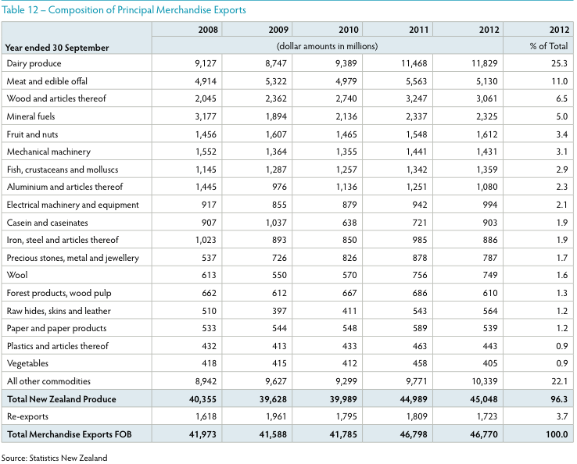
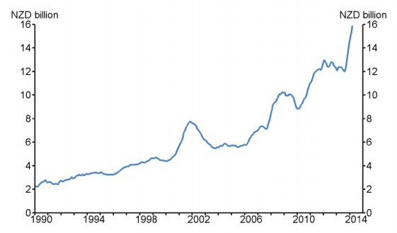
55.3% Primary Industries

Slide 36
“…education and research, together with innovation, are often
referred to as the knowledge triangle. They are at the core of
today’s economies and drive economic
growth...”.1
OECD - Science, Technology and Industry Scoreboard (2011)

Slide 37
1. Producing excellent science of the highest quality
2. Ensuring value by focusing on relevant science with the highest potential for impact for the benefit of New Zealand
3. Committing to continue increasing investment over time
4. Increasing focus on sectors of future need or growth
5. Increasing the scale of industry-led research
6. Continuing to implement Vision Mātauranga
7. Strengthening and building international relationships to strengthen
the capacity of our science system to benefit New Zealanders

Slide 38
Performance Based Research Fund NZ$294m
Marsden Fund NZ$51m
Centre for Research Excellence (CoRE) NZ$50m
Callahan Innovation NZ$123m
National Science Challenges NZ$47m
Crown Research Institute NZ$47m
MBIE (commercialisation/specific sector NZ$218m
Primary Growth Partnerships NZ$83m
Business R&D NZ$141m

Slide 39
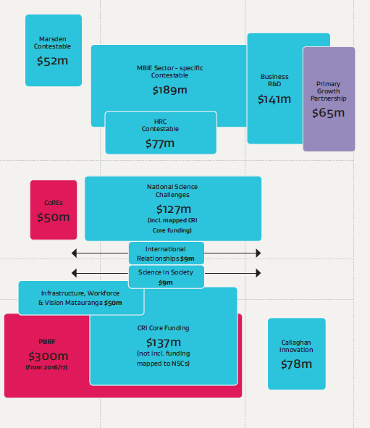

Slide 40
9 universities
25 tertiary education organisations
Two thirds state subsidised with a loan system
Mismatch between industry needs and graduate profile
Not enough STEM graduates

Slide 41
Some world trends

Slide 42
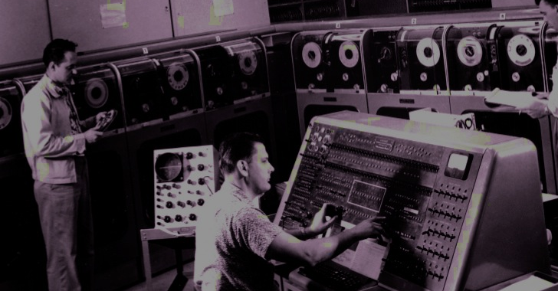
The new invisible college represents a challenge to the Big Science paradigm that has dominated since the end of World War II. The Big Science system was based on the idea of scientists working on behalf of national interests, funded and led by national agencies such as the National Science Foundation. The system represented by the new invisible college is international in scope and scale and is outside the direct funding and control of any national organization. It behaves almost like a high-tech version of the Republic of Letters, an Enlightenment-era network of scholars.
The demise of Big Science

Slide 43
The rapidly increasing churn of knowledge
“The half-life of medical knowledge is seven years”.
Dr. Michael Gold, Medical University of South Carolina

Slide 44

The need for more flexible, accessible education for greater numbers of people
More than sixty percent of students enrolled are now over twenty-five and more than sixty percent of students are now working full-time while pursuing their education.
In the next 30 years more young people will finish their education than in the rest of history.
Stephen Heppell

Slide 45
More than 300 million under employed young people (18 – 25)
Graduate profile – employer need mismatch

Slide 46
Unitec

Slide 47
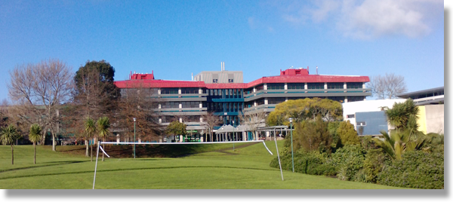
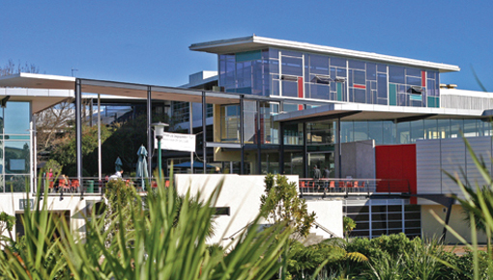
One of largest TEOs
over 23,000 students
over 160 programmes
over 55 hectares of land
3 campuses

Slide 48
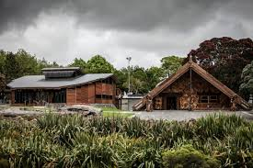


Slide 49
Unitec Transformation

Slide 50
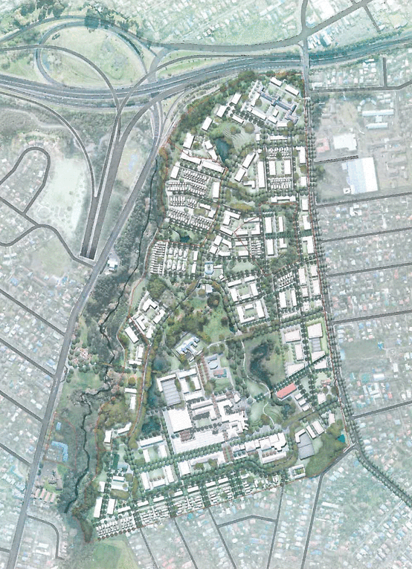

Slide 51

- Develop 21 Century Learning Environments
- Invest in Digital Literacies and Infrastructure
- Diversify Revenue Streams
- Reframe the Workforce
- Engage with industry

Slide 52
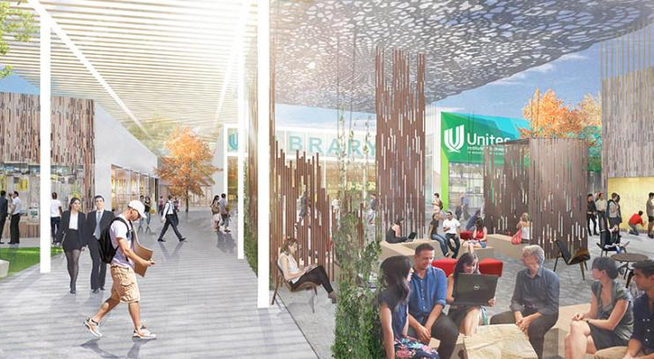

Slide 53
the mind lab
digital literacy for primary/secondary teachers
partnered business model
student centered/project based

Slide 54

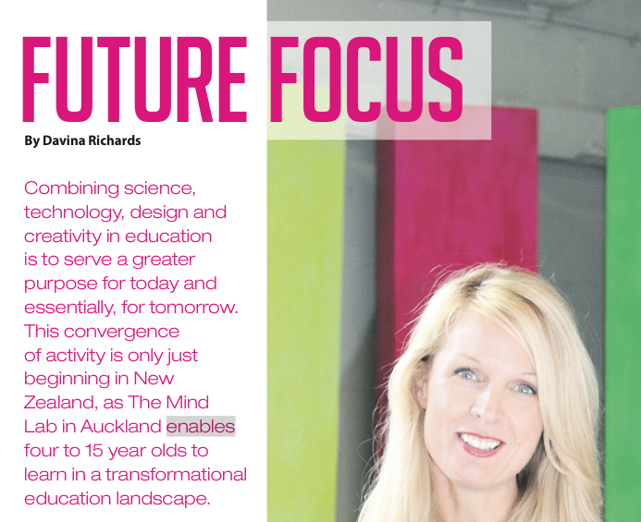
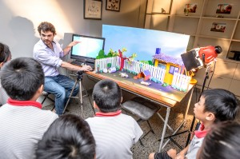
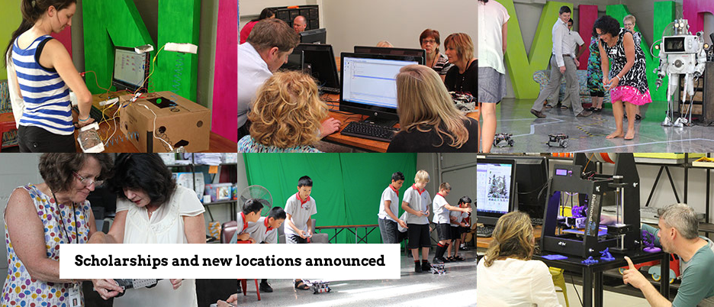

Slide 55
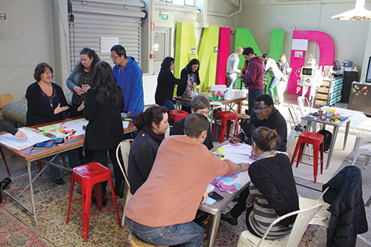

Slide 56
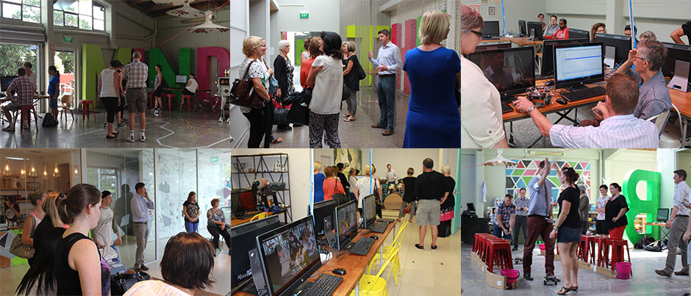

Slide 57
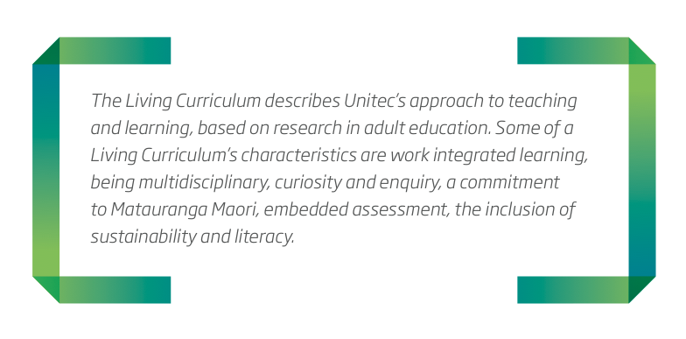

Slide 58
Unitec programmes will have a living curriculum that :
a) involves complex conversations
b) is curiosity/inquiry led, and stimulating
c) integrates learning with work
d) is socially constructed – self-sufficiency and collaboration are equally valued, and together they help nurture resourcefulness and resilience
e) blends face-to-face and web-based learning
f) is research-informed and encourages research engagement where appropriate
g) has a discipline base, and is also interdisciplinary
h) develops literacies for life-long learning
i) includes embedded assessment
j) considers issues of sustainability

Slide 59
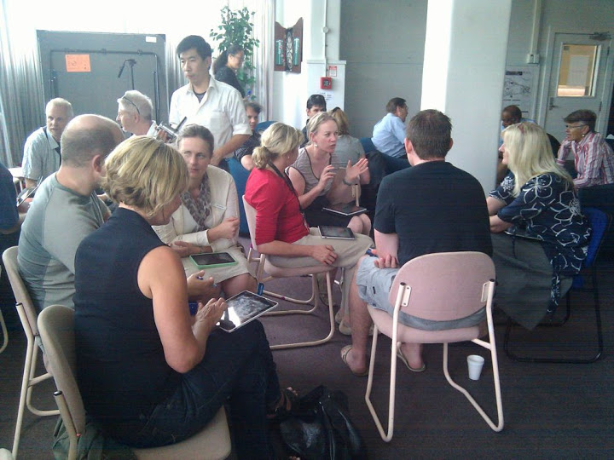
a) involves complex conversations

Slide 60
project based learning
“researchers found that there were fewer attention lapses reported during active-learning methods compared to those reported during lecture segments” Bunce et al. (2010)

Slide 61
student centered learning
"We can do a much better job of college admissions, as well as instruction and assessment, if we think about student abilities in a broader way than we have in particular, by valuing, assessing, and teaching for analytical, creative, practical, and wisdom-based skills.”
Robert Sternberg

Slide 62
flipped learning
Students engage in the content when and where they wish.
Class is where you have a complex conversation about that content
Casual learning is enhanced by the physical and virtual environments

Slide 63
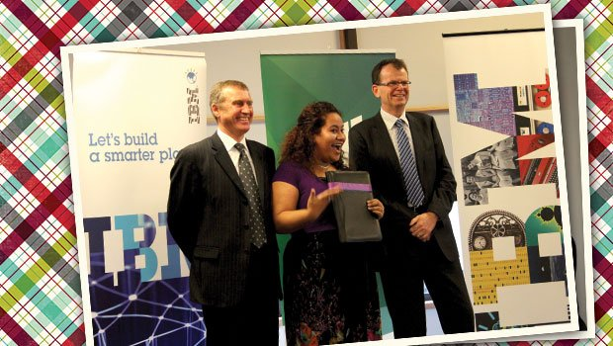
c) integrates learning with work

Slide 64
work integrated learning
- onsite business and innovation hub
- degrees with “work in companies” components
- doctoral programme for industry
- research and education partnered with industry

Slide 65
research vouchers
- insentivising industry partnership
- Creates industry partnerships for teaching and learning
- doctoral programme for industry
- research and education partnered with industry

Slide 66
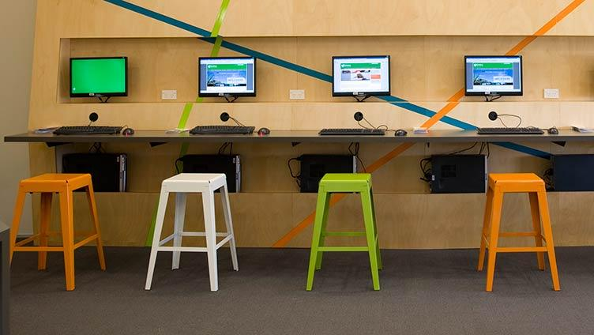
h) develops literacies for life-long learning

Slide 67
research and soft skills
accessing information and data
utilising online systems
working in industry
working in collaborative teams

Slide 68
Unitec Innovation in Education

Slide 69
why eLearning
- to meet the service expectations of students, staff and stakeholders
- to allow an institution to enhance the quality of the student learning experience
- to increase enrolments by targeting new groups of potential students
- to deliver teaching services more efficiently

Slide 70
eLearning is not a cost saving tool
- Unitec has invested in eLearning facilitators
- It will be investing in a new eLearning Management System
- The next step is to invest in the development of online resources instructional designer, a multimedia expert and a web developer who will work alongside the teacher in a ‘production team.’

Slide 71
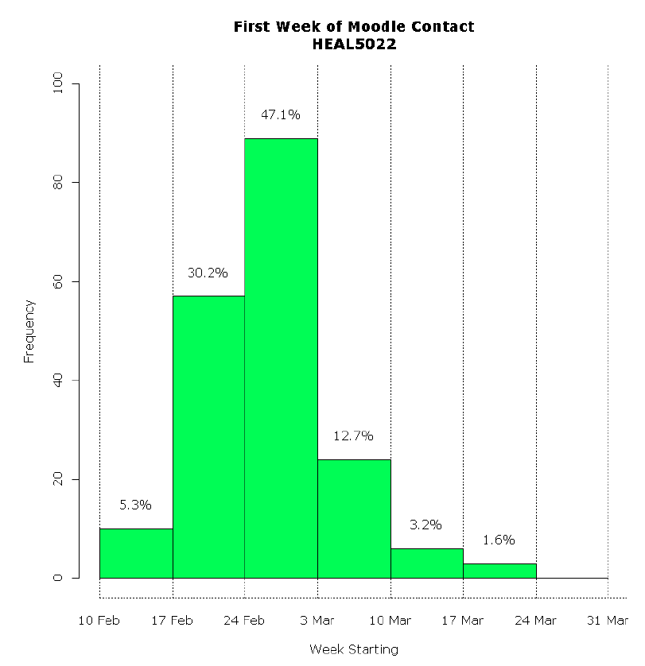
Using data-mining tools, Unitec will start linking student transcripts to wage data records, drawing connections between success at school and success in the workplace. Unitec will track not only the employment success of the students (e.g., first job) but also the career path of all the graduates (e.g., second and third jobs and promotions received) in order to get the real picture of the value of the institution's programmes. This is also true of the provision of lessons and learning styles.

Slide 72
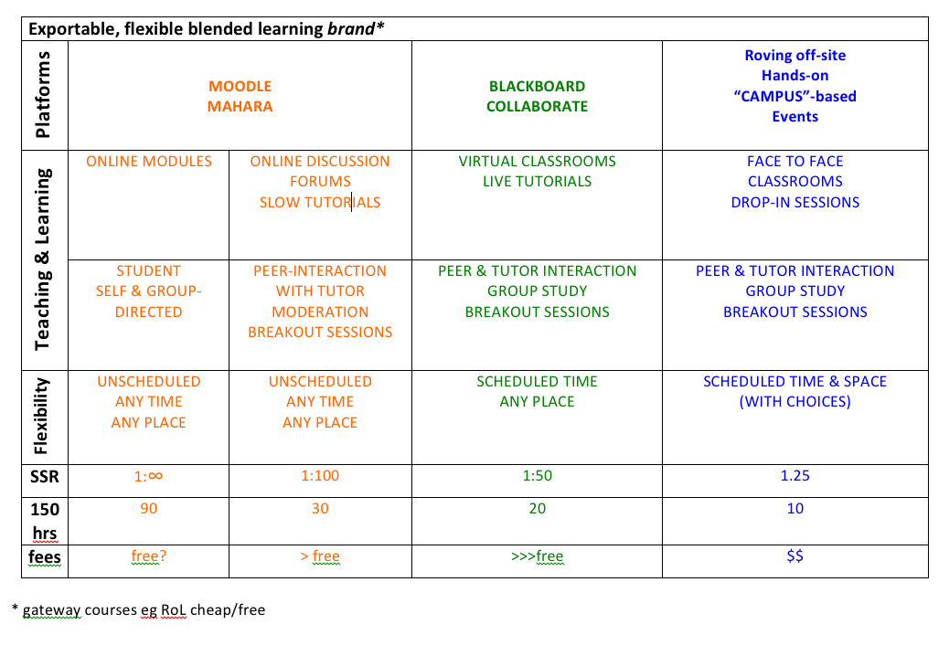

Slide 73
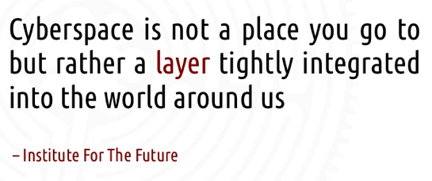

Slide 74
