Slide 1
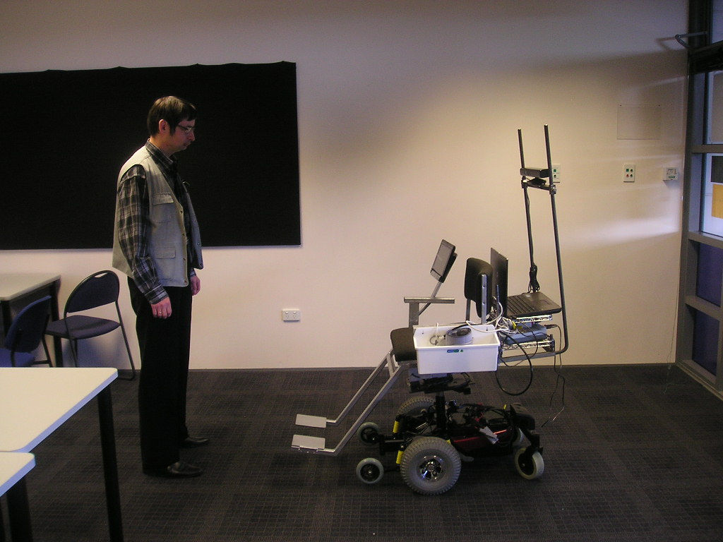
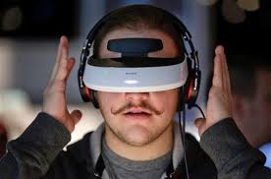
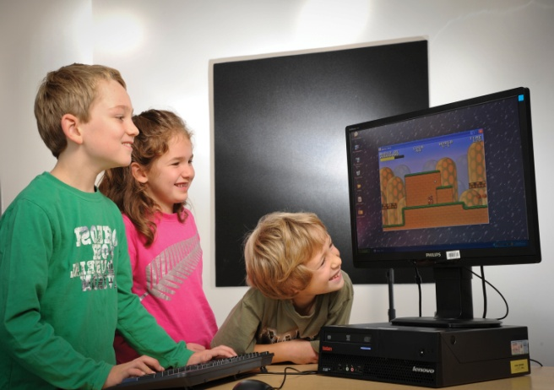
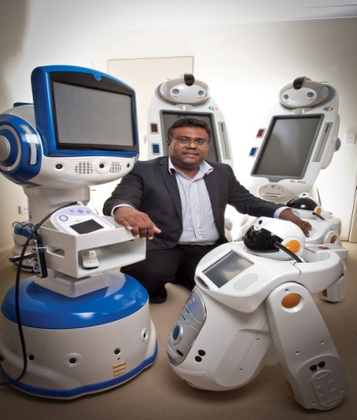



Professor & Head of Department
Department of Computing
Impacting our societies and knowledge economies –
Research and Education in new and emerging information technologies at Unitec Institute of Technology

Slide 2

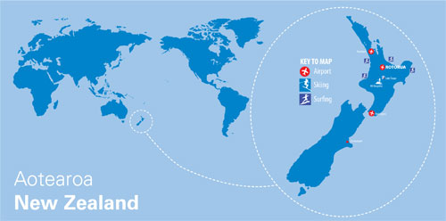

Slide 3


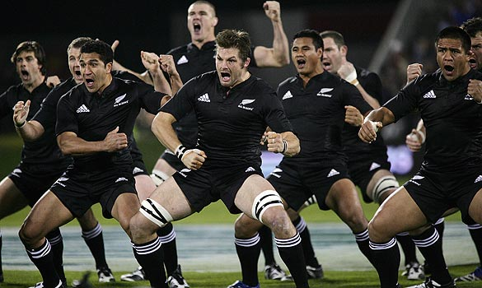
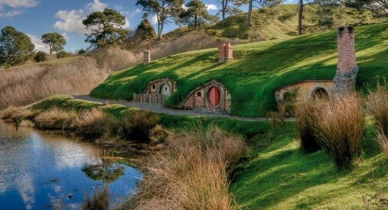

Slide 4
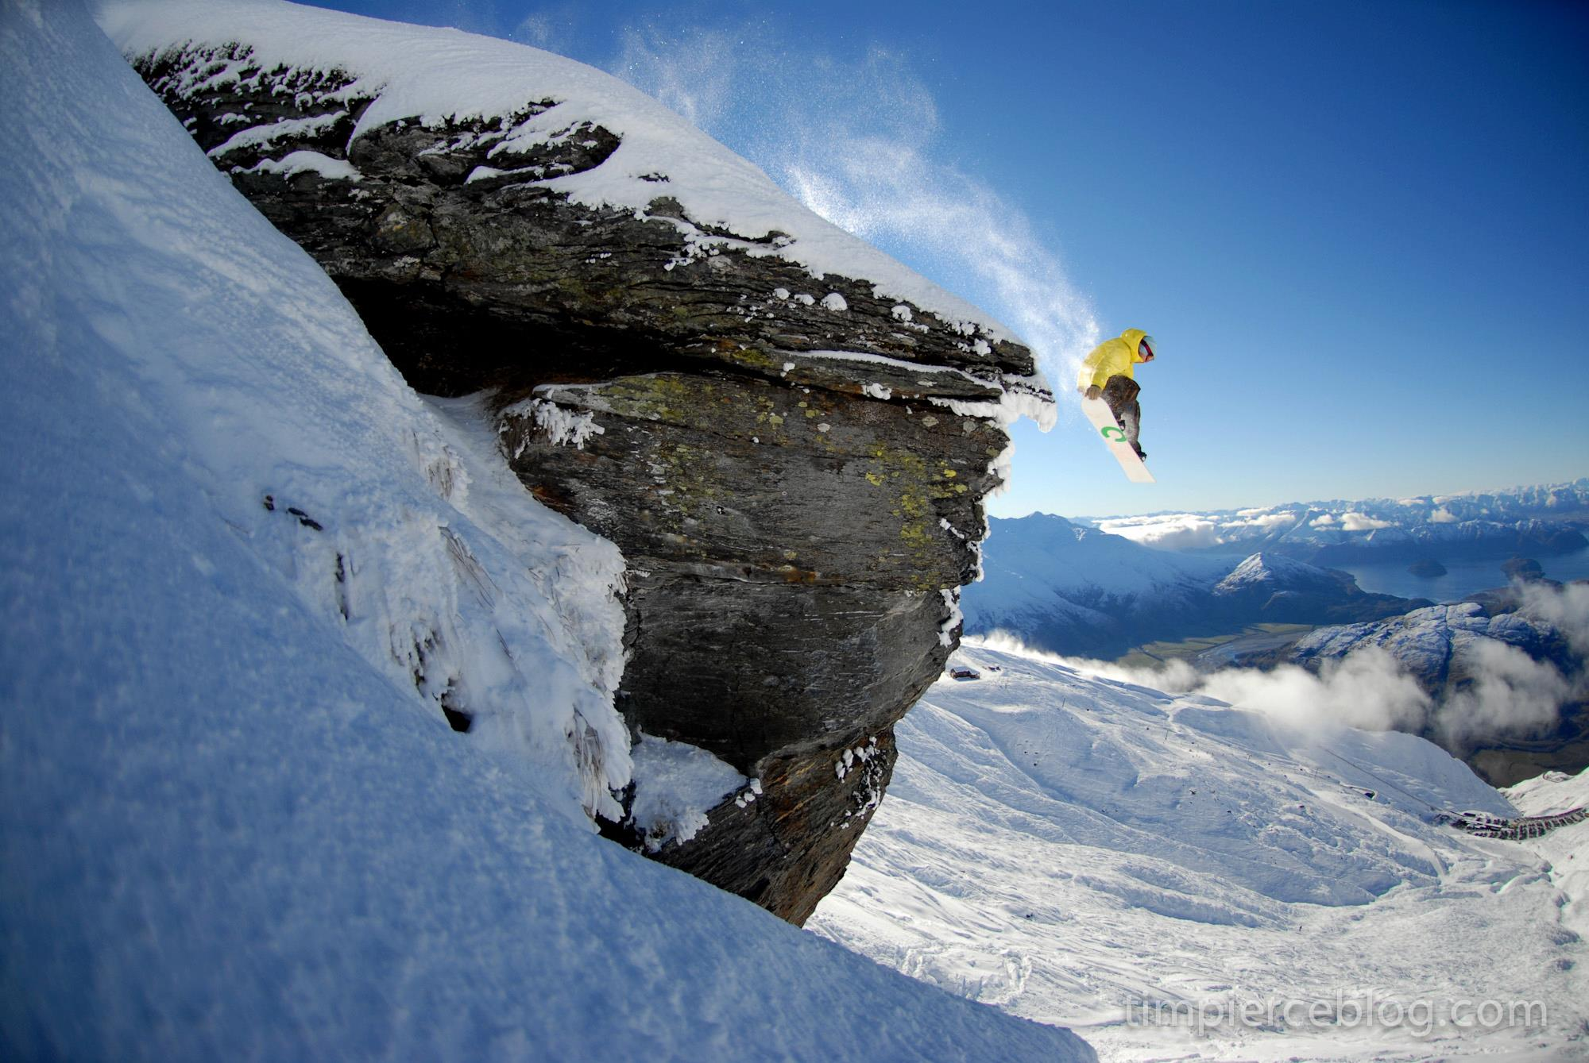


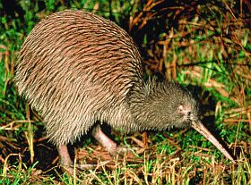

Slide 5


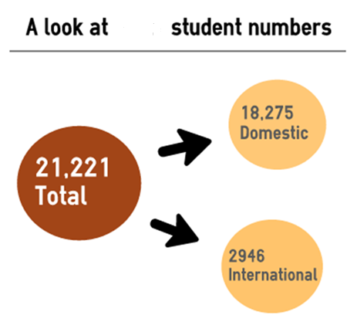

Unitec
Over 160 programmes
3 campuses
55 hectare main campus
>> UNITEC INSTITUTE OF TECHNOLOGY
Kuching Presentation<<
Notes:
J 4 mins
Demand vs supply… We are now demand driven
ITO leadership role worked with industry to confirm the need through research

Slide 6
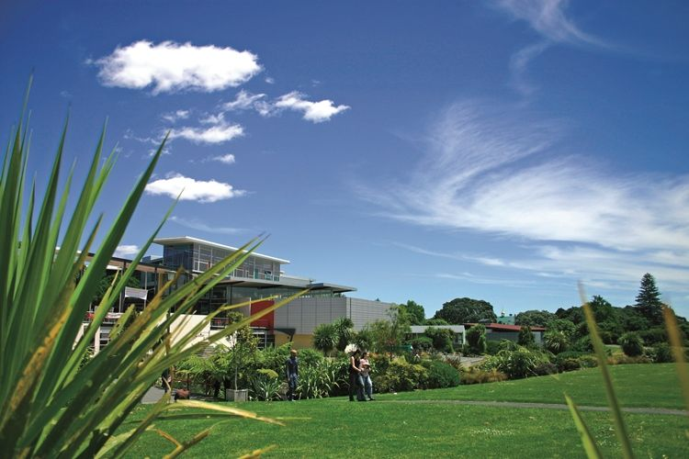

Slide 7


Slide 8


Nearly 62,000 New Zealanders work in information and communication technology currently but economists predict that by 2017 this number could double and reach 80,000.
Exciting Field of
Information Technology
Information technology will be an employment machine, generating 5.8 million new jobs in the coming four years, according to International Data Corporation (IDC) research released.
The US Cyber Security market needs 40,000 experts in this area and there is only 2000 in the entire country (Report to President Obama, Washington Post 2013)
Kuching Presentation<<

Slide 9
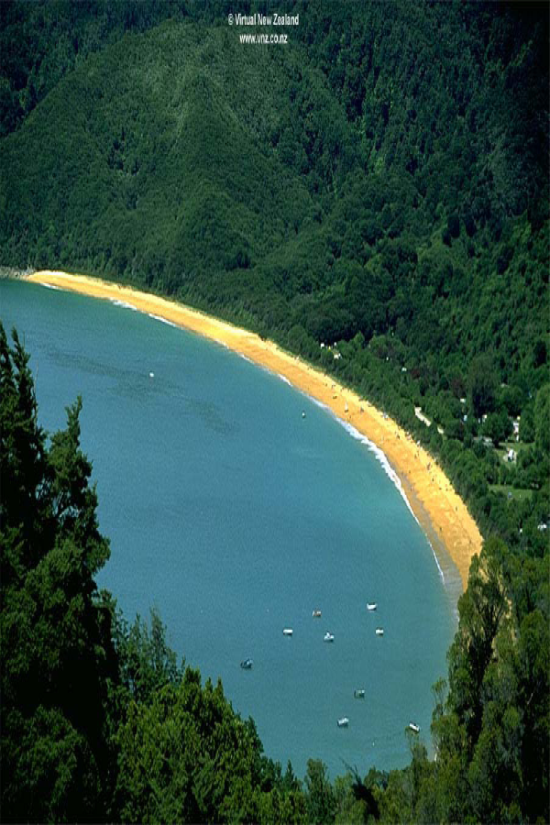

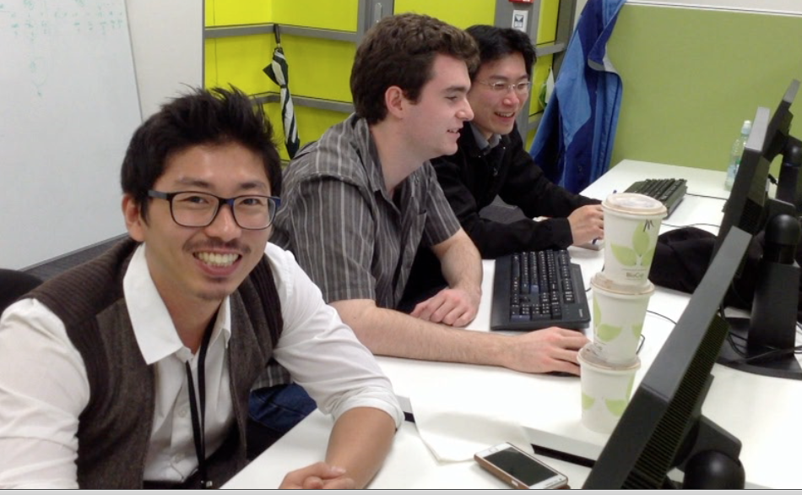
One of the largest Computing Departments in NZ
  Student Numbers-
  Variety of Programs from Certificate to Doctorate
  IBM on campus
  Centres for research excellence
Student numbers
2014 1256 (290 International)
Staff
  2014 57
Kuching Presentation<<

Slide 10
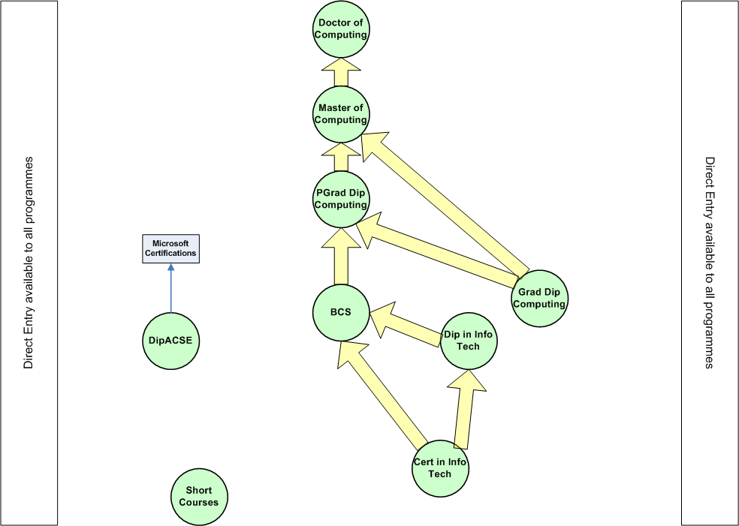
Joint PhD
Cybersecurity
Networks and Security
Software Engineering
Business Intelligence
Games
Health Software Development
Professional Practice
Joint PhD
L5
CCS
L3
NCC

Slide 11













…
Kuching Presentation<<

Slide 12

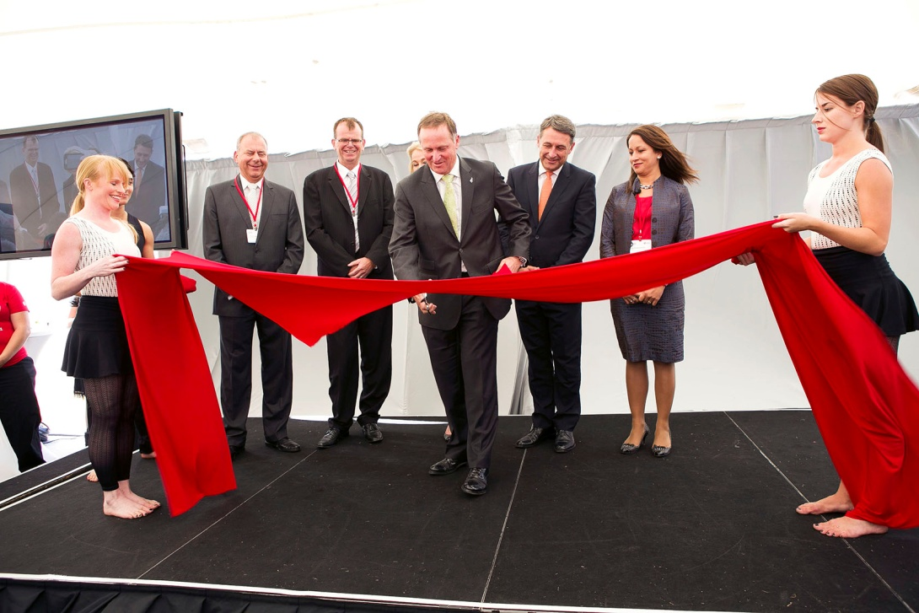
Partnership Projects 2012
Several clients- Apple, Banks, Airlines
500 employed- will reach 1000 in 2015
IBM Success Scholarships
>> UNITEC INSTITUTE OF TECHNOLOGY
Kuching Presentation<<
Notes:
J 4 mins
Demand vs supply… We are now demand driven
ITO leadership role worked with industry to confirm the need through research

Slide 13
Environmental Change Detection
Data
Mining
Network and Cyber Security
Computer vision and Emotion detection
Computational Intelligence
Research
Foci
NLP, SSP, Machine translation
Health IT
  Social networking and health
  Health informatics
  Games in health
  Robots in eldercare
Internet of things
and Smart Sensors
Kuching Presentation<<

Slide 14
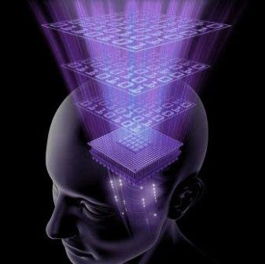
Cloud computing
Business Intelligence
Virtual reality
Services computing and data centres
Data mining and big data
Smart cities and planet
  mobile, location awareness, pervasive
Health Informatics
Cyber-security
Social networks
Kuching Presentation<<

Slide 15
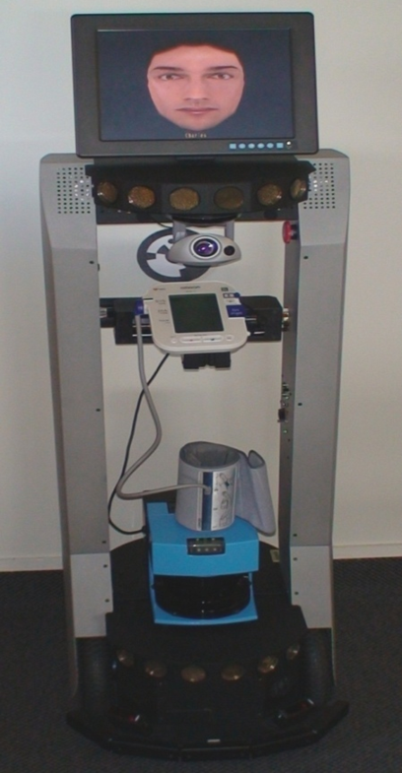
Trends in intelligent systems
Emotion sensitive systems
Gesture based games
Gesture based interfaces
Intelligent and affective tutoring systems
NLP and Natural language interfaces
Speech to speech machine translation on mobile devices
Wearable intelligence
Robotics
Kuching Presentation<<

Slide 16
A selection of current projects
Kuching Presentation<<

Slide 17

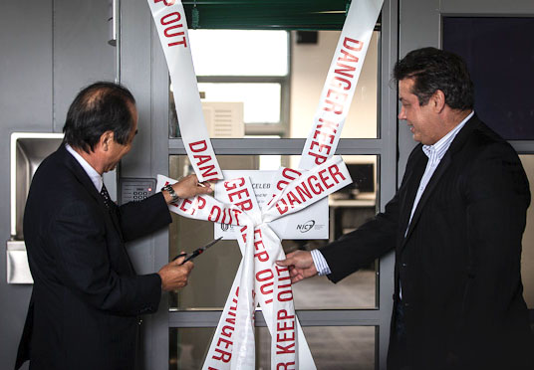
Centre for Computational Intelligence for Cyber Security
Collaborative research project
Commissioned research project
2 Doctoral students hosted by NICT
4 visits made by research teams from the 2 institutions
>> UNITEC INSTITUTE OF TECHNOLOGY
Kuching Presentation<<
>> UNITEC INSTITUTE OF TECHNOLOGY
Notes:
J 4 mins
Demand vs supply… We are now demand driven
ITO leadership role worked with industry to confirm the need through research

Slide 18
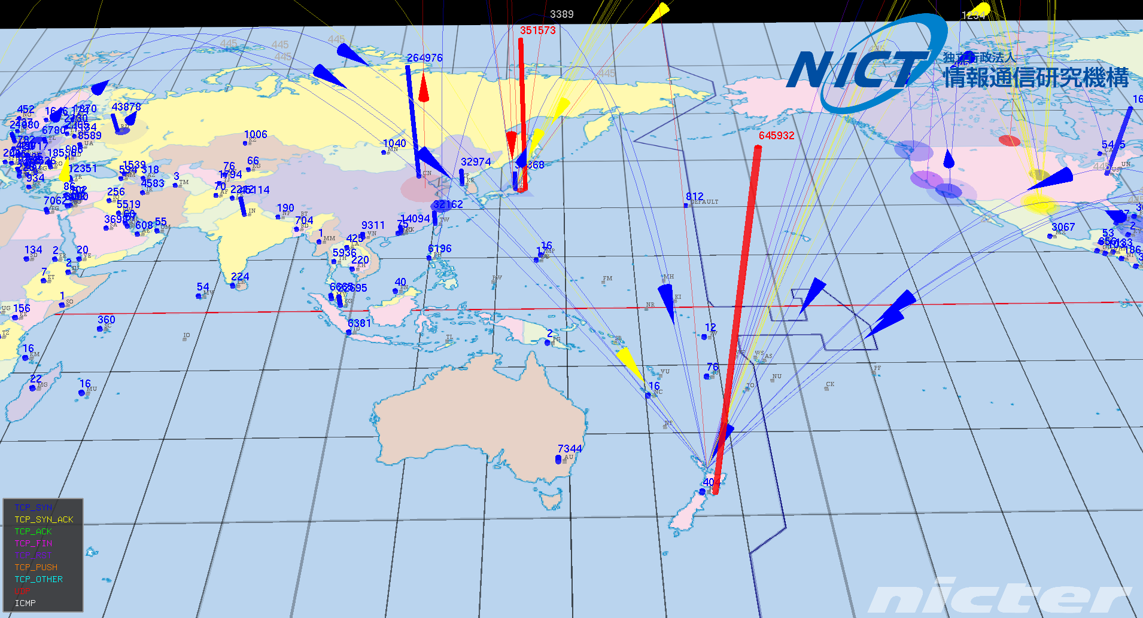
Cyber security is of strategic importance.
We have a shared responsibility for providing for the educational needs and developing advanced tech for the country. We extend our hand
to you. We need to collaborate.
Notes:
Attacks on NZ 4 times that of Japan based on the limited study of 6000 IP addresses.

Slide 19
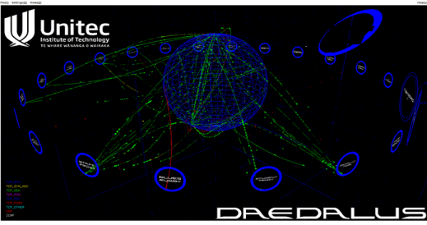
Alert System
The alert system will allow Unitec to monitor attacks on businesses, alerting them when they need to respond to attacks

Slide 20
External Funding Brought to Unitec to Date
MBIE Funding $12,600,000
NICT contract - $150,000/year
NICT Internships- $120,000
NAIST Internships- $50,000
Aura Info Security in kind donation $200,000

Slide 21




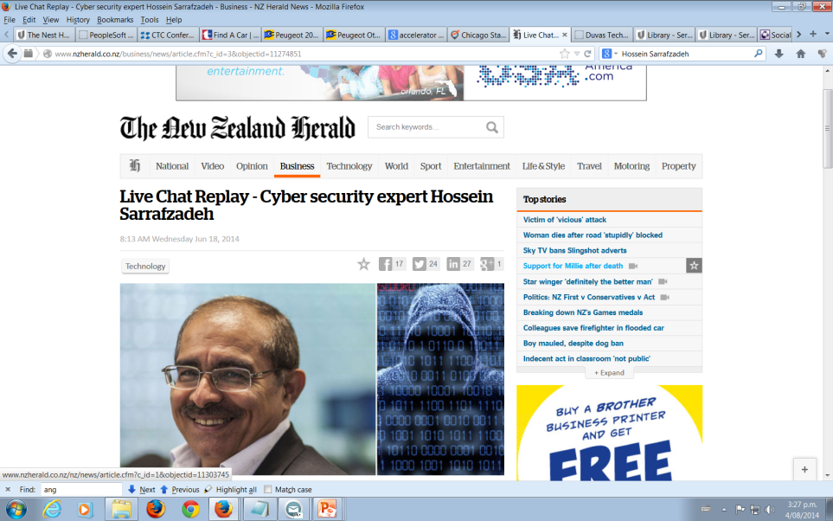


Recognition

Slide 22
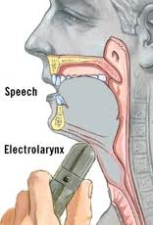

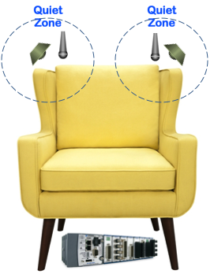
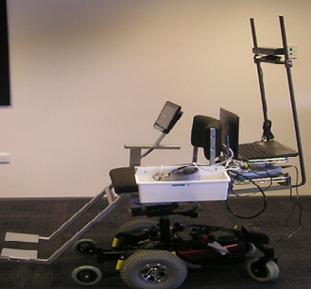
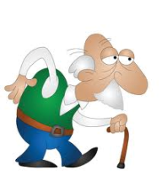
Unitec Smart Room (USR)
IoT
Gesture Recognition
Face Recognition
Facial Expressions
Voice
Functions:
Intelligent interaction with the room occupants.
Online monitoring of key medical/healthcare information of the occupants, and
Intelligent communication with caregivers or other authorized parties.
Noise Cancelation *
Whisper to speech *
Telemedicine chair
* Patents
Cloud Storage
Embedded Data Processing
Mobile Applications
Unitec SR
Assistive Information
Intelligent Agents
Embedded Sensors Network
Assistive Actions
Robotic Agents
Kuching Presentation<<
Notes:
Main components of the Unitec IAR are as follow.
1) Embedded Sensors Network: In order to collect raw data from the IAR occupants and ambient conditions, a sensors network has to be used.
2) Embedded Data Processing: The raw data collected by the Embedded Sensors Network has to be processed and converted to appropriate data formats before being used by autonomous agents of the IAR.
3) Intelligent Agents: The intelligent agents of the IAR can make suggestions or decisions, based on the information provided by the Embedded Data Processing Components.
4) Robotic Agents: The robotic agents of the IAR include a wide range of mechatronic devices that may interact with the IAR ambient.
5) Cloud Storage: The IAR components share their information with each other through a cloud storage.
6) Mobile Applications: In order to report the conditions of the IAR occupants to the trusted stakeholders (e.g. offspring, caregivers, nurses, emergency centre) and the IAR ambient conditions to the appropriate stockholders (e.g. building manager, electricians and etc.), a set of mobile applications can be developed.

Slide 23
Voice Back
Kuching Presentation<<
>> UNITEC INSTITUTE OF TECHNOLOGY

Slide 24
Active Noise Control for Furniture
>> UNITEC INSTITUTE OF TECHNOLOGY
Kuching Presentation<<

Slide 25
RoboChair Project
Multimodal interactions e.g. Touch screen, Voice, Gestures
The robot engages the
user using multiple HRI
techniques.
e.g. Greeting
Rotating towards the user
Displaying friendly messages
Making sounds
Trying to recognize the person
…
>> UNITEC INSTITUTE OF TECHNOLOGY
Kuching Presentation<<

Slide 26
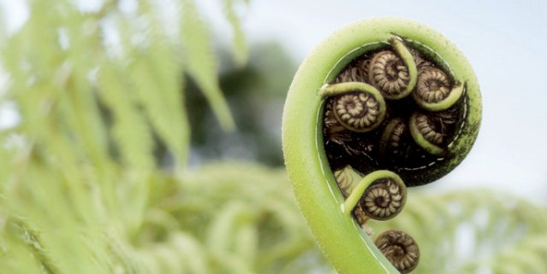
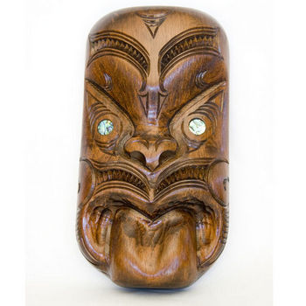
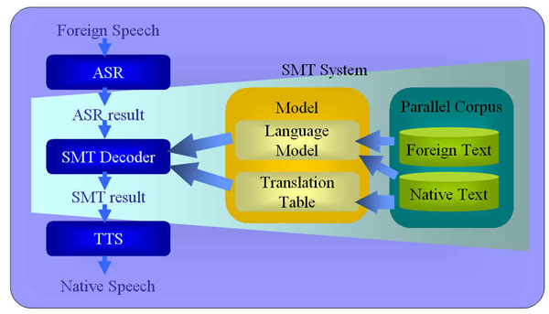
Speech to Speech SMT
Speech-to-text
Machine translation
Text-to speech
1.35
>> UNITEC INSTITUTE OF TECHNOLOGY
Kuching Presentation<<
Notes:
The statistical machine translation system will be developed using Moses which is a public domain statistical development tool the team is familiar with.Speech-to-speech translation, which is still in the experimental stage, is a complex process requiring speech-recognition technology that converts speech to text, machine translation of the text, and then text-to-speech conversion.
************************************
The scope of this research was originally intended to cover the development of a handheld speech-to-speech translator for the Persian-English language pair. However, shortly after this venture was undertaken, it became clear that developing the translation engine alone was an immense task in itself. This was because very little work had been done in the area of SMT for this particular language pair, and what had been done had yielded very unsatisfactory results. Given the significant shortage of resources required for successful development, it became apparent that the development of the translation engine would easily cover the duration of time allotted to the whole research project. Because of this, it was decided that the focus needed to be solely on the development and improvement of the central part of the system – the statistical machine translation engine.

Slide 27

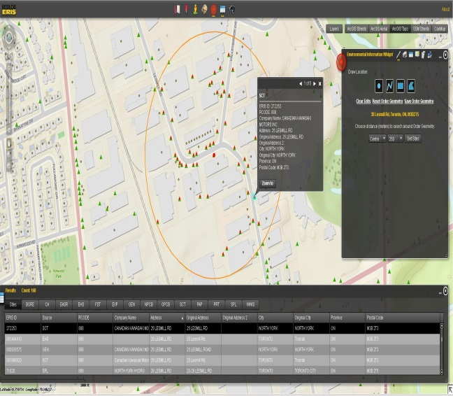

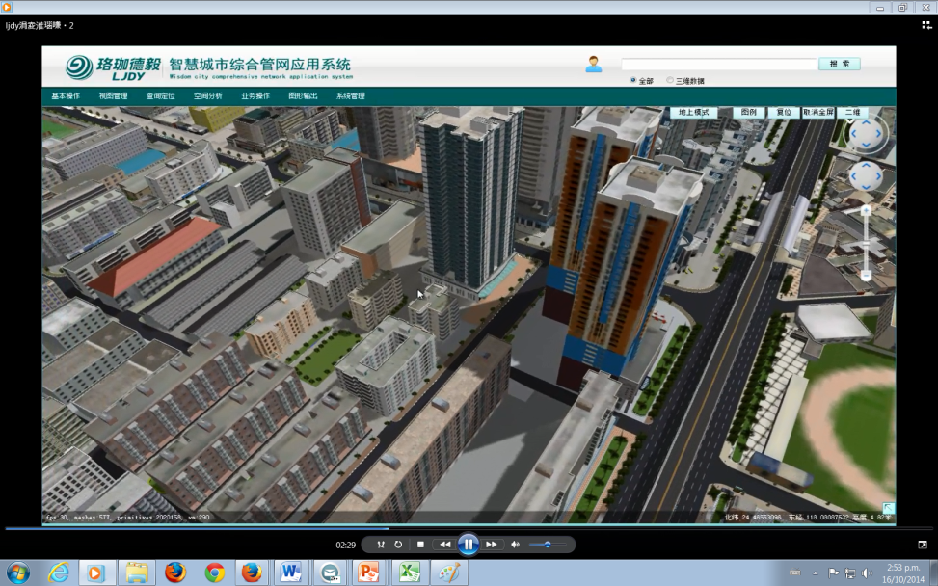
Centre for
Computational Intelligence for Environmental Information Engineering
Kuching Presentation<<

Slide 28
Sensor Fingerprint for identification of Smart Phones
Smart cell phones are equipped with multitude of sensors, such as touchscreens, accelerometers, gyroscopes, GPS, cameras and microphone.
Different hardware instances of a specific sensor are quite different due to the imperfections in the manufacturing and assembly phase. These introduce variations in their sensory output specific to the sensor, and that are consistent throughout the life of the sensor.
Smart phone sensors data are exposed to programmer via Application Programming Interfaces (APIs) and can be easily accessed.
This research is developing a robust device ID, or fingerprint that is independent of software state and could survive a hard reset.

Slide 29
Applications
An unclonable device ID’s can withstand hard reset of the operating system. Registration of unclonable ID of a cell phone to a cloud service would disable the use of a stolen cell phone.
In the cybersecurity domain, a database of malicious devices can be created based on the unclonable ID. This will help in mitigating any cyber threat launched from those devices.
An uncloneable device ID could be used for device forensic in the court of law.

Slide 30


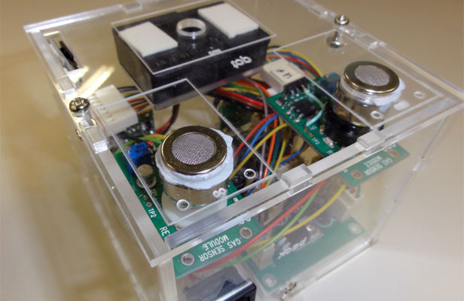
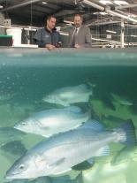
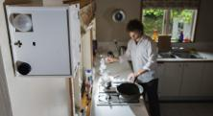
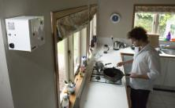

NIWA- Automatic Harbor Event Detection- MPI
Our objective is to automate the process of counting boats returning to boat ramps by computer vision
NIWA: Emission source detection
Equipment
  Particles, Activity and Context
  Monitoring Autonomous Node
(PACMAN)
Observed pollutants
  PM₁₀
  CO₂
  CO
  Events
  Frying canola oil on electric hob.
  Frying olive oil on an electric hob.
  Frying olive oil on a gas hob.
  Spray of household pesticide.
  Lighting a cigarette and allowing it to smoulder.
>> UNITEC INSTITUTE OF TECHNOLOGY
Kuching Presentation<<

Slide 31
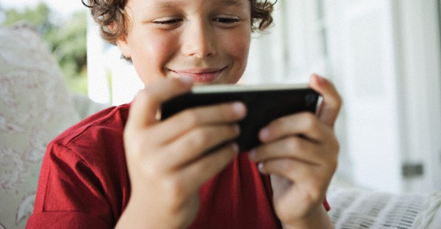
Games & Mobile Apps for Health & Education
Games for Health
Games for Education
Mobile Applications for Health & Education

Slide 32
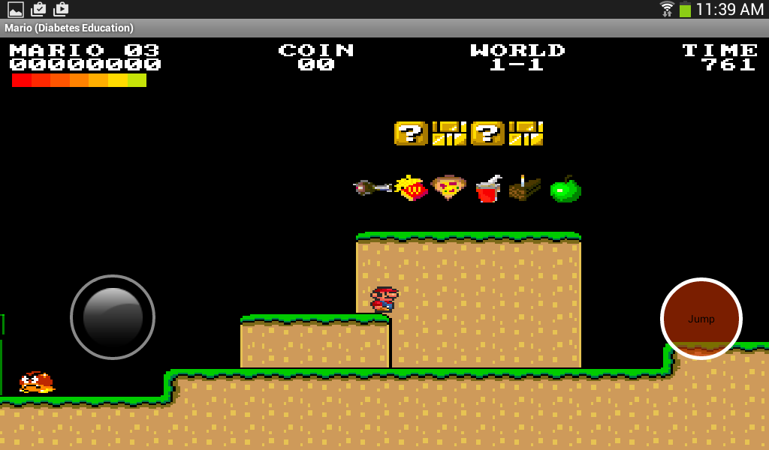
Mobile Android Games for Diabetes Education
Notes:
The games have been implemented on Android platform

Slide 33
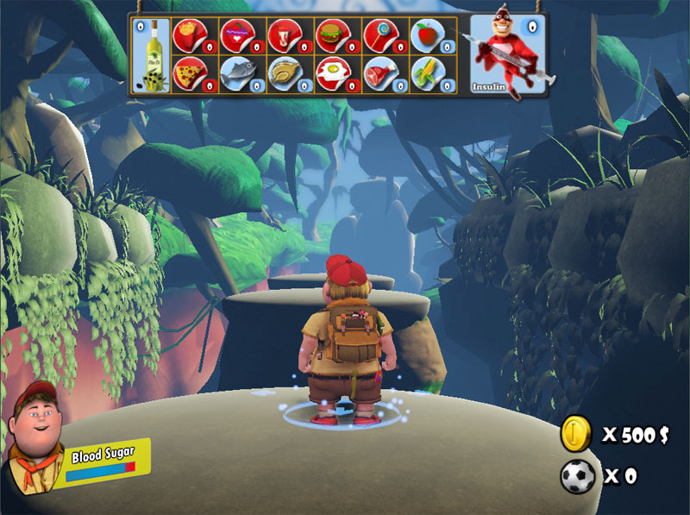
3D Games for Children’s Health
Kuching Presentation<<

Slide 34
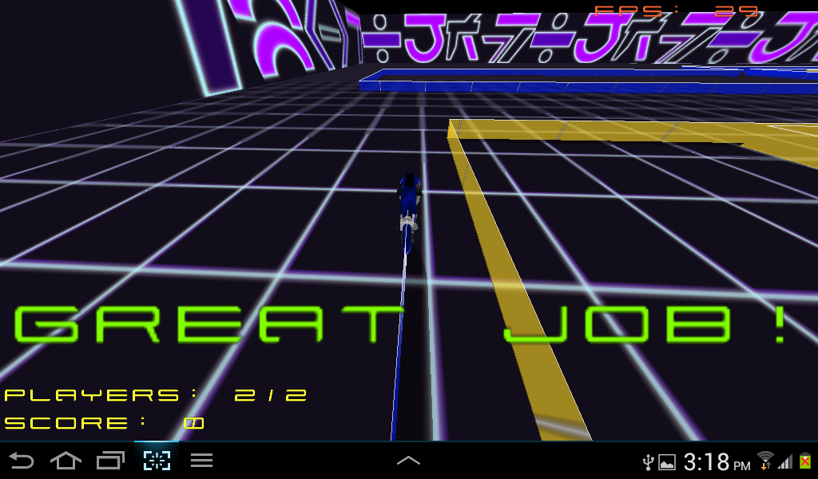
Mobile Games for Children with ADHD
We proposed to design, implement and evaluate a game prototype that aims to improve self-esteem in children with ADHD.
We have come up with a set of design principles that can be applied to any game to make it suitable for ADHD children, especially with the aim of increasing their self-esteem
A prototype of the mobile game has
been developed for Android. The
changes are being made to an
existing open source game GLTron
as a proof of concept.
Trial of the game will be done in
near future

Slide 35
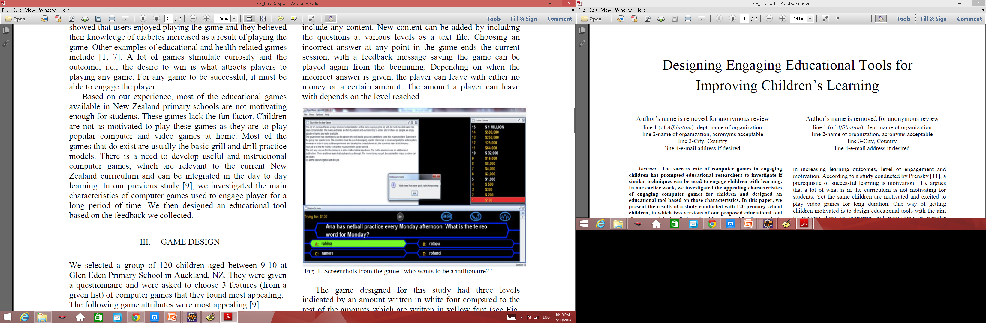
Games for Education

Slide 36
Evaluation Study
120 children 9-10 yrs at Glen Eden Primary School in Auckland
The participants were divided into a Control group and a Test group of 60 students each.
Both groups pre-tested; firstly on the numeracy learning outcomes and then on the Te Reo language learning outcomes
Test and control groups given customised application to play with over four weeks
  2 weeks were spent on numeracy
  2 weeks was spent on the Te Reo language
Test group assigned the feature enhanced version (added challenges, feedback and enhanced graphics)
Both groups given post tests to evaluate the learning effect of both version of the games.
Notes:
Control and test groups:
Two versions of the game were developed:
A feature enriched version of the game which made extensive use of the: challenge, feedback and enhanced graphical features that the children identified as important
A second game, which had an overt absence of the features identified by the children as important
The test group were given the feature enhanced game, while the control group were given the feature devoid game

Slide 37
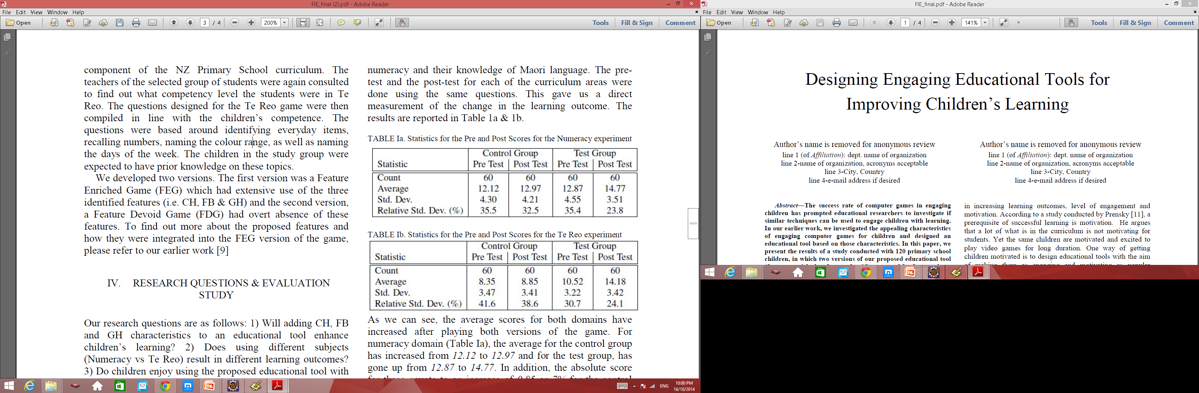
Pre and Post Scores for Numeracy & Te Reo (Maori Language)
Average scores for both domains have increased after playing both versions of the game, but more so for the Test group – change in the learning outcome was statistically significant for both groups.
Students preferred the feature
enhanced version of the game
and were more likely to play
this in their own time.
Notes:
As we can see, the average scores for both domains have
increased after playing both versions of the game. For
numeracy domain (Table Ia), the average for the control group
has increased from 12.12 to 12.97 and for the test group, has
gone up from 12.87 to 14.77. In addition, the absolute score
for these equate to an increase of 0.85 or 7% for the control
group and an increase of 1.9 or 14.8% for the test group. Thus,
the percentage increase in the mean score is twice as much for
the FEG compared to the FDG game. Comparison of the posttest
scores for the control and the test groups (12.97 compared
to 14.77) also shows that the FEG was more effective in
raising the performance level of the students. The T-Test
values are 3.63 x 10-10 for the Control group and 1.31 x 10-31
for the Test group. Both values are orders of magnitude
smaller than 0.05, showing that the change in the learning
outcome (post-test vs pre-test) was statistically significant for
both groups. Additionally, the T-Test value for the Test group
is orders of magnitude smaller than the Control group T-Test
value, implying a significant effect of the FEG.
The corresponding figures for the Te Reo game is 0.5 or
6% increase for the control group compared to 3.66 or 34.8%
for the test group. This gives us an approximately 6 fold
increase in the learning score for the Te Reo experiment. The
results in the case of the Te Reo curriculum also show a
similar pattern to the Numeracy curriculum, in that the test
group performed better compared to the control group.

Slide 38
Emotion sensitive systems
Facial expression recognition
Gesture recognition
Physiology based recognition
Expression of emotion
Kuching Presentation<<

Slide 39
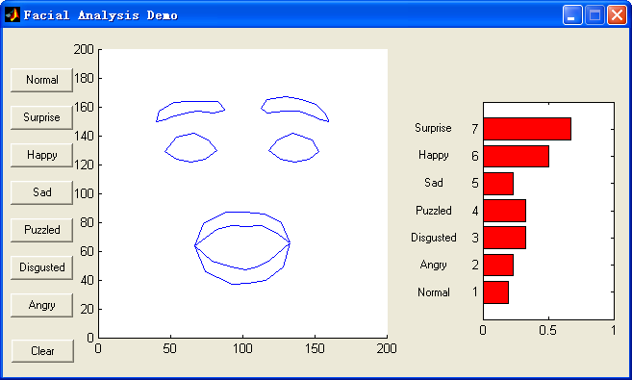
Facial Expression Recognizer
Kuching Presentation<<
Notes:
The Figure on this slide shows a screenshot of a state-of-the-art automated facial expression analysis system that was developed in-house by the research team in 2003. There are three main components to the system: face detection using an Artificial Neural Network, facial feature extraction and a fuzzy facial expression classifier. The right hand side bars show the certainty of the system in its detection. In this case a surprise expression with a certainty of 0.7 has been detected.
The system is capable of accurately identifying seven affective states: surprise, happiness, sadness, puzzlement, disgust, and anger, plus a neutral state.
A new improved system has recently been developed and tested which is more suitable for use in ATS and operates in realtime. Test results show a high degree of accuracy and real-time performance as presented in the following slides.

Slide 40
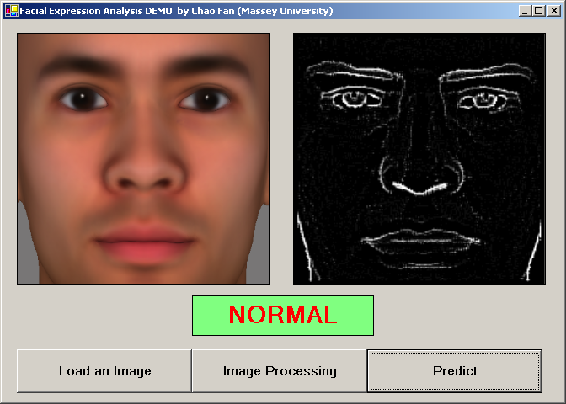
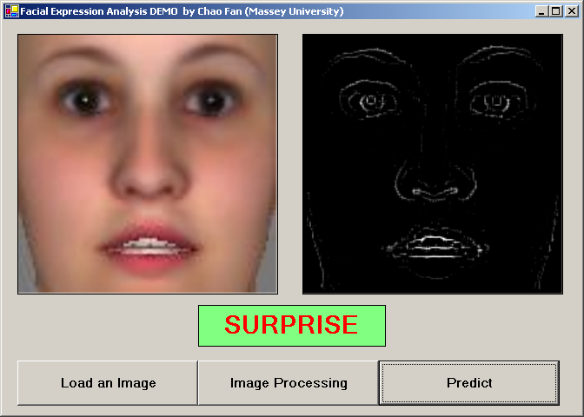
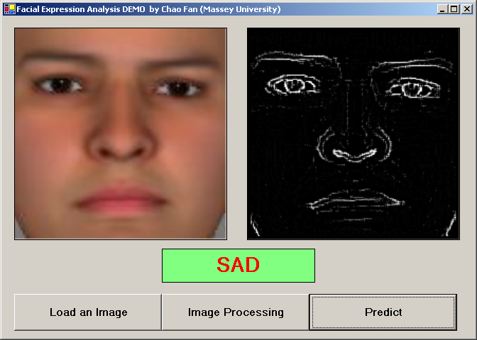
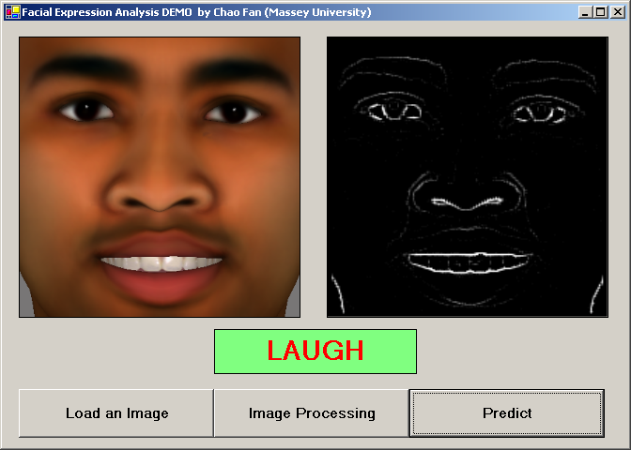
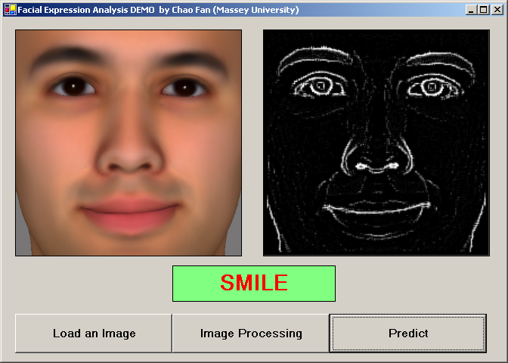
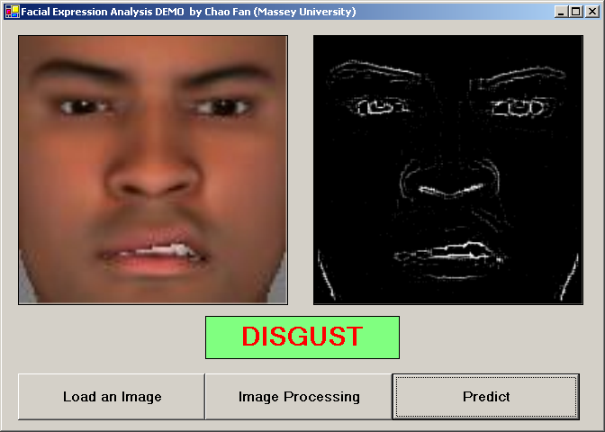
Facial Expression Analysis Results
Kuching Presentation<<

Slide 41
The early result for facial expression recognition system
Expression | Recognition
Normal | 92%
Disgust | 93%
Fear | 90%
Smile | 93%
Laugh | 96%
Surprised | 94%
Kuching Presentation<<
Notes:
The new approach based on support vector machines (SVM) has produced promising results. An SVM is a supervised learning algorithm based on statistical regression. The SVM algorithm operates by mapping the training set into a high-dimensional feature space, and separating positive and negative samples.
We represented the facial expression database that we used by connection features. Each raw image is 200 pixels in width and 200 pixels in height. By connection extraction, we reduced the image size to 50 pixels by 50 pixels, which is 2500 connection features. This makes the training process significantly faster than the pixel-wise analysis of the image which we used in the earlier version.
The SVM was trained using the summarized facial images using our connection features algorithm. The training was obviously considerably shorter using this
approach. Memory requirements were also considerably lower. To train SVM, a 5-fold crossvalidation was applied. Different Kernel methods are used in SVM to classify non-linear functions. We tested different kernel models, namely a linear model, a polynomial model and an RBF Kernel with the SVM, and have presented the results in Table 1. The test image database contains 1000 image for each facial expression, 6000 images in total. Results obtained using an RBF kernel were the most promising.
Video sequences are recorded and analyzed at a rate of 12 frames per second which is real-time. Our SVM analyzer is triggered each 0.0833 seconds. These results indicate that the system is capable of operating in real-time and with a high rate of accuracy.

Slide 42
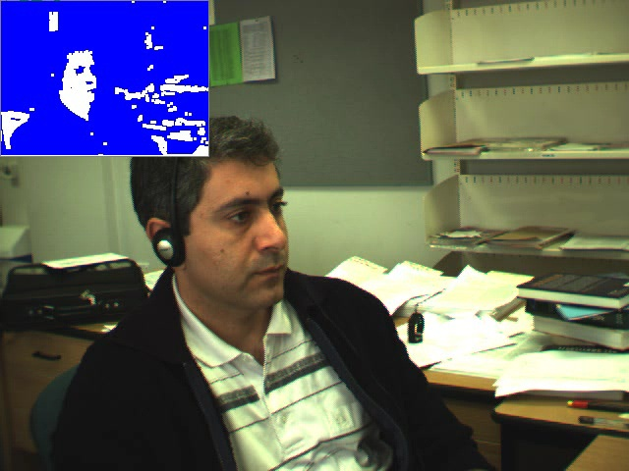
Gestures
Kuching Presentation<<

Slide 43
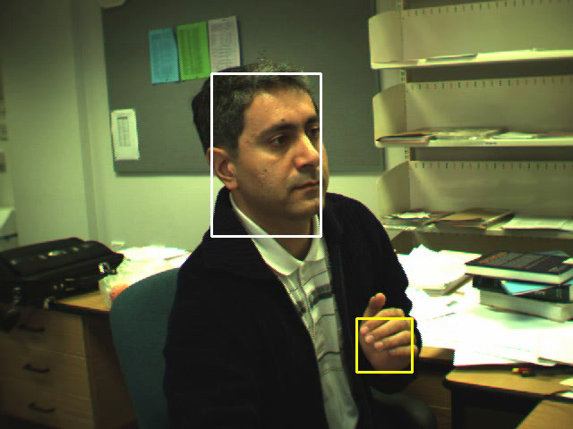
Multi-Tracker
Kuching Presentation<<

Slide 44
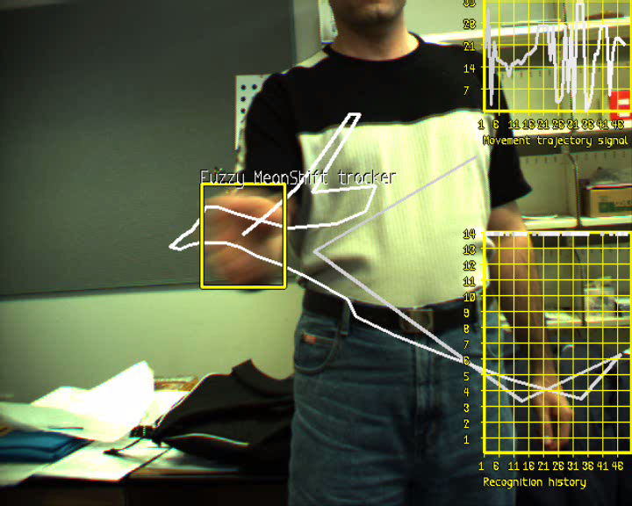
Gesture recogniser tracking the hand
Demos
Kuching Presentation<<
Notes:
An affective tutoring system should be able to analyse the body movements of the learner just as a human tutor would. A child counting fingers when given an addition or subtraction is in a totally different developmental stage than one who doesn’t. Detecting counting on fingers and various other head and hand movements is a slightly different case, as these are gestures, and not facial expressions. However, similar techniques employed by automated facial expression analysis can also be applied to automated gesture analysis. We have developed a system that detects various hand and body movements which is being extended to include a student counting on his/her fingers.

Slide 45

The gesture recognition technique - Overview
Kuching Presentation<<
Notes:
We have developed a novel approach to 2D gesture trajectory recognition for use in our affective tutor. This approach taken consists of two main steps: i) gesture modeling, and ii) gesture detection.
The gesture modeling technique which we have developed is robust against slight rotation, requires a small number of samples, is invariant to the start position of the gesture and it is device independent. For gesture recognition, we used one classifier for detecting each gesture signal. We implemented the gesture recognition system using both multilayered feed-forward ANNs and support vector machines. We evaluated the neural network approach in comparison with a SVM with radial basis kernel function.
The results showed high accuracy of 98.27% for ANN and 96.34% for SVM in gesture signal recognition. The results also show that the overall
performance of the ANN classifier is slightly better than the SVM classifier. We have therefore adopted the ANN approach.

Slide 46
Evaluation of gesture recognition system
Gesture No. | Correctly Detected | Correct Positive Detection
1 | 80 | 100%
2 | 110 | 98.21%
3 | 101 | 98.05%
4 | 96 | 93.2%
5 | 175 | 99.43%
6 | 176 | 96.7%
7 | 93 | 100%
8 | 82 | 97.62%
9 | 96 | 100%
10 | 89 | 98.89%
11 | 103 | 98.09%
12 | 105 | 100%
13 | 116 | 98.30%
Avg |  | 98.27%
Kuching Presentation<<
Notes:
This table presents the results of testing the gesture recognition system which is currently capable of movement trajectory information. Therefore, it can be
used with a variety of front-end input systems and techniques including vision-based hand and eye tracking, digital tablet, mouse, and digital gloves, recognizing 13 gesture signals. The accuracy of the detection is satisfactory as shown here.

Slide 47
The results in comparison to a SVM classifier
Kuching Presentation<<

Slide 48

IntelliMouse
Kuching Presentation<<

Slide 49


Expression of emotion

Slide 50

Dr. Eve- Starship Hospital
Others
Kuching Presentation<<

Slide 51
Cognitive Computing
Dr Watson
IBM
Watson Research Centre
Kuching Presentation<<

Slide 52

Planned
Develop the tools and make them available for other applications
e.g. Autism assistive tool
Use speech as another channel
Study the socio-cultural issues
Develop the Intelli-mouse further
Give the agent the ability to understand other languages!

Slide 53
Possible collaboration opportunities
Joint projects – research and funding
Student visits
Staff visits
Postgraduate opportunities
Cybersecurity conference 2015
Other areas

Slide 54

Come visit us in NZ – Discover Downunder ☺

