Slide 1
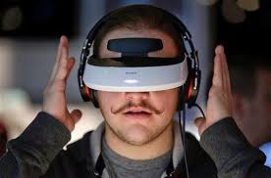
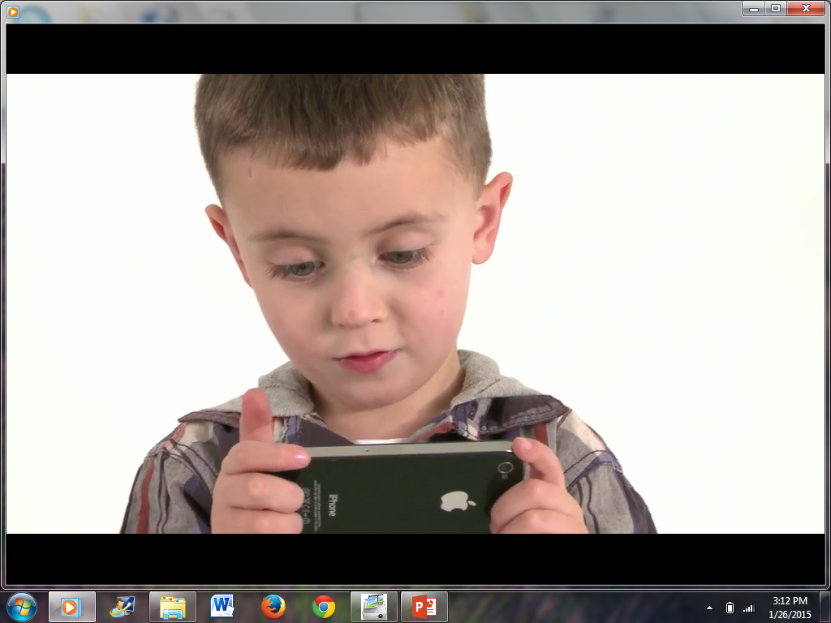
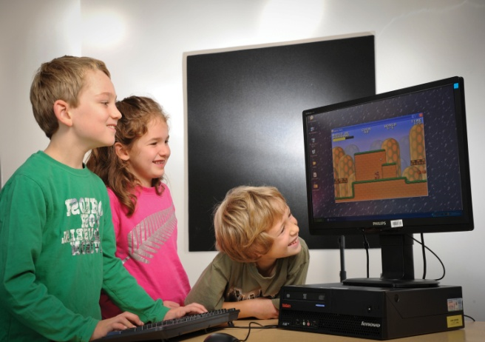



Professor & Head of Department
Department of Computing, Unitec
eLearning– status and trends for the future with a focus on in class applications
عبدالحسین صراف‌زاده
دانشگاه صنعتی یونیتک نیوزیلند

Slide 2
E Learning – trends for the future
Personal experiences- 2 + 1 FB, Lecture recordings, Tabrizi
MOOCs
SPOCs
Intelligent and Affective Systems
Big Data
Gamification
Mobile Learning
Augmented reality
Cloud Learning Management Systems

Slide 3
MOOC’s - Massive Open Online Courses
Embraced by many top level institutions, including high profile such as Princeton, Stanford, MIT and Harvard
Mixed levels of success – high failure/lack of completion rates for many (https://moocmoocher.wordpress.com/2013/02/13/synthesising-mooc-completion-rates/)
Major providers such as Udacity changing from lecture based model to much more interactive model (http://bits.blogs.nytimes.com/2013/01/17/measuring-the-success-of-online-education/?_r=0)
Corporates may start using MOOC’s as part of their professional development and training strategies – and to publicise themselves in the wider community

Slide 4
MOOC’s continued
Most are free, however increasing numbers are offering certification for a fee
Some institutions are partnering with professional organisations to offer credentialisation/professional development hours for maintaining registration
A Time poll reported in 2012 that 68% of the general public felt that much of the teaching on campuses will be replaced by online learning (vs 22% of College leaders) – this poll however also reflected that many felt that students would learn less with the online learning (http://nation.time.com/2012/10/18/higher-education-poll/?pcd=teaser)

Slide 5

Pedagogy
Today’s MOOC presents largely traditional instruction: lecture segments (often video), readings, and quizzes. The MOOC instructional paradigm works best for self-directed learners. Typically, only a fraction of enrolled students complete the course, and an even smaller subset (e.g., 5 percent) pass. However, options are likely to expand as MOOC pedagogy and technology matures.

Slide 6
MOOC Platforms
Coursera: A Stanford spinoff focusing on elite institutions and faculty. Major university partners include University of Virginia, Duke University, University of Pennsylvania, and University of Illinois.
edX: The Harvard, MIT, and Berkeley collaboration.
Udacity: Disseminates select MOOCs in partnership with individual professors. Founded by ex-Stanford professor Sebastian Thrun after his MOOC went viral.
Udemy: Allows anyone to create and offer a course, whether free or for a fee.
While not MOOCs, Knewton and Khan Academy offer massively online material. As students work, these platforms track and correlate data generated—from time of day to clicks and response patterns—to personalize instruction. Ultimately all platforms may use data to adapt instruction to the learner.
Adaptive Learning Platforms

Slide 7


Slide 8


Slide 10


Slide 11
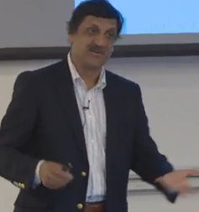

Slide 12

SPOC’s
Small Private Online Course
Localized instance of a MOOC course
Courses where the learning is ‘flipped’ – students view their lectures from home, and attend classes to undertake their practical/homework sessions
Micro-modules- can be downloaded from MOOCS or created
Supplementary testing following the online learning allows the lecturer to tailor the face to face sessions to address areas of weakness/lack of understanding

Slide 13
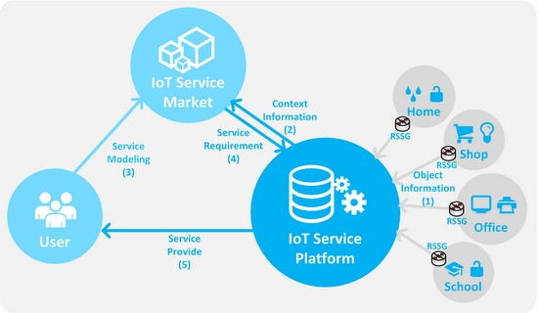
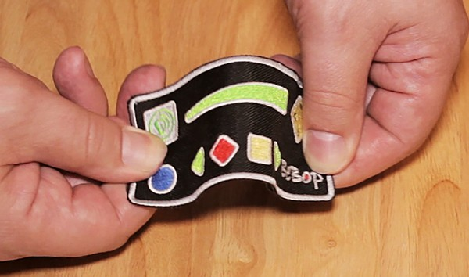

Smart sensors in ECE

Slide 14
Intelligent and affective tutoring systems

Slide 15
Intelligent
Tutoring
Systems

Slide 16

Student
Modeller
Domain
Knowledge Base
Pedagogical
Module
Communication Module
Major Components of an Intelligent Tutoring System

Slide 17

An Example
Division
6 * 3
6*3=9
6*3=3
6*3=18
6*3=63
6*3=2

Slide 18
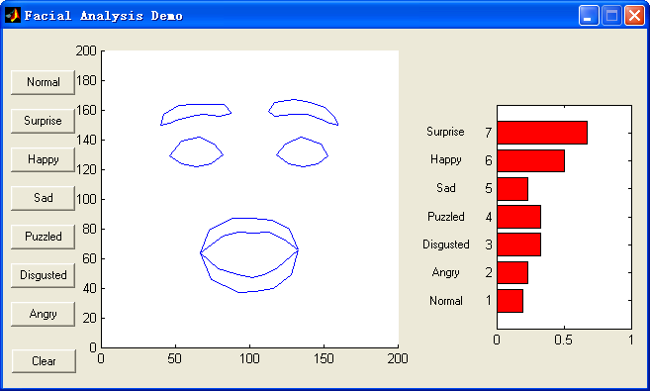
Facial Expression Recognizer
Kuching Presentation<<
Notes:
The Figure on this slide shows a screenshot of a state-of-the-art automated facial expression analysis system that was developed in-house by the research team in 2003. There are three main components to the system: face detection using an Artificial Neural Network, facial feature extraction and a fuzzy facial expression classifier. The right hand side bars show the certainty of the system in its detection. In this case a surprise expression with a certainty of 0.7 has been detected.
The system is capable of accurately identifying seven affective states: surprise, happiness, sadness, puzzlement, disgust, and anger, plus a neutral state.
A new improved system has recently been developed and tested which is more suitable for use in ATS and operates in realtime. Test results show a high degree of accuracy and real-time performance as presented in the following slides.

Slide 19
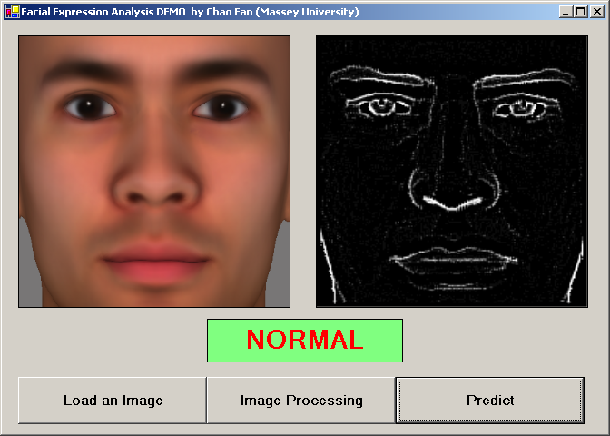
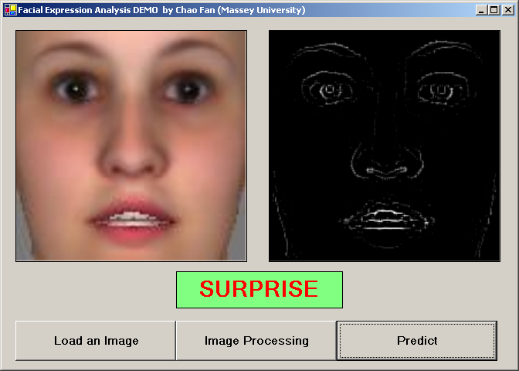
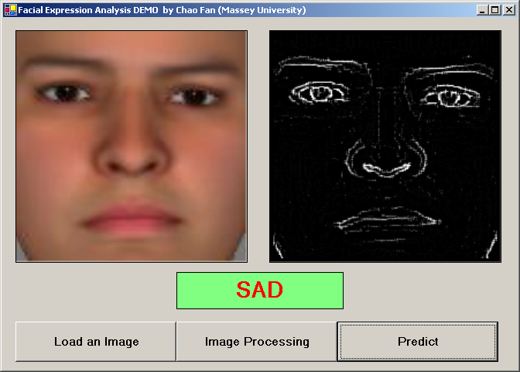
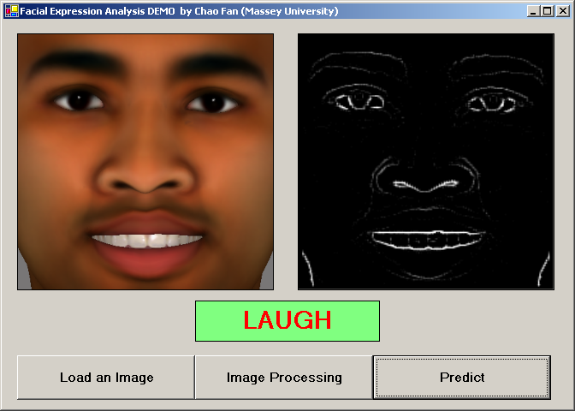
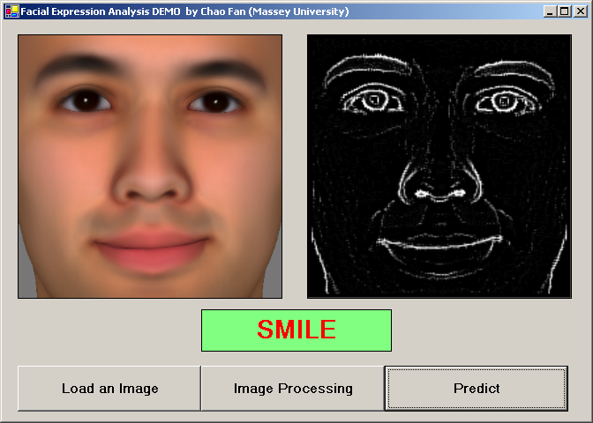
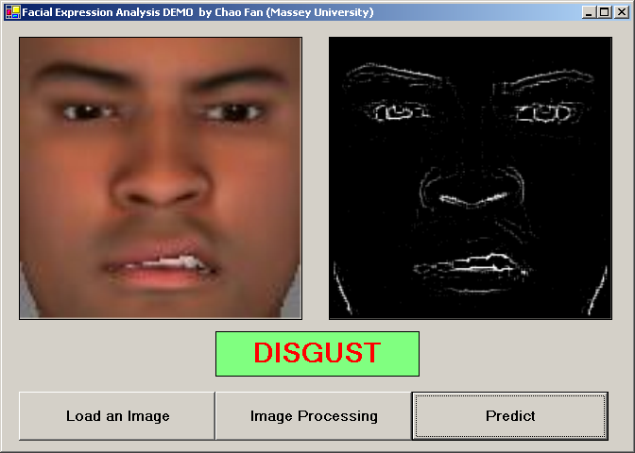
Facial Expression Analysis Results
Kuching Presentation<<

Slide 20
The early result for facial expression recognition system
Expression | Recognition
Normal | 92%
Disgust | 93%
Fear | 90%
Smile | 93%
Laugh | 96%
Surprised | 94%
Kuching Presentation<<
Notes:
The new approach based on support vector machines (SVM) has produced promising results. An SVM is a supervised learning algorithm based on statistical regression. The SVM algorithm operates by mapping the training set into a high-dimensional feature space, and separating positive and negative samples.
We represented the facial expression database that we used by connection features. Each raw image is 200 pixels in width and 200 pixels in height. By connection extraction, we reduced the image size to 50 pixels by 50 pixels, which is 2500 connection features. This makes the training process significantly faster than the pixel-wise analysis of the image which we used in the earlier version.
The SVM was trained using the summarized facial images using our connection features algorithm. The training was obviously considerably shorter using this
approach. Memory requirements were also considerably lower. To train SVM, a 5-fold crossvalidation was applied. Different Kernel methods are used in SVM to classify non-linear functions. We tested different kernel models, namely a linear model, a polynomial model and an RBF Kernel with the SVM, and have presented the results in Table 1. The test image database contains 1000 image for each facial expression, 6000 images in total. Results obtained using an RBF kernel were the most promising.
Video sequences are recorded and analyzed at a rate of 12 frames per second which is real-time. Our SVM analyzer is triggered each 0.0833 seconds. These results indicate that the system is capable of operating in real-time and with a high rate of accuracy.

Slide 21

Gestures
Kuching Presentation<<

Slide 22
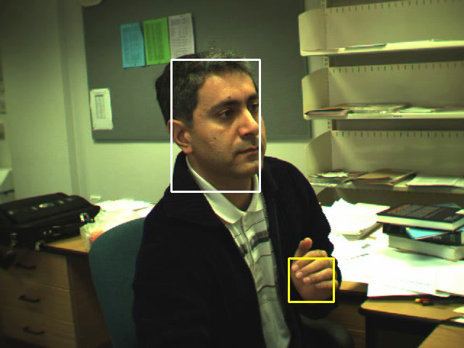
Multi-Tracker
Kuching Presentation<<

Slide 23
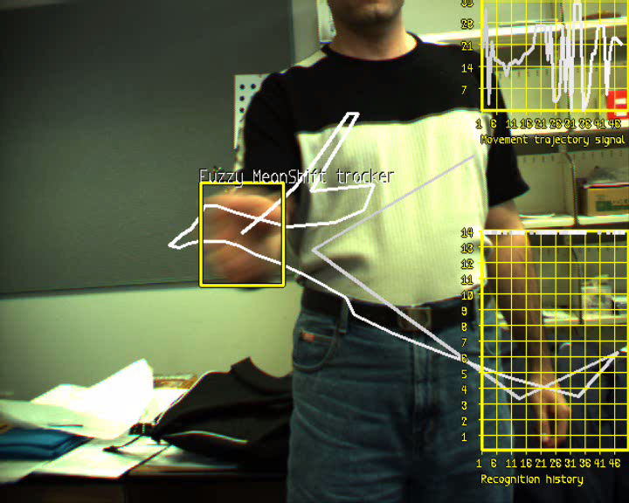
Gesture recogniser tracking the hand
Demos
Kuching Presentation<<
Notes:
An affective tutoring system should be able to analyse the body movements of the learner just as a human tutor would. A child counting fingers when given an addition or subtraction is in a totally different developmental stage than one who doesn’t. Detecting counting on fingers and various other head and hand movements is a slightly different case, as these are gestures, and not facial expressions. However, similar techniques employed by automated facial expression analysis can also be applied to automated gesture analysis. We have developed a system that detects various hand and body movements which is being extended to include a student counting on his/her fingers.

Slide 24
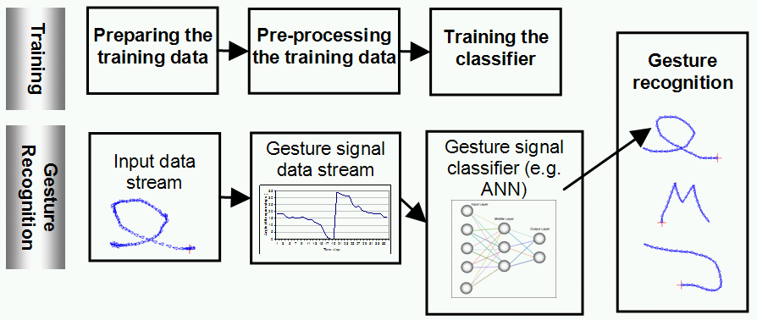
The gesture recognition technique - Overview
Kuching Presentation<<
Notes:
We have developed a novel approach to 2D gesture trajectory recognition for use in our affective tutor. This approach taken consists of two main steps: i) gesture modeling, and ii) gesture detection.
The gesture modeling technique which we have developed is robust against slight rotation, requires a small number of samples, is invariant to the start position of the gesture and it is device independent. For gesture recognition, we used one classifier for detecting each gesture signal. We implemented the gesture recognition system using both multilayered feed-forward ANNs and support vector machines. We evaluated the neural network approach in comparison with a SVM with radial basis kernel function.
The results showed high accuracy of 98.27% for ANN and 96.34% for SVM in gesture signal recognition. The results also show that the overall
performance of the ANN classifier is slightly better than the SVM classifier. We have therefore adopted the ANN approach.

Slide 25
Evaluation of gesture recognition system
Gesture No. | Correctly Detected | Correct Positive Detection
1 | 80 | 100%
2 | 110 | 98.21%
3 | 101 | 98.05%
4 | 96 | 93.2%
5 | 175 | 99.43%
6 | 176 | 96.7%
7 | 93 | 100%
8 | 82 | 97.62%
9 | 96 | 100%
10 | 89 | 98.89%
11 | 103 | 98.09%
12 | 105 | 100%
13 | 116 | 98.30%
Avg |  | 98.27%
Kuching Presentation<<
Notes:
This table presents the results of testing the gesture recognition system which is currently capable of movement trajectory information. Therefore, it can be
used with a variety of front-end input systems and techniques including vision-based hand and eye tracking, digital tablet, mouse, and digital gloves, recognizing 13 gesture signals. The accuracy of the detection is satisfactory as shown here.

Slide 26
The results in comparison to a SVM classifier
Kuching Presentation<<

Slide 27
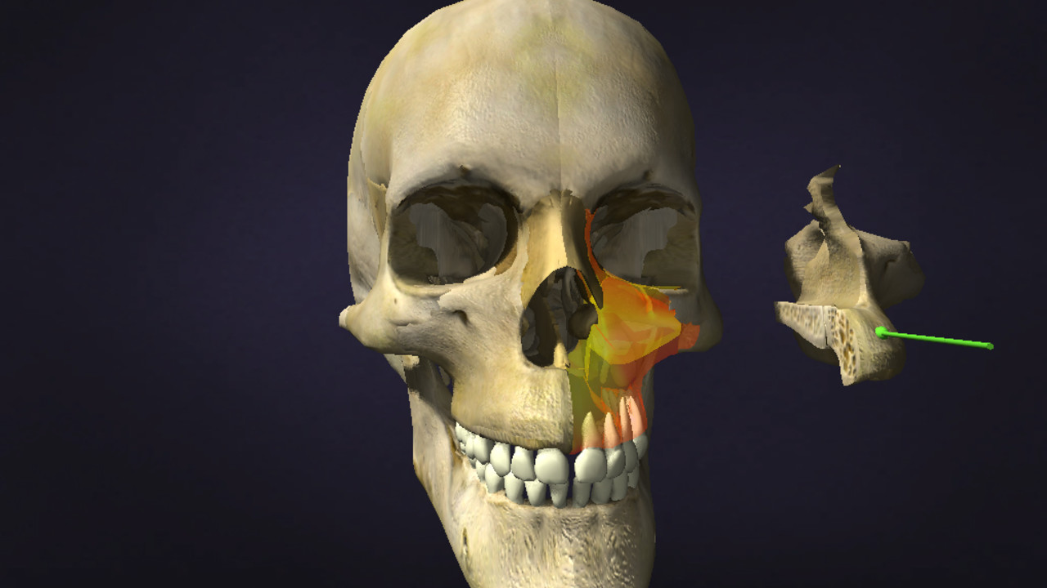

Demo

Slide 28


Expression of emotion

Slide 29
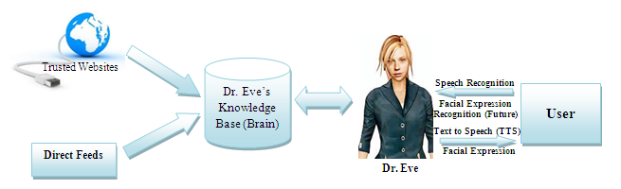
Dr. Eve- Starship Hospital
Others
Kuching Presentation<<

Slide 30
Cognitive Computing
Dr Watson
IBM
Watson Research Centre
Kuching Presentation<<

Slide 31
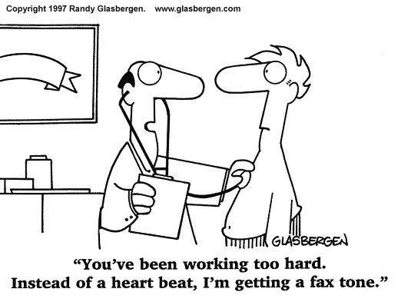
IntelliMouse
Kuching Presentation<<

Slide 32

Big Data
With more learners undertaking online learning the quantity of data emerging from their activities is increasing exponentially
Data includes click rates on pages, length of time taken to complete tasks, number of attempts, …
Analysis of this data allows the institution to better assess the effectiveness of their online learning offerings and to track patterns of learning amongst and between cohorts
Sophisticated use of this data may also allow the institution to tailor learning to the individual learner
http://www.publicpolicy.telefonica.com/

Slide 33

Educational Data Mining Association
http://www.educationaldatamining.org/

Slide 34
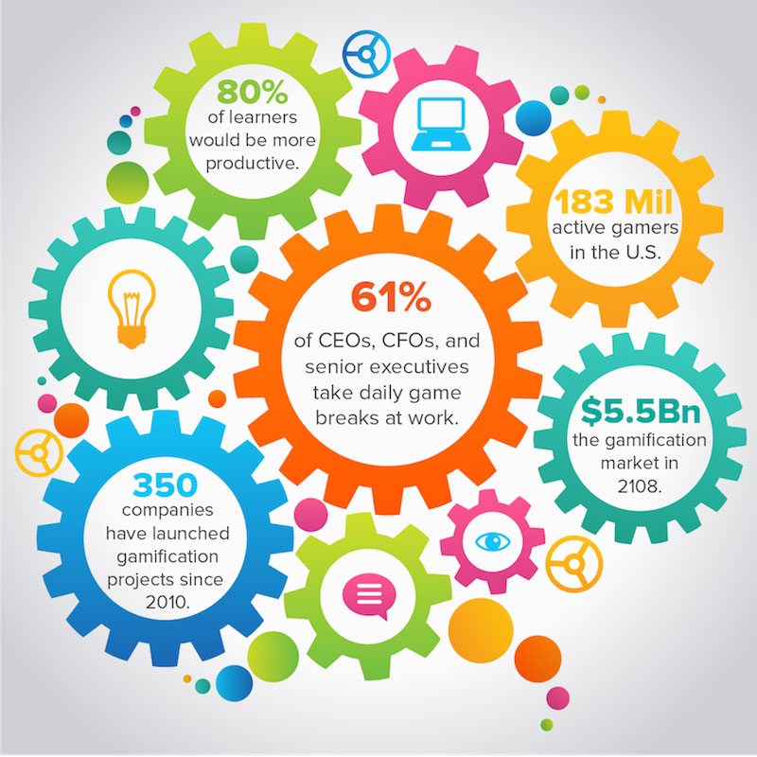
Gamification
Use of game design and development techniques to engage and motivate learners is proliferating, as is evident by the statistics following
Many feel gamification would help their learning
http://www.digitalchalk.com/blog/8-surprising-gamification-statistics

Slide 35
Gamification Statistics
The gamification industry is expected to grow to over $2 billion in the U.S. by 2015, according to M2 Research. (Huffington Post)
61% of surveyed CEOs, CFOs, and other senior executives say they take daily game breaks at work. More than half of these gameful executives say they play during work in order “to feel more productive.” (Ryan Jenkins)
By 2014…more than 70% of Global 2000 organizations will have at least one gamified application, driving 50% of all innovation. (Engagement Alliance)
Since 2010, over 350 companies have launched major gamification projects. These include consumer brands like MLB, Adobe, NBC, Walgreens, Ford, Southwest, eBay, Panera, and more. (Huffington Post)
In the United States alone, there are 183 million active gamers. Those gamers play 13 hours a week on average. (Ryan Jenkins)
Almost 80% of the learners say that they would be more productive if their university/institution or work was more game-like. (Talent LMS)
Over 60% of learners would be motivated by leader boards and increased competition between students. 89% say that a point system would increase their engagement with an eLearning application. (Talent LMS)
By 2108, the Global Gamification Market will reach $5.5Bn. (Engagement Alliance)

Slide 36

Games & Mobile Apps for Health & Education
Games for Health
  Mobile Games for Diabetes: Collaboration with Auckland University and Starship Children’s hospital
  Mobile Games for ADHD: Collaboration with Starfish Clinic (Whangarei, NZ)
Games for Education
  Enhancing Children's Numeracy & Te Reo (Maori language) Skills using Computer Games
Mobile Applications for Health & Education
  Mobile ITS: An Intelligent Educational Mobile application for
  teaching process plant operations (pending QF funding
  application in collaboration with CNA-Q and University of
  Canterbury)
  Designing mobile applications for smoking cessation in Maori

Slide 37

Mobile Android Games for Diabetes Education
Notes:
The games have been implemented on Android platform

Slide 38

3D Games for Children’s Health
Kuching Presentation<<

Slide 39

Mobile Games for Children with ADHD
We proposed to design, implement and evaluate a game prototype that aims to improve self-esteem in children with ADHD.
We have come up with a set of design principles that can be applied to any game to make it suitable for ADHD children, especially with the aim of increasing their self-esteem
A prototype of the mobile game has
been developed for Android. The
changes are being made to an
existing open source game GLTron
as a proof of concept.
Trial of the game will be done in
near future

Slide 40
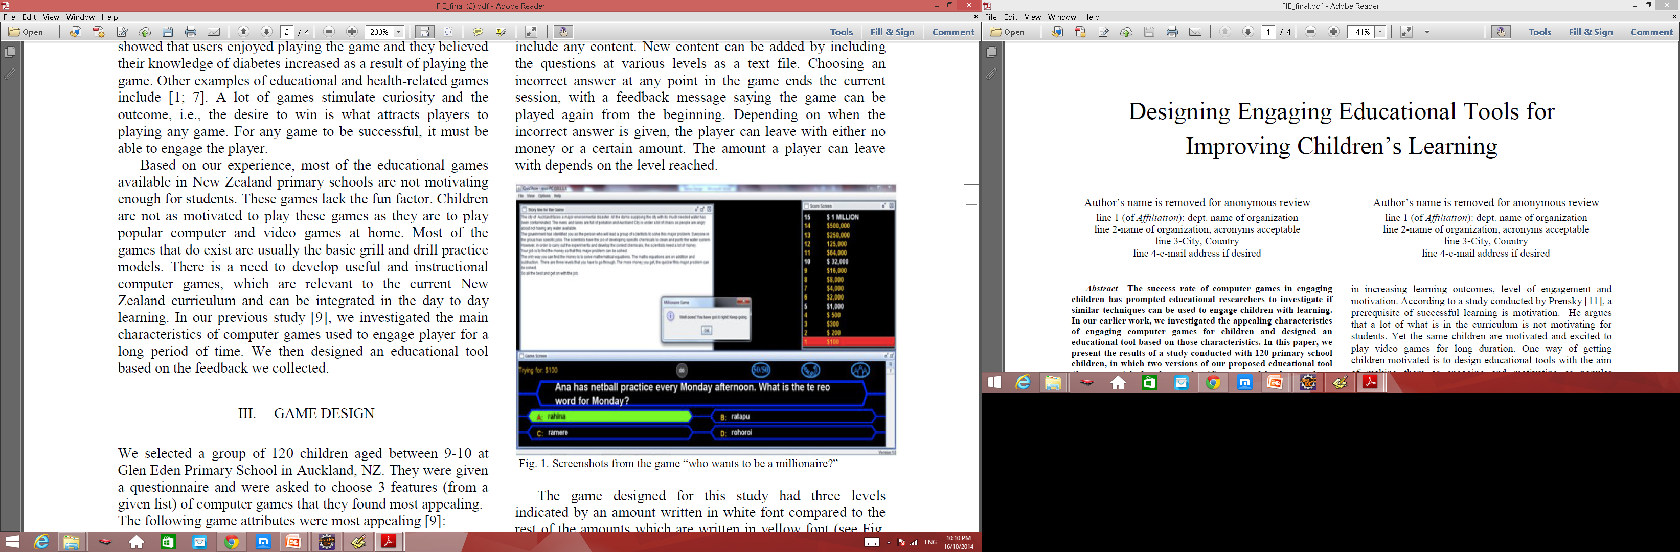
Games for Education

Slide 41
Evaluation Study
120 children 9-10 yrs at Glen Eden Primary School in Auckland
The participants were divided into a Control group and a Test group of 60 students each.
Both groups pre-tested; firstly on the numeracy learning outcomes and then on the Te Reo language learning outcomes
Test and control groups given customised application to play with over four weeks
  2 weeks were spent on numeracy
  2 weeks was spent on the Te Reo language
Test group assigned the feature enhanced version (added challenges, feedback and enhanced graphics)
Both groups given post tests to evaluate the learning effect of both version of the games.
Notes:
Control and test groups:
Two versions of the game were developed:
A feature enriched version of the game which made extensive use of the: challenge, feedback and enhanced graphical features that the children identified as important
A second game, which had an overt absence of the features identified by the children as important
The test group were given the feature enhanced game, while the control group were given the feature devoid game

Slide 42
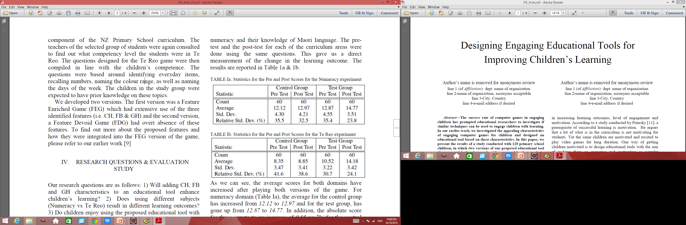
Pre and Post Scores for Numeracy & Te Reo (Maori Language)
Average scores for both domains have increased after playing both versions of the game, but more so for the Test group – change in the learning outcome was statistically significant for both groups.
Students preferred the feature
enhanced version of the game
and were more likely to play
this in their own time.
Notes:
As we can see, the average scores for both domains have
increased after playing both versions of the game. For
numeracy domain (Table Ia), the average for the control group
has increased from 12.12 to 12.97 and for the test group, has
gone up from 12.87 to 14.77. In addition, the absolute score
for these equate to an increase of 0.85 or 7% for the control
group and an increase of 1.9 or 14.8% for the test group. Thus,
the percentage increase in the mean score is twice as much for
the FEG compared to the FDG game. Comparison of the posttest
scores for the control and the test groups (12.97 compared
to 14.77) also shows that the FEG was more effective in
raising the performance level of the students. The T-Test
values are 3.63 x 10-10 for the Control group and 1.31 x 10-31
for the Test group. Both values are orders of magnitude
smaller than 0.05, showing that the change in the learning
outcome (post-test vs pre-test) was statistically significant for
both groups. Additionally, the T-Test value for the Test group
is orders of magnitude smaller than the Control group T-Test
value, implying a significant effect of the FEG.
The corresponding figures for the Te Reo game is 0.5 or
6% increase for the control group compared to 3.66 or 34.8%
for the test group. This gives us an approximately 6 fold
increase in the learning score for the Te Reo experiment. The
results in the case of the Te Reo curriculum also show a
similar pattern to the Numeracy curriculum, in that the test
group performed better compared to the control group.

Slide 43
Mobile Learning
Increased use of mobile devices to access learning – when and where the learner chooses
Implications for design of learning material – very small screens
Use of mobile technologies to augment and supplement learning eg QR codes used in training of construction students http://tpa.unitec.ac.nz/livingcurriculum/?p=370

Slide 44
Classroom Tools

Slide 45
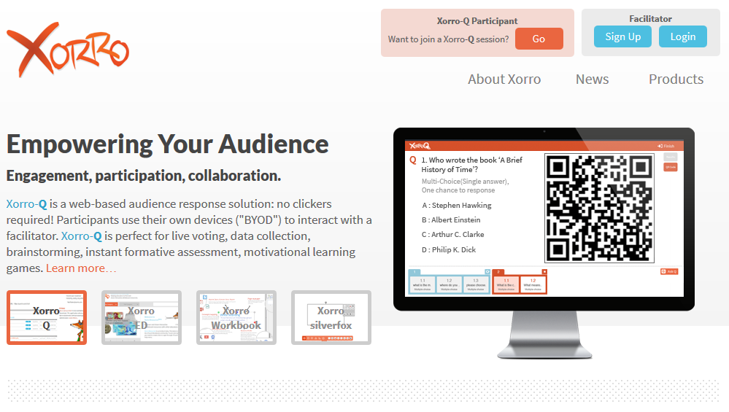
Xorro http://www.xorro.com/

Slide 46

Augmented Reality
Use of virtual/augmented reality as a training tool where the learner is immersed in a virtual environment
Tools such as Occulist Rift headset, used to enable this to occur, becoming much more affordable
Aurasma
http://www.aurasma.com/#/whats-your-aura

Slide 47
QR Codes - Quick Response Code
Generator: http://www.qrstuff.com/
http://cfu.ac.ir/

Slide 48
Collaborate provides a comprehensive online learning and collaboration platform designed specifically for education. To deliver a more effective learning experience through blended and mobile learning online collaboration tools- all-new aspects of real time, or anytime, learning to engage more students.

Slide 49

PeerWise- https://peerwise.cs.auckland.ac.nz/

Slide 50
Cloud Learning Management Systems
Learning management systems previously hosted internally by organisations now increasingly being hosted in the cloud
Ease of set up, ease of accessibility (especially important for large organisations on multiple sites/countries), and scalability are all reasons organisations are choosing this option

Slide 51
1. No Need to Manage the Software
This eliminates the need to control your own server especially if you don’t have the IT expertise or the staff to handle such a big project.
2. Streamlines Workflow Processes
A cloud-based system has the ability to store documents and arrange data that can be easily created into Excel or PDF reports.
3. Mobile Capability
Some of the better cloud-based learning management systems allow you and your learners to access the software from a variety of mobile devices.
4. Cost Effective

Slide 52
Conclusions
Education is being impacted by digital technologies in a revolutionary way
Digital technologies not used correctly can lead to problems
Those that ignore these new developments, or think that they can just use these the same conventional ways, are putting themselves at risk.
The really big questions for university are about what students get from the classroom, what works, what could be done better.
Institutions that sit back and watch, they may be in trouble. One can imagine a large institution where there isn't much difference between online and classroom - and then you'd be silly not to realize there's a problem.

Slide 53



Slide 54

Questions

